Slide 1
TIERED FLUENCY INSTRUCTION
Thebestclass.org chaseyoung@shsu.edu

Slide 2
Word Recognition Automaticity, Accuracy, and Prosody
National Institute of Child Health and Development, 2000; Snowling & Hume, 2005

Slide 3
History of Reading Fluency
Hyatt, 1943
Goodman, 1964
Farrell, 1966
LaBerge & Samuals, 1974
Allington, 1983
Dowhower, 1991
National Reading Panel, 2000
Valencia & Buly, 2004
Snowling & Hulme, 2005

Slide 4
Components of Reading Fluency
Accurate Word Recognition Automaticity

Slide 5
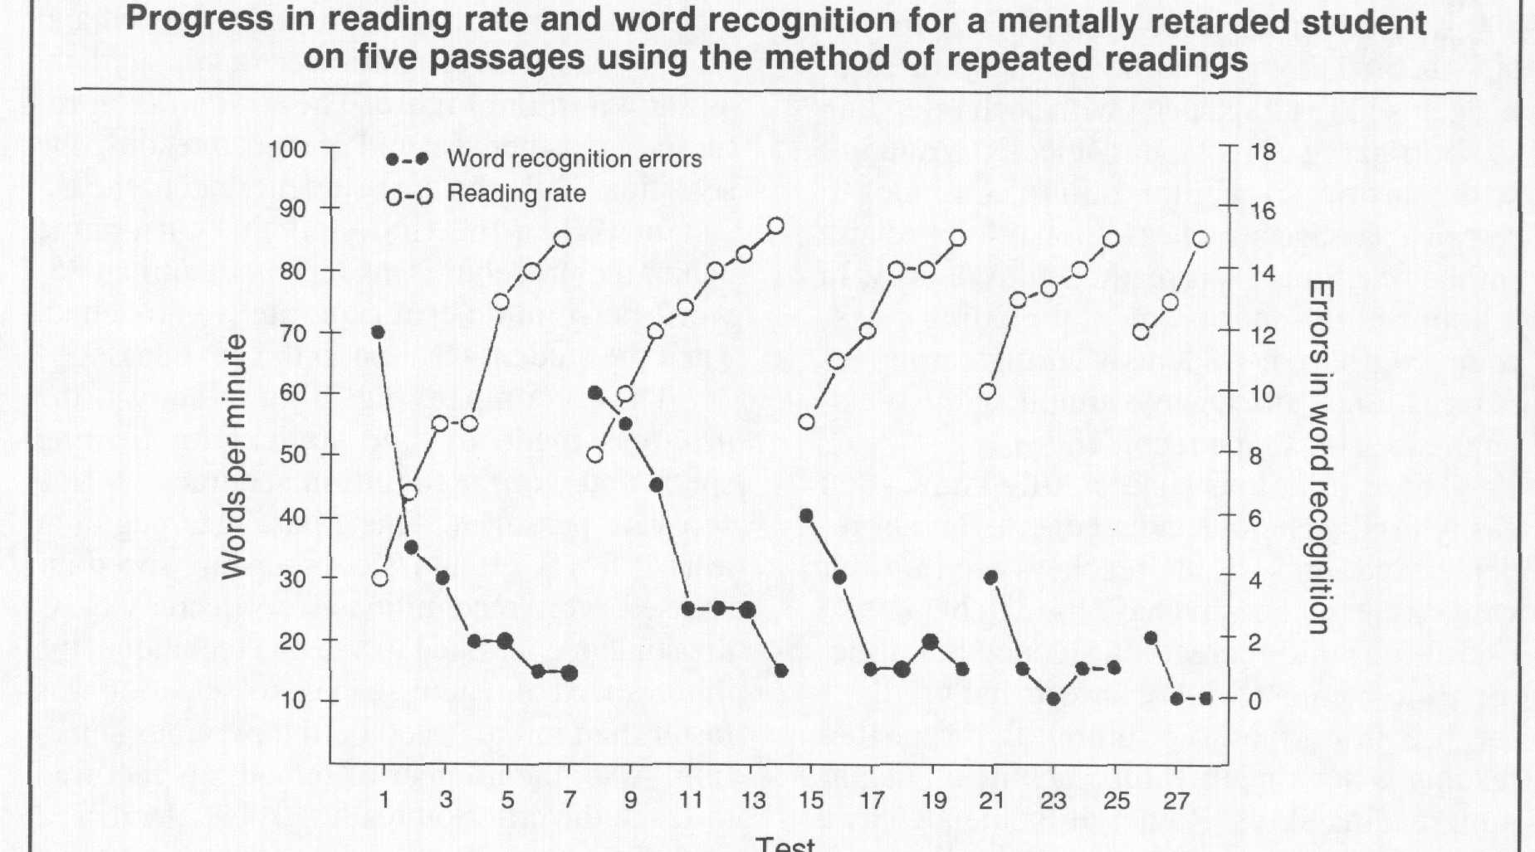
Repeated Reading (Samuels, 1979)

Slide 6
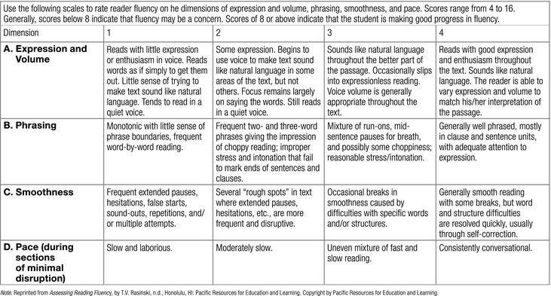
Components of Reading Fluency
Prosody

Slide 8
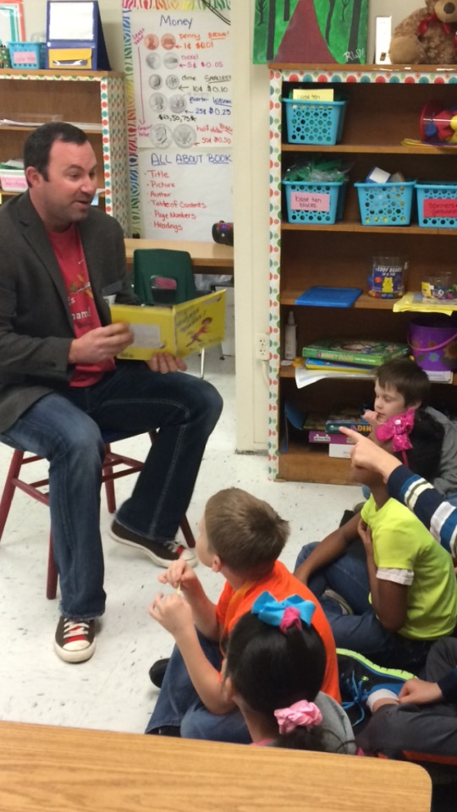
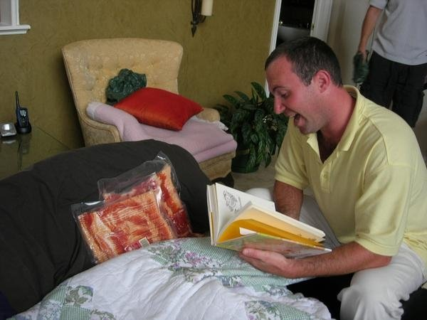
Listen child… …and you shall read.

Slide 9
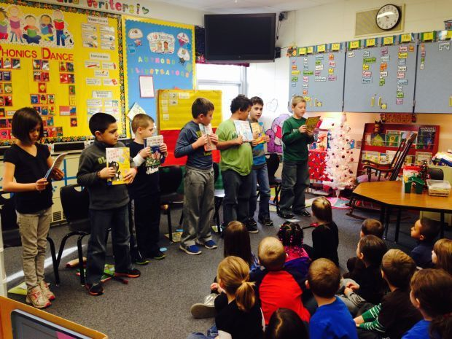
Video
Monday: Select scripts and read for meaning
Tuesday: Choose parts and focus on automaticity
Wednesday: Focus on Prosody
Thursday: Practice Performance
Friday: Performance

Slide 10
The Performance
Video (Example)

Slide 11
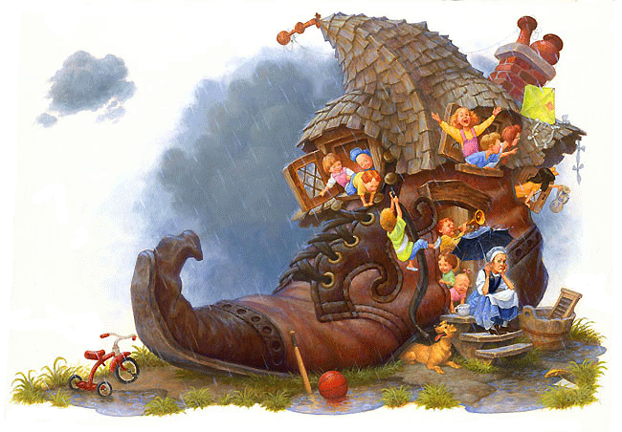
There Was An Old Woman – 4 Parts
Narrator 1: There was an old woman Who lived in a shoe;
Narrator 2: With so many children, What else could she do?
Narrator 3: Their home had no windows, No doors, and no locks—
Narrator 4: The kids were all happy But smelled like old socks.

Slide 12
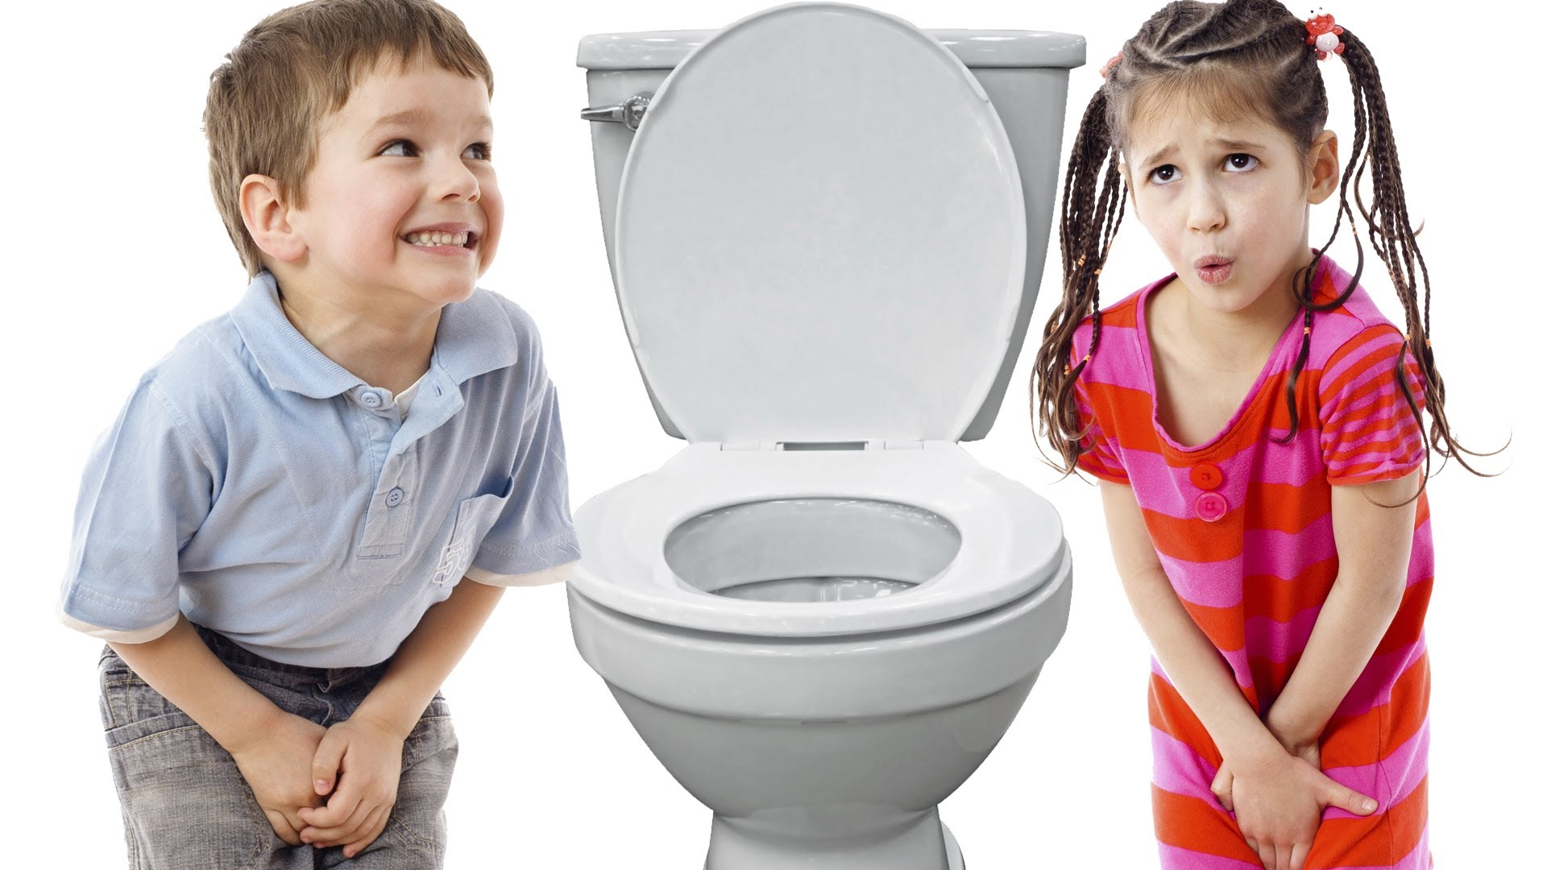
I Gotta Go!
Readers Theater Performance

Slide 13
www.thebestclass.org (rtscripts)
www.timrasinski.com (resources)
Google “Readers Theater Scripts”
Teacher Created
Student Created
Mentor
Parody
Scratch

Slide 14
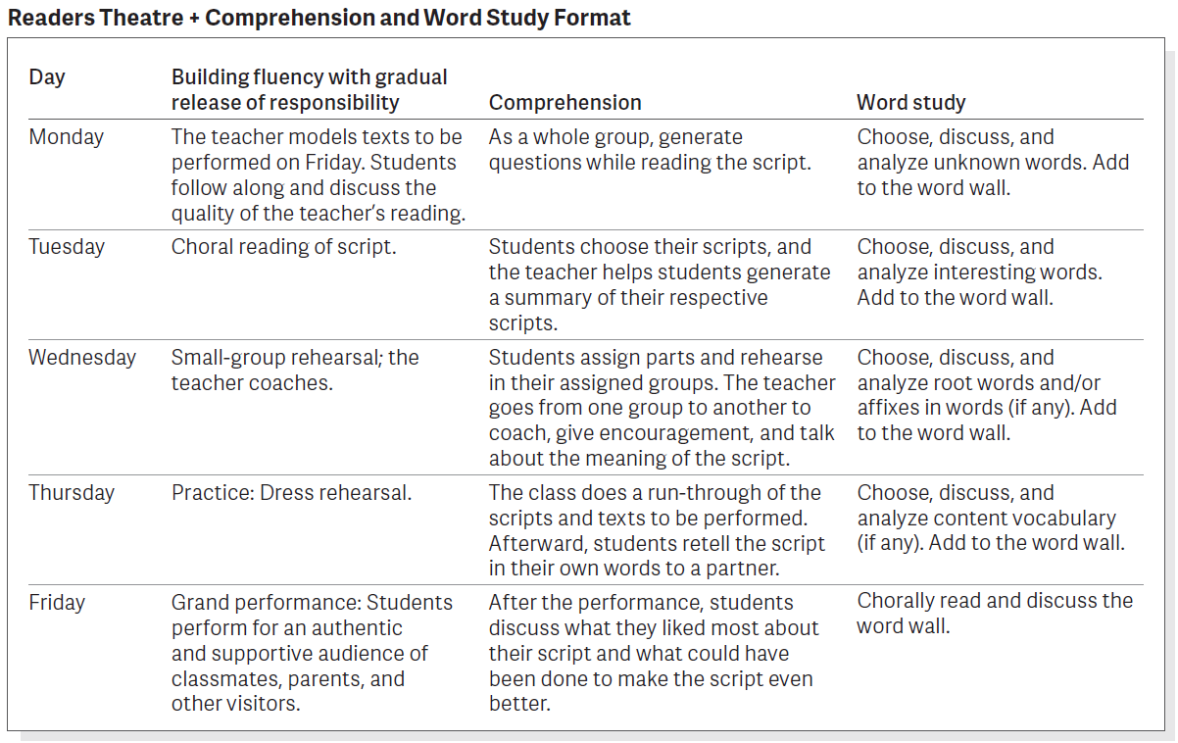

Slide 15
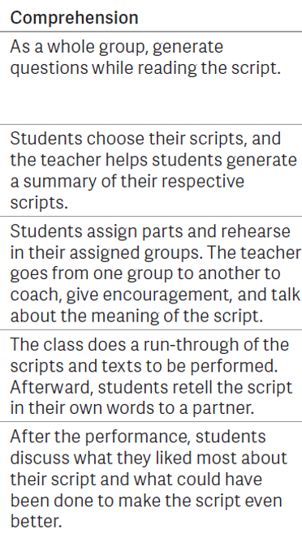
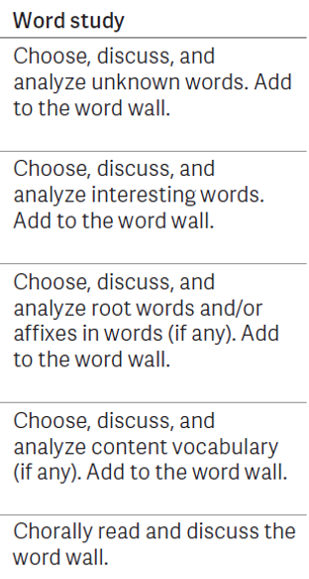
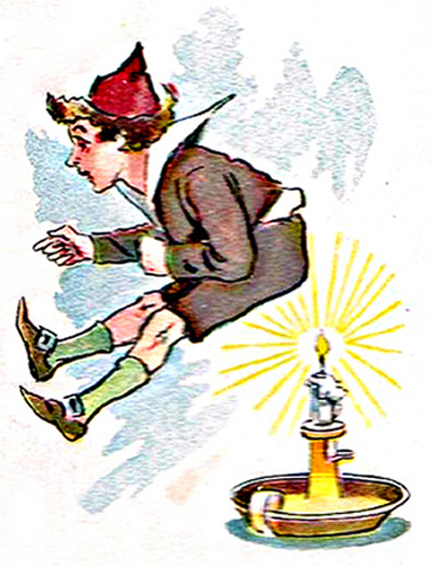
Jack was Nimble – 3 Parts
Narrator 1: Jack was nimble,
Narrator 2: Jack was quick.
Narrator 3: Jack jumped over the candlestick.
Narrator 1: Jack kept jumping much too close.
Narrator 2: Now his pants
Narrator 3: smell like burnt toast.

Slide 16
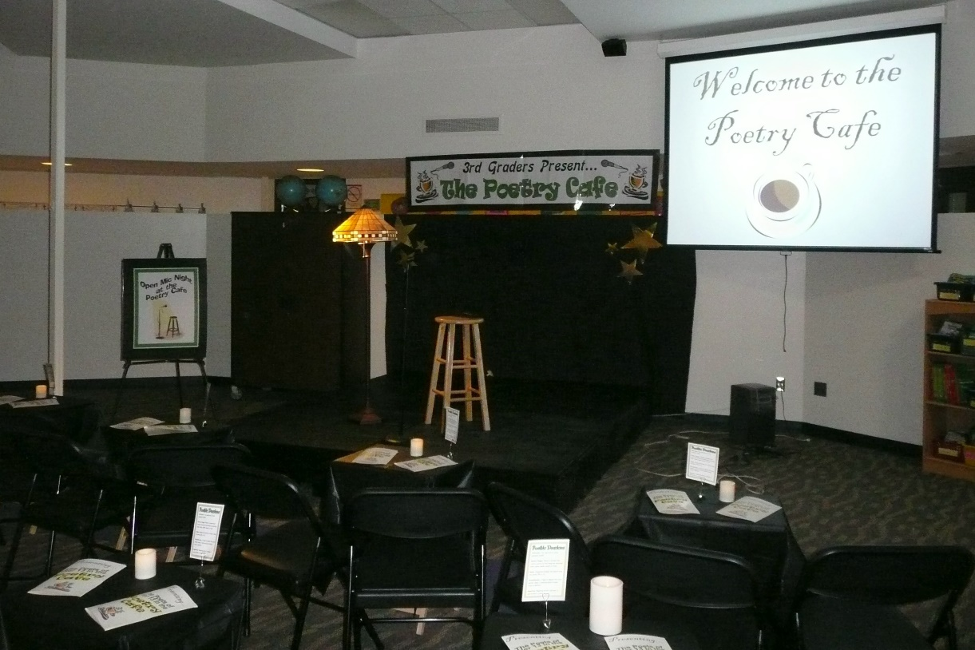
POETRY ACADEMY Wilfong (2008)
Students choose a poem
Rehearse the poem daily
Recite to a volunteer
POETRY SLAMS
(Young & Rasinski, 2017)
Day 1: Choose a poem and read for overall meaning
Day 2: Word Identification
Day 3: Prosody
Day 4: Practice for a Partner
Day 5: Dim the lights, dress in black, and enjoy the poetry slam – don’t forget to “snap clap”

Slide 17
I NEED A VOLUNTEER!
Cockroach Sandwich for my lunch
Hate the taste but love the crunch.

Slide 18
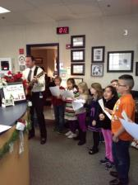
Primary Advanced
You can sing about anything!
Take our Test
Snowball Fight

Slide 19
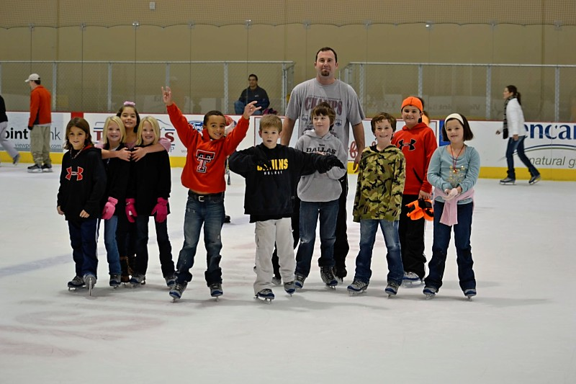
TIER II

Slide 20
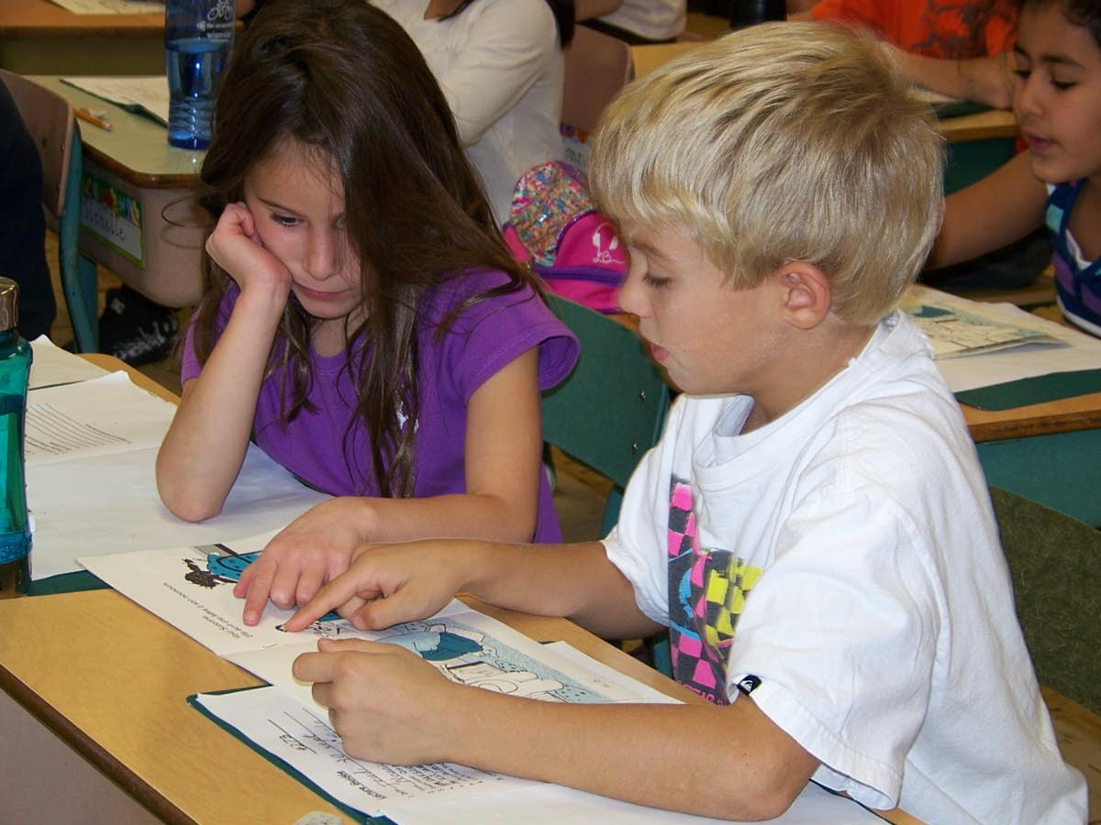
PAIRED READING
VIDEO

Slide 21
CHORAL READING

Slide 22
CHORAL READING
Let’s Try!
Cinnamon, Aluminum, Linoleum
Cinnamon, Aluminum, Linoleum
Cinnamon, Aluminum, Linoleum

Slide 23
ECHO READING

Slide 24
ECHO READING
Let’s Try!
Let’s eat, Grandma.
Let’s eat Grandma!

Slide 25
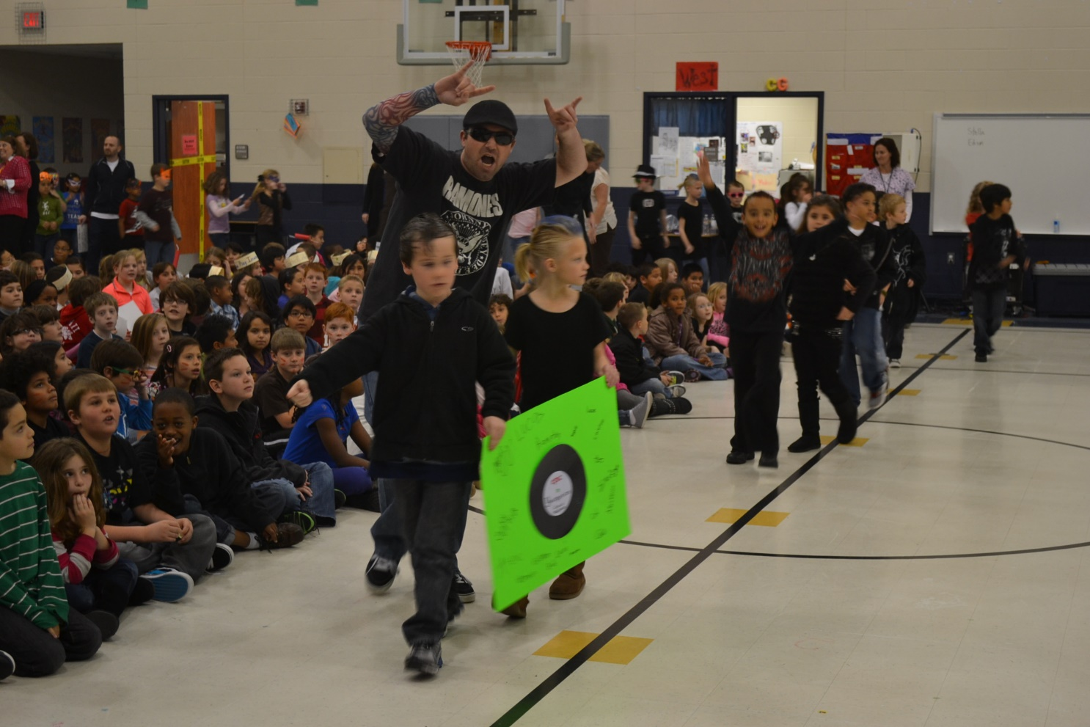
Questions?

Slide 26
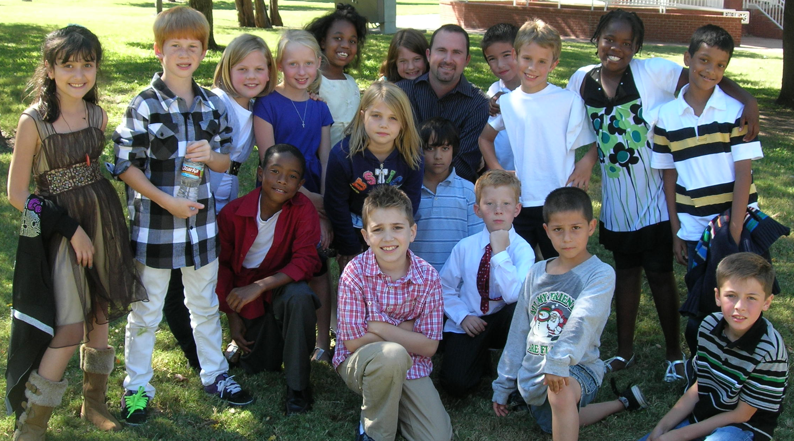
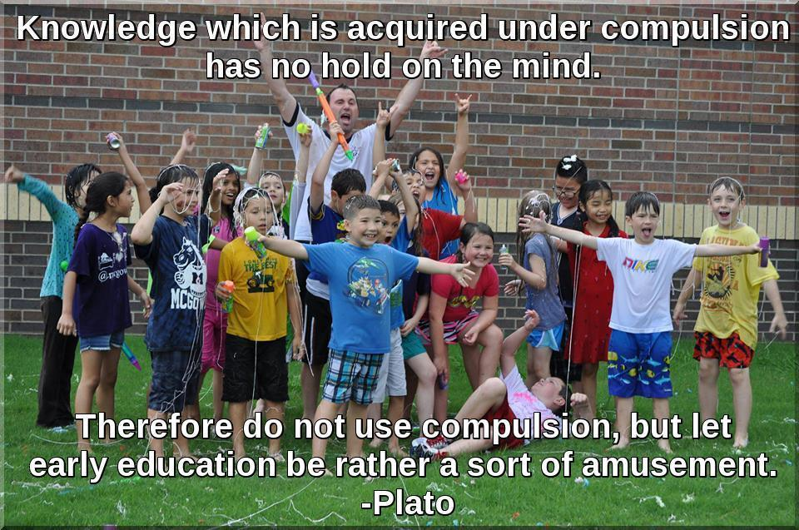
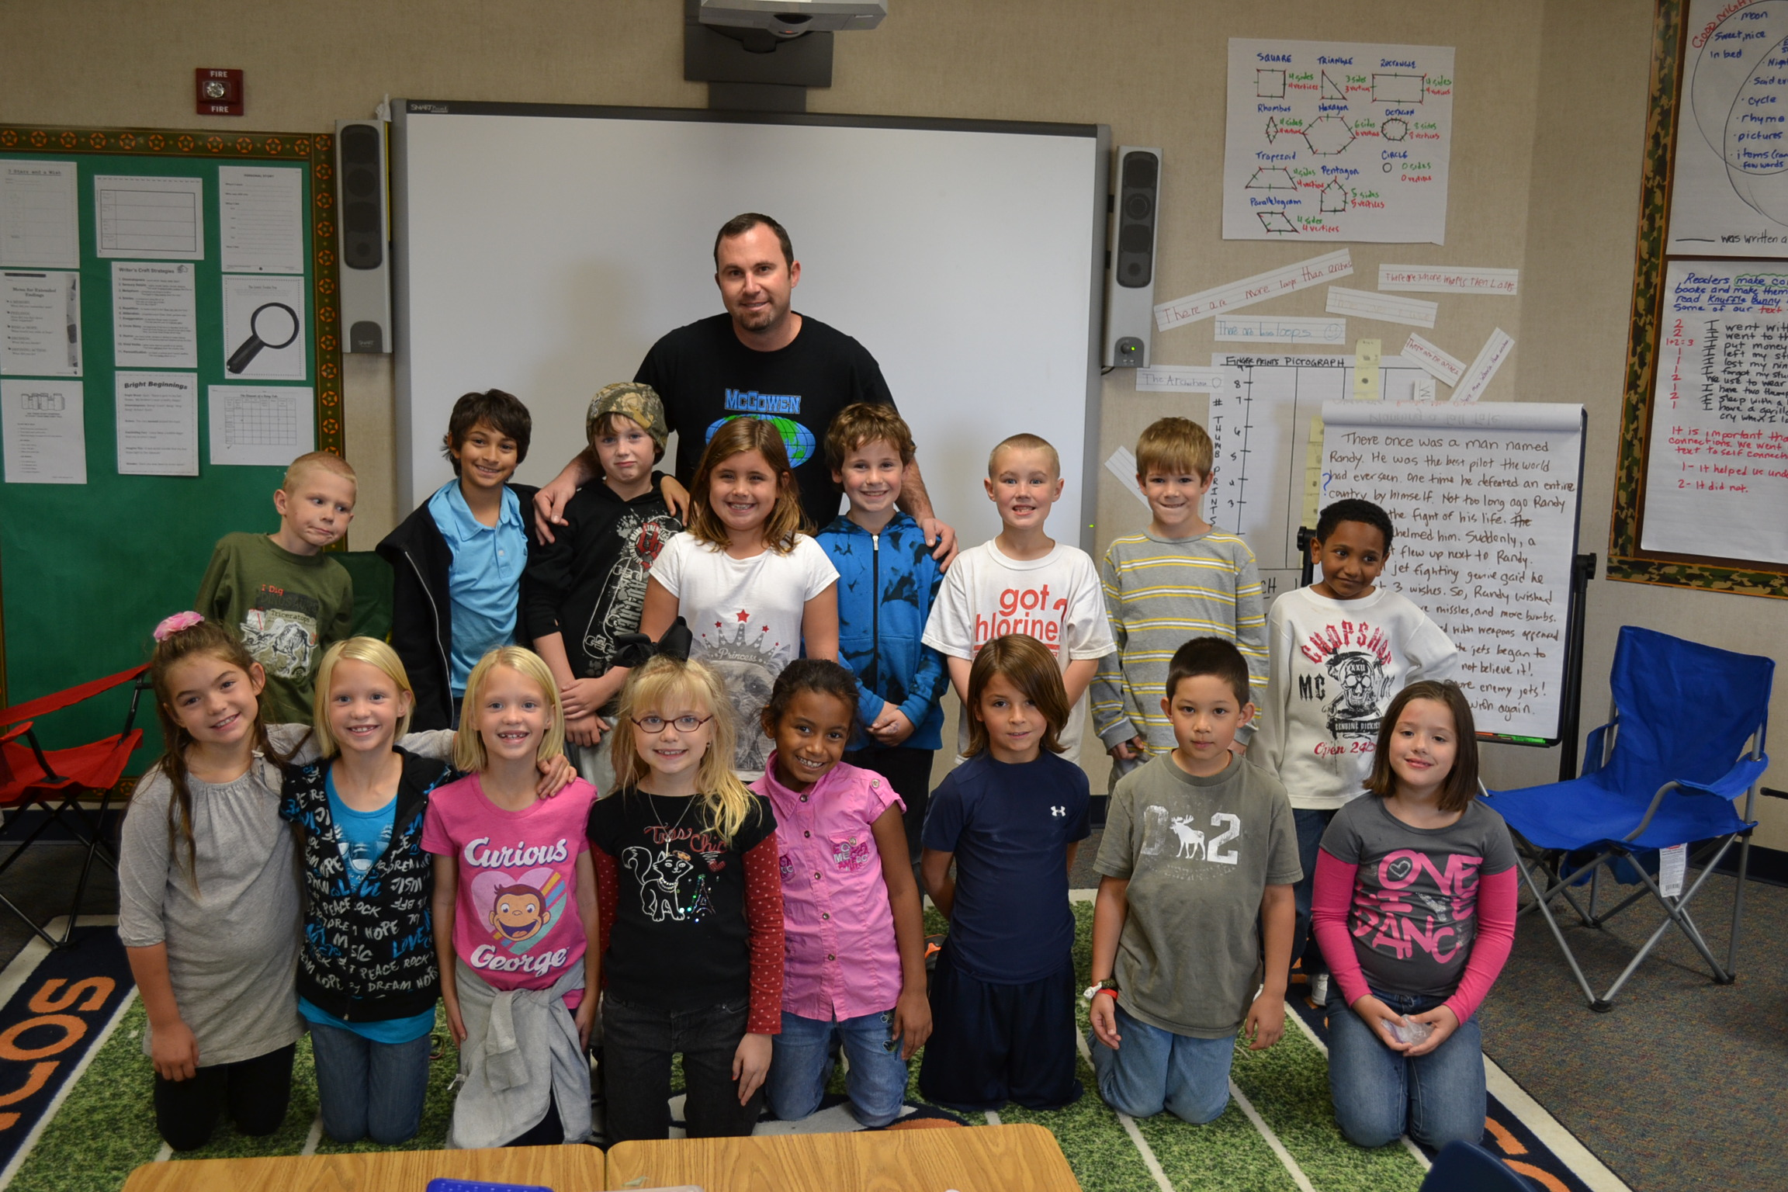
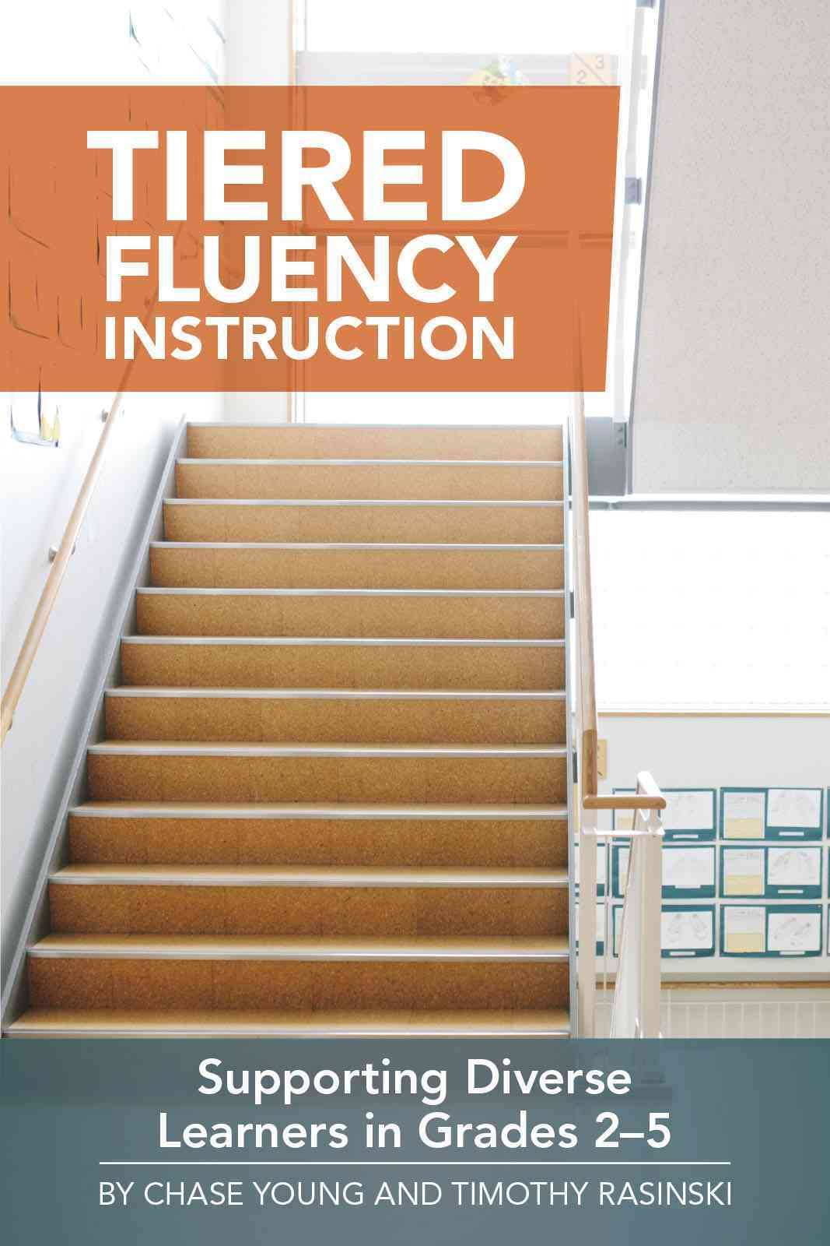
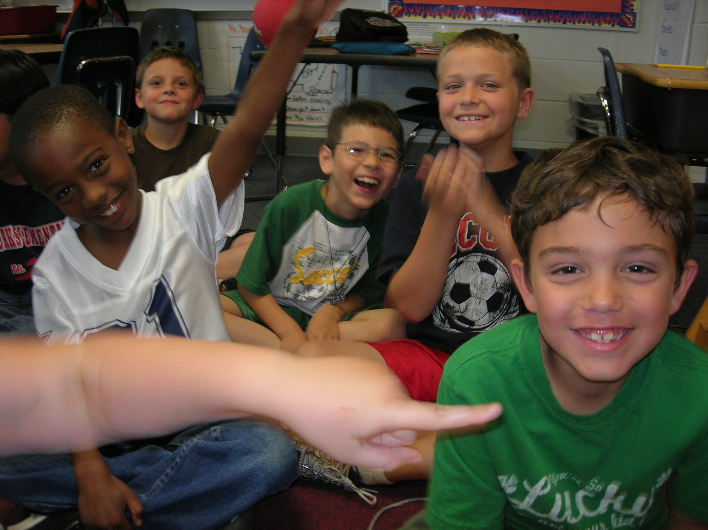
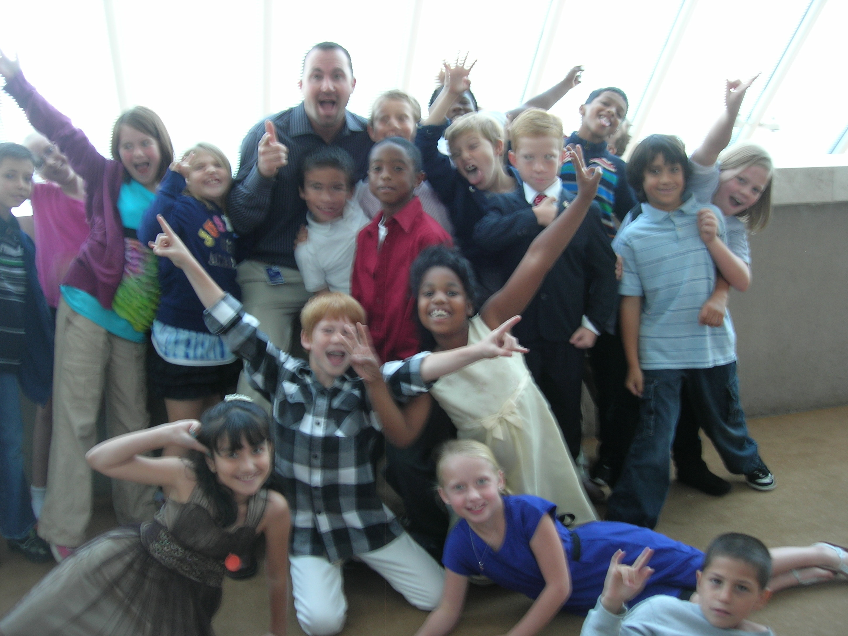
Thank you
chase@thebestclass.org www.thebestclass.org

