Slide 1


The art and science of teaching reading
Chase Young
Chaser@LiTerrific.com
Thebestclass.org
@chasejyoung1
“It is the supreme art of the teacher to awaken joy in creative expression and knowledge.”
-Albert Einstein

Slide 2
The Principal’s Job
On top of daily student discipline, principals are entrusted with budgets, community relations, curriculum and professional development, parent concerns, teacher and staff concerns, student concerns, board concerns, facility management/maintenance, event coordination, event supervisions, program management and strategic planning, school traffic safety, overall school safety, student assessment, teacher assessment–the list goes on, and that’s just in the written job description.

Slide 3

SOR

Slide 4
SOR Glossary for Texans
  “The best thing I did was stop using a Reading Log. Now I use a Reading Tracker.”
Science of Reading =
Readin’ Research
Skill-Based Targeted Small Group Reading Instruction =
Teachin’ Small Groups
Structured Sequential Phonics Instruction =
Teachin’ Phonics
Explicit Systematic Instruction =
Teachin’
Encoding =
Spellin’
Heart Words =
Knowin’ Words by Heart
The components of the Science of Reading include a comprehensive and integrated, structured literacy = approach when teaching.
Teachin’ the Big Five
If you can sound out the words and understand them, you readin’
Decoding + Language Comprehension = Reading Comprehension =

Slide 5
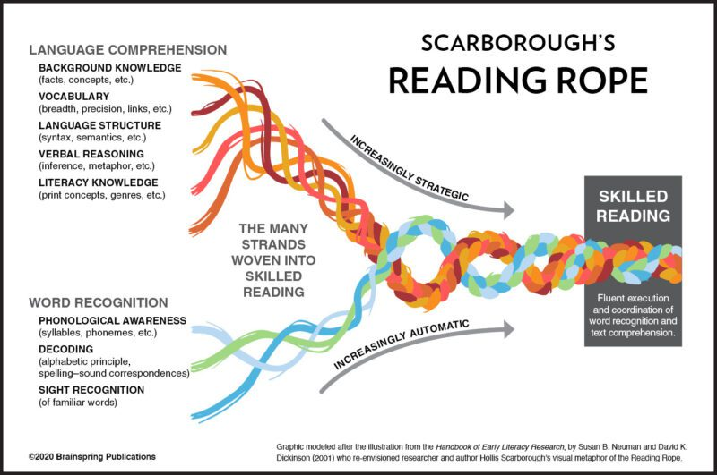

Slide 6
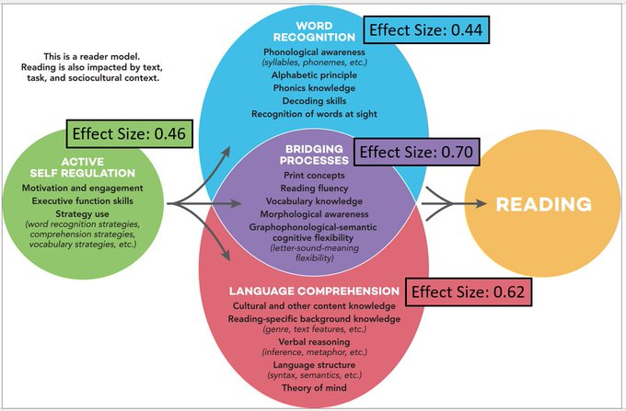
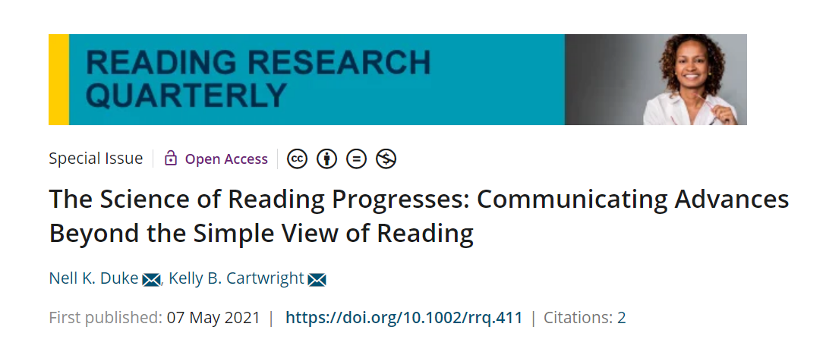

Slide 9
What we can lose sight of.
Creativity
Authenticity
Aesthetics
Innovation

Slide 10
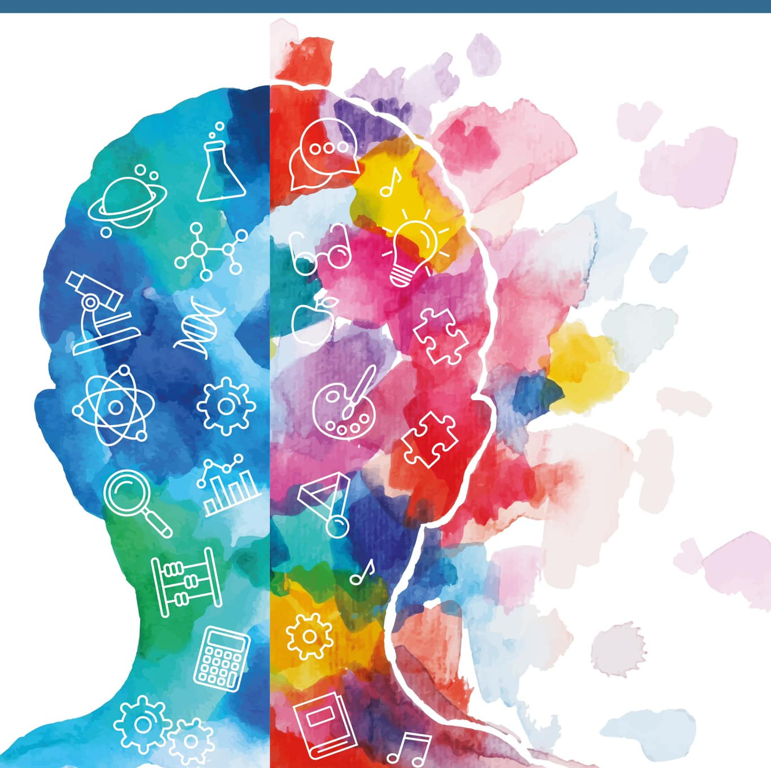
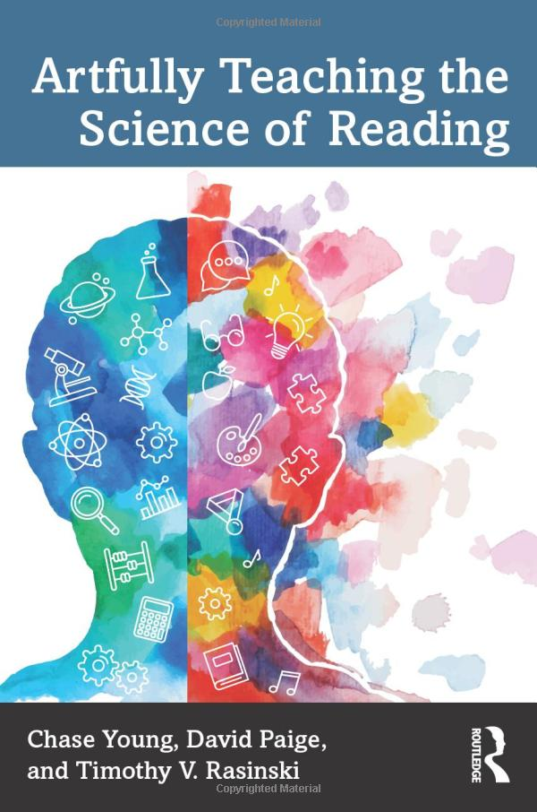
“We define the art of teaching as being embodied in the teacher’s decision making that involves selection, differentiation, and delivery of engaging and efficacious reading instruction.”

Slide 11

Phonemic Awareness

Slide 12
The Research
Maclean and colleagues (1987) found that rhyming knowledge helped children become aware of word parts.
The ability to identify similar words by their parts is related to future reading skills (Goswami & Bryant, 1986)
Researchers have found that preschool children who have knowledge of nursery rhymes are more likely to have future success in reading and writing (Bradley & Bryant, 1983 , 1985 ; Vloedgraven & Verhoeven, 2007)

Slide 13

Nursery rhymes are for babies and pre-schoolers

Slide 14
How we make it artful?
Text Choice?
Activities?
Being downright crazy?

Slide 15
Mary Had a Little…Lamb?
Mary had a little pet.
Its fur was black as night.
It followed her to school one day,
Which gave the kids a fright.
It made the teachers shout and scream,
It gave them such a scare.
For Mary didn’t have a lamb
She had a grizzly bear

Slide 16
Add Some Crazy to your Oddity Task
I’m going to say three words.
When I ask if they all rhyme, yell, “Let’s Go!!!”
If they do not rhyme, yell “That ain’t right!”
Night, Fright, Light
Scare, Bear, Lamb
Scream, Night, Fright
Bear, Scare, Share

Slide 17

Phonics

Slide 18
The Research
Synthetic Phonics
A synthetic approach teaches students to convert letters into sounds and then blend those sounds to make a word. This is often referred to as a whole-to-part-to-whole approach (NRP, 2000).
In 2004, Johnston and Watson found that a synthetic approach resulted in better phonemic awareness, spelling, and reading at the end of kindergarten. Assessing these same students seven years later, the authors found that the synthetic phonics group had better word reading and comprehension skills ( Johnston, McCeown,& Watson, 2012 ). Christensen and Bowey (2005 ) and de Graaf, Bosman, Hasselman, and Verhoeven (2009 ) also found the synthetic approach to be superior to one that is analytic.

Slide 19
The Research Continued
Analytic Phonics
An analytic approach teaches students to blend the onset and rime into a word using word families (NRP, 2000).
Just because the results say synthetic phonics is superior, does not mean that there is no place for analytic phonics. Brady (2020 ) points out that the adoption of a synthetic or analytic approach is not so much an either/or decision, but more a question of when and why one should be chosen over the other.

Slide 20
The Research Continued
Phonics by Analogy
A third approach to phonics instruction is to teach children to use analogies to pronounce unknown words (Goswami, 1986 , 1988). For example, take a child who can pronounce the word peak but is unfamiliar with the word beak.

Slide 21
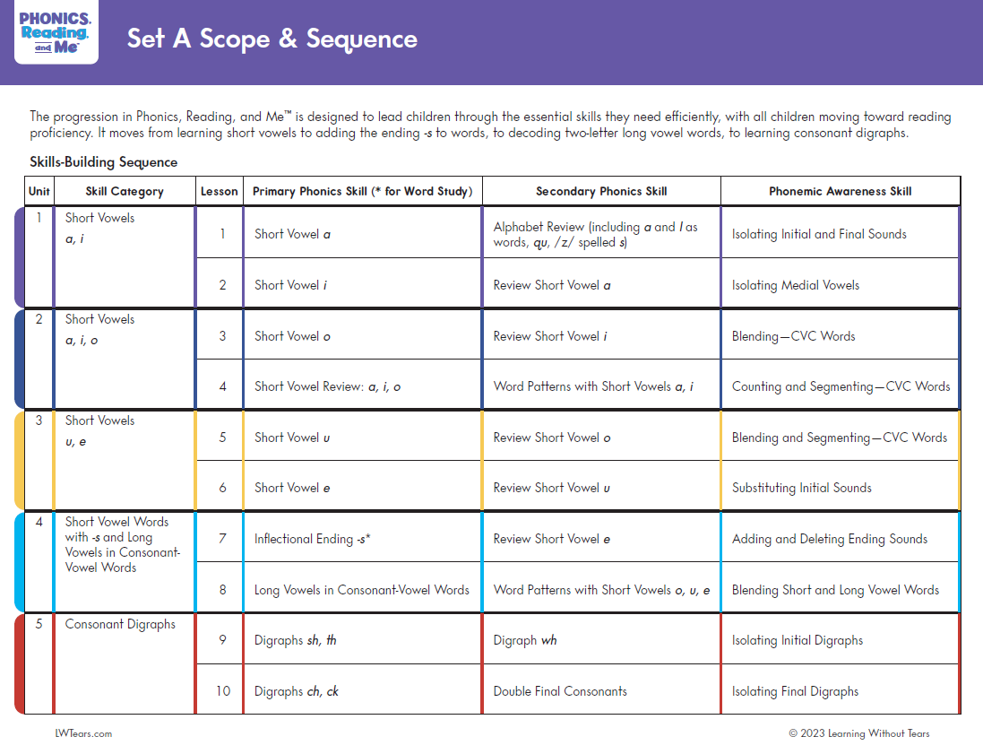

Slide 22

How do we make it artful?
Make it engaging
Dare I say make it fun?
Make it meaningful by giving a purpose

Slide 23
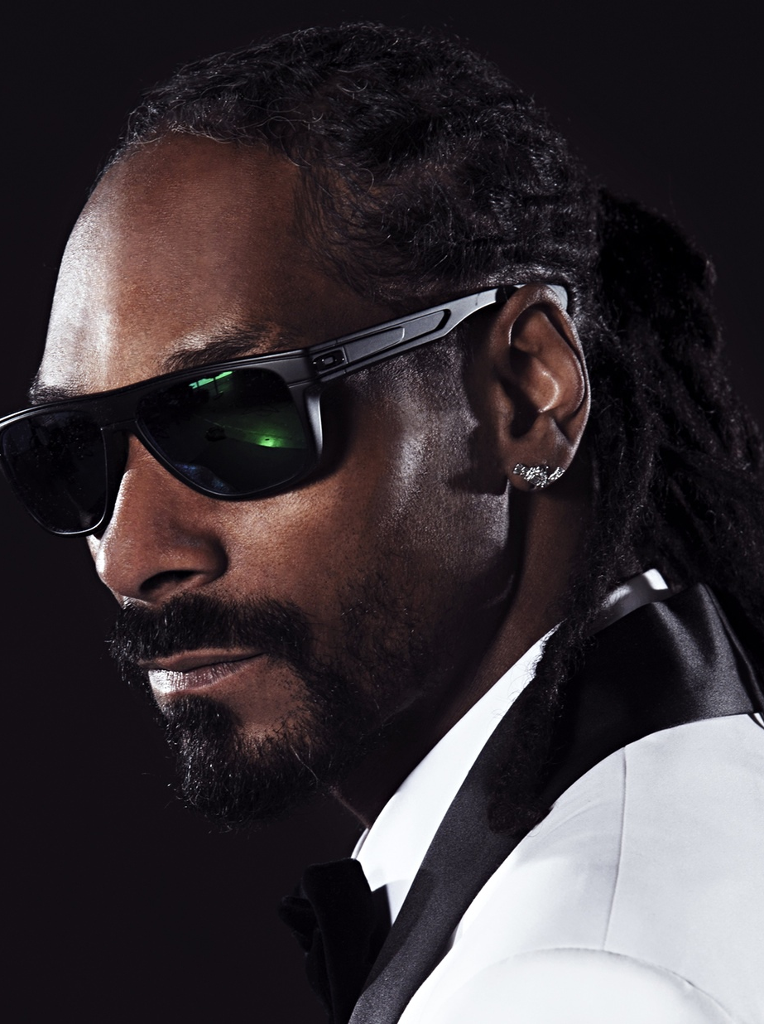
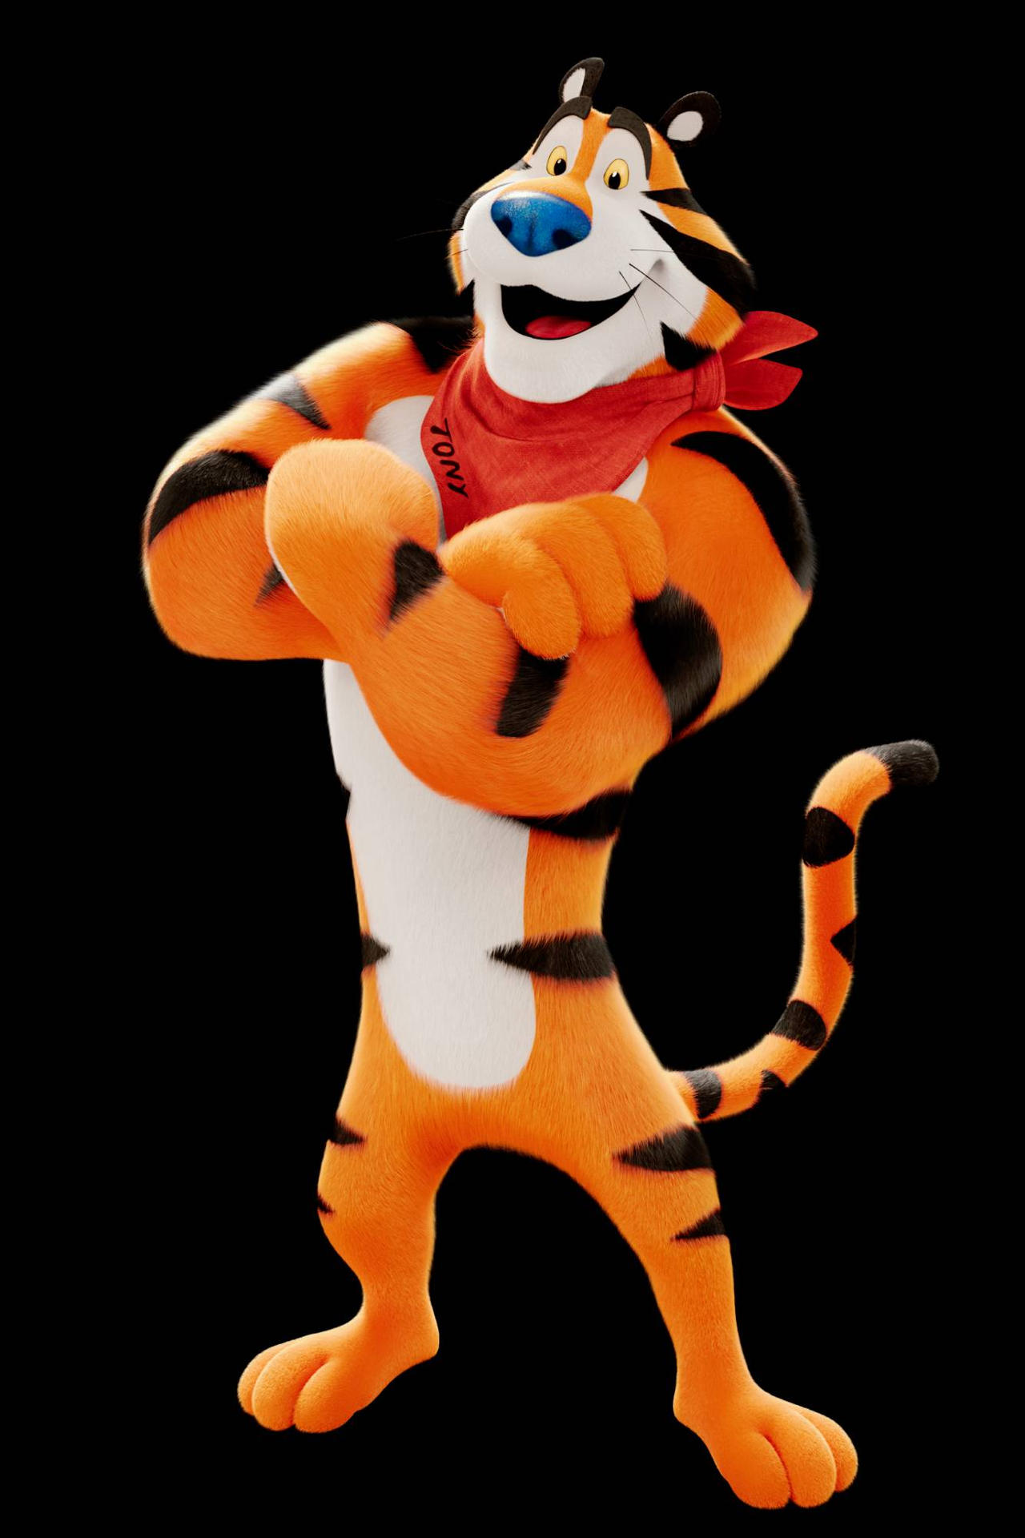
Making and Writing Words
O, u, b, d, g, l, l
Log
Gold
Transfer Words
Blog
Bold
Logger
Bog
Bod
Dog
Blogger
God
Magic Word:
Bulldog
ELAR 2.A,B,C,E

Slide 24

Vocabulary

Slide 25
Predictive Power Of Early Vocabulary
Best kindergarten predictors of 1st and 2nd Grades reading achievement:
  Phonemic Awareness
  Alphabet Knowledge
Best kindergarten predictor of Grades 3 & up reading achievement:
  Oral Vocabulary
A word on Els and the simple view of reading
Decoding + Language Comprehension = Reading Comprehension
Notes:
This slide shows the importance of vocabulary even in elementary school. Phonemic awareness and alphabet knowledge are the best predictors of success in beginning reading (the task is to learn to decode and to develop a good “sight” vocabulary). By third grade, decoding has caught up with oral language for most students, and they beginning reading text with more challenging vocabulary. Thus, we have to pay attention to students understanding of word meanings from an early age.
You may want to ask the group to read the slide and discuss in pairs or groups why kindergarten PA and Alphabet Knowledge predict 1st and 2nd reading, but kindergarten vocabulary is a better predictor in 3rd and up.

Slide 26
How Many Words????
18 month needs to learn avg. of ___ new words a day to have avg. vocab. of approx. ______ words by the time he or she is 6 years old (Senechal & Cornell, 1993)
Avg. high school graduate knows approx. ______ words (Nagy & Herman, 1985)
To go from 8,000 to 40,000 in 12 years, a child needs to learn 32,000 words or ____ words a day (even summer).
Children typically learn _________ words a year between 3rd and 12th grades (Nagy & Anderson, 1984)
₅
_{8,000}
_{40,000}
₇₋₈
_{3,000}
Notes:
Handout: PPt slides for Vocab. and Comprehension
Have participants fill in the blanks on their handout or ppt. whichever is easier for them to use.
1. 18 month needs to learn avg. of 5 new words a day to have avg. vocab. of approx. 8,000 words by the time he or she is 6 years old (Senechal & Cornell, 1993)
2. Avg. high school graduate knows approx. 40,000 words (Nagy & Herman, 1985)
3. To go from 8,000 to 40,000 in 12 years, a child needs to learn 32,000 words or 7 words a day.
4. Children typically learn 3,000 words a year (over 8 words a day) between 3rd and 12th grades (Nagy & Anderson, 1984)

Slide 27
Let’s combine learning vocabulary in connected text with a part-whole-part approach through semantic categorization, shared reading, and discussion. Oh, and make it engaging.

Slide 28
Word Splash
Distressing
Piloted
Atmosphere
Meteor
Engulfed
Immersed
Slime
Burbled
Tentacles
Exudes
Stench

Slide 29
I NEED A VOLUNTEER!
The Aliens Have Landed! by Kenn Nesbitt
The aliens have landed! It's distressing, but they're here.
They piloted their flying saucer through our atmosphere.
They landed like a meteor engulfed in smoke and flame.
Then out they climbed immersed in slime and burbled as they came.
Their hands are greasy tentacles. Their heads are weird machines.
Their bodies look like cauliflower and smell like dead sardines.
Their blood is liquid helium. Their eyes are made of granite.
Their breath exudes the stench of foods from some unearthly planet.
And if you want to see these sickly, unattractive creatures,
You'll find them working in your school; they all got jobs as teachers.

Slide 30
Aliens Landing
Describing the Aliens
Distressing
Piloted
Atmosphere
Meteor
Engulfed
Immersed
Slime
Burbled
Tentacles
Exudes
Stench

Slide 31

Use these words to write (or tell) your own short story about aliens!
ELAR .1.3
Distressing
Piloted
Atmosphere
Meteor
Engulfed
Immersed
Slime
Burbled
Tentacles
Exudes
Stench

Slide 32

Reading Fluency

Slide 33
The research says practice…

Slide 34
The science
The THEORY
Repeated Readings
  Lee & Yoon, 2018; Mercer, Campbell, Miller, Mercer, & Lane, 2000; Vadasy & Sanders, 2008; Vaughn, Chard, Bryant, Coleman, & Kouzekanani, 2000; NRP, 2000
Automaticity Theory
Ecological Systems Theory
Complexity Theory

Slide 35
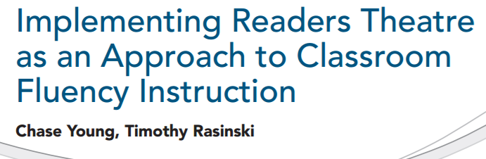
ELAR 3.4

Slide 36
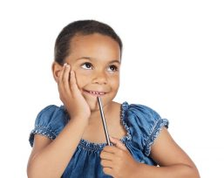
Monday
Select scripts and read for meaning

Slide 37
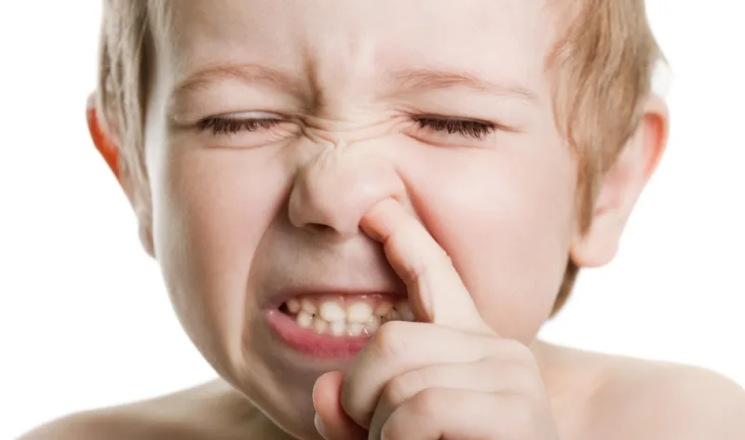
Tuesday
Pick your parts and focus on decoding the words

Slide 38
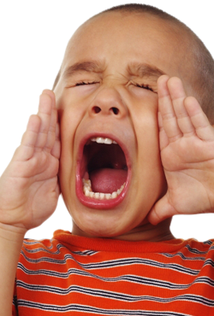
Wednesday
Focus on expression

Slide 39
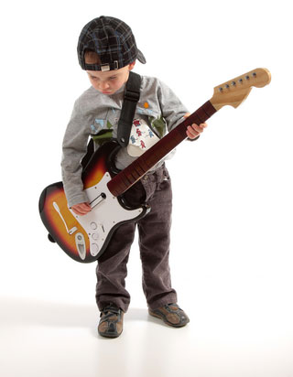
Thursday
Practice Performance

Slide 40
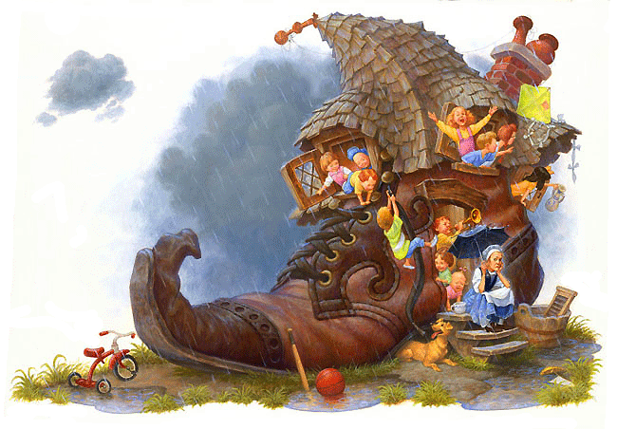
Friday: Performance
There Was An Old Woman – 4 Parts
Narrator 1: There was an old woman
Who lived in a shoe;
Narrator 2: With so many children,
What else could she do?
Narrator 3: Their home had no windows,
No doors, and no locks—
Narrator 4: The kids were all happy
But smelled like old socks.

Slide 41
www.thebestclass.org (rtscripts)
www.timrasinski.com (resources)
Google “Readers Theater Scripts”
Teacher Created
Student Created
Mentor
Parody
Scratch

Slide 42
Really Cool SCIENTIFIC Findings
Young, C., Durham, P., Rasinski, T., Godwin, A., & Miller, M. (2021). Closing the gender gap in reading with readers theater. Journal of Educational Research, 114(5), 495-511. https://doi.org/10.1080/00220671.2021.1986460
Young, C., Mohr, K. A. J., Landreth, S. (2020). Improving boys’ reading comprehension with readers theatre. Journal of Research in Reading, 43(3), 347-363. https://doi.org/10.1111/1467-9817.12307
Young, C., Polk, L., Durham, P., & Kerbs, M. (2020). The boys are back and they’re looking for drama. Texas Journal of Literacy Education, 8(1), 112-125. https://www.talejournal.com/index.php/TJLE/article/view/52

Slide 43
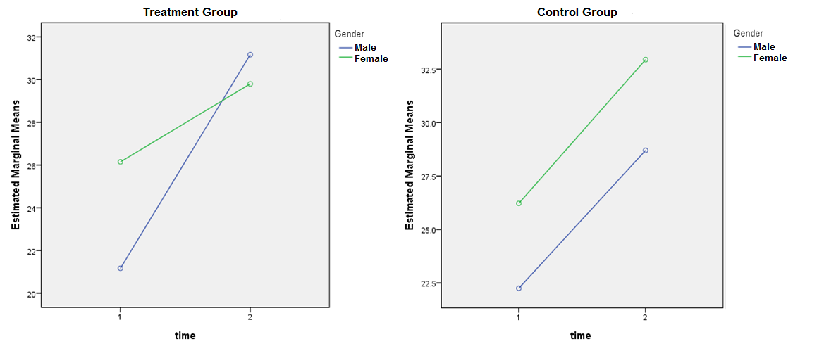
Decoding

Slide 44
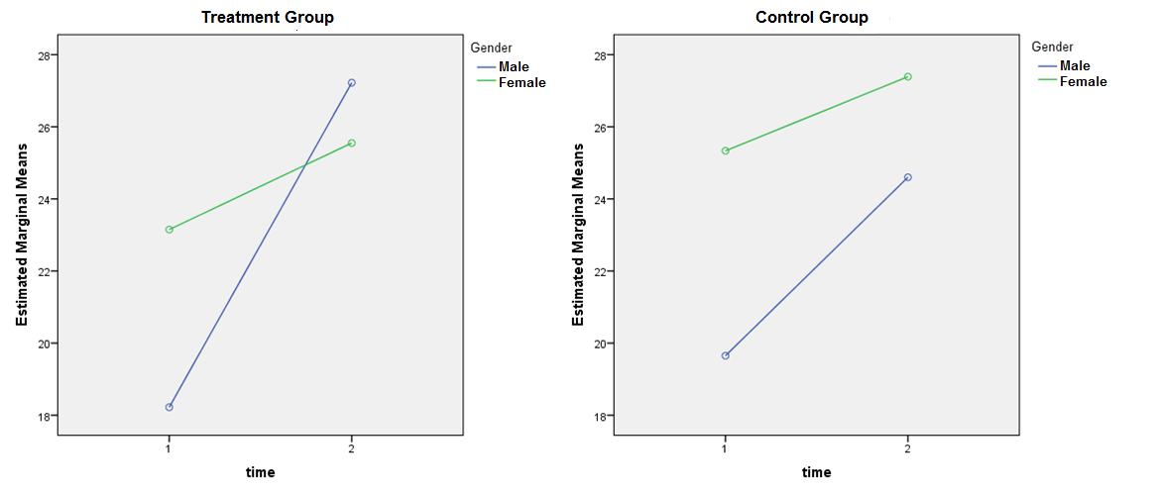
Word Knowledge

Slide 45
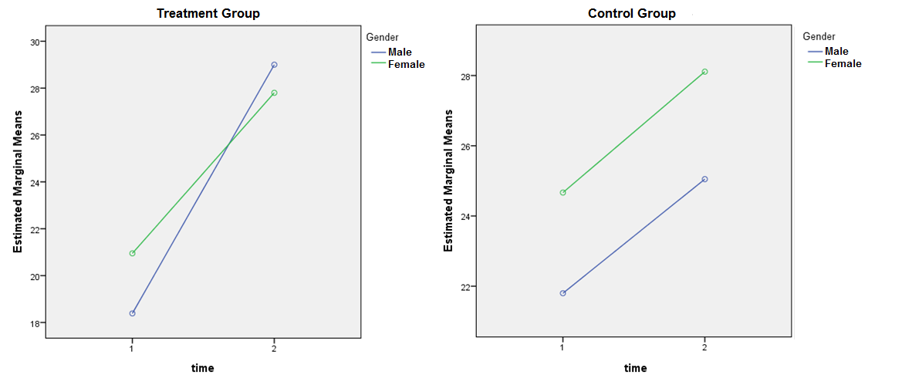
Comprehension

Slide 46
Any other creative and/or authentic ways to use repeated readings?

Slide 47

Putting it all together:
Reading Comprehension

Slide 48
How can we develop all of these in an authentic, aesthetic, and creative way?
Consider reading preferences (Pachtman & Wilson, 2006)
Explore genres (Risko & Walker-Dalhouse, 2011).
Visually represent sequences of text (Naughton, 2008),
Compose summaries (NICHD, 2000)
Transform texts into dialogue and add voice in writing (Culham, 2011; Dorfman & Cappelli, 2007; Young & Rasinski, 2011)
Students utilize technology (National Governors Association for Best Practices & Council of Chief State School Officers, 2010)

Slide 49
Student Produced Movies!
Phase 1: Grouping
1
Phase 2: Idea Development
2
Phase 3: Script Treatment
3
Phase 4: Storyboard
4
Phase 5: Scripting
5
Phase 6: Preproduction Conference
6
Phase 7: Filming
7
Phase 8: Post-Production
https://www.youtube.com/watch?v=MDSjOC9fes4
Young & Rasinski, 2013

Slide 50
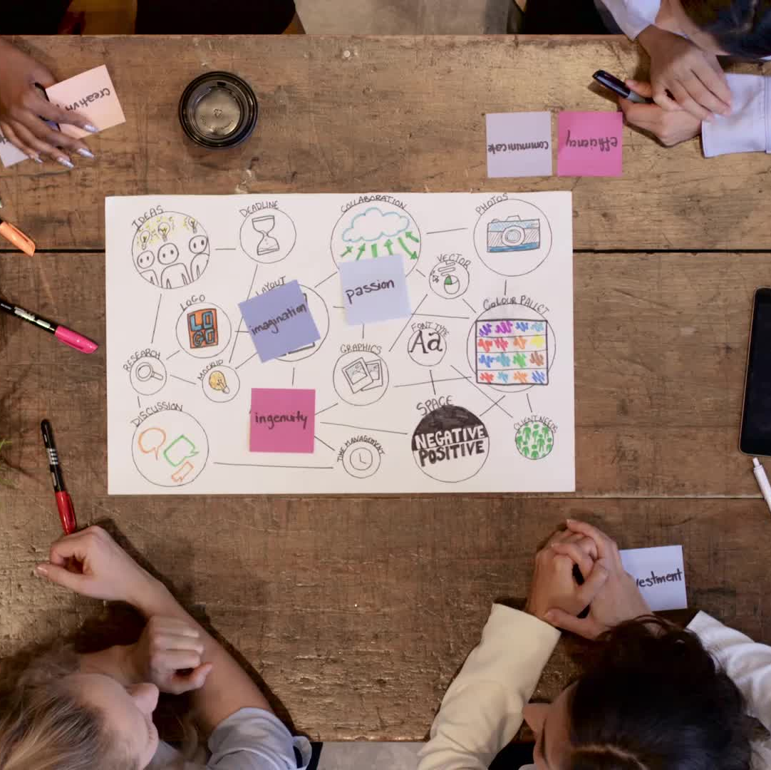
How can we develop fluency, vocabulary, and comprehension in an authentic, aesthetic, and creative way?

Slide 51

It is illegal to sell one's eyes. And other organs too!
It is illegal to milk another person's cow.
It is illegal to commit a crime without giving a 24-hour notice.
It is illegal to be in possession of the Encyclopedia Britannica collection.
It is illegal to walk around barefoot. (requires $5 permit)
It is illegal to carry wire cutters in your pocket.
It is illegal to feather dust in public buildings.
It is illegal to buy cheese on Sunday.
It is illegal to eat trash.

Slide 52
We even found a way to add a bit art to test taking!
Take our Test
Parody by Dr. Danny Brassell Starring my amazing second graders

Slide 53
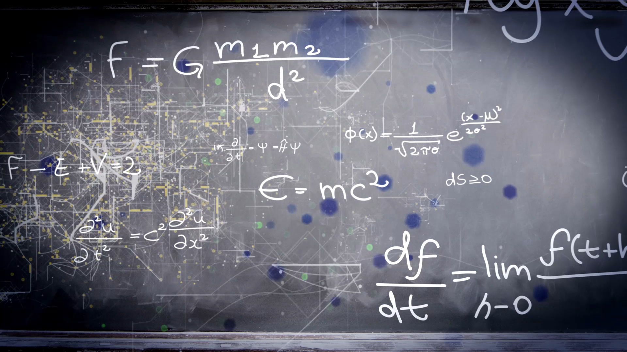
Science is not enough.

Slide 54
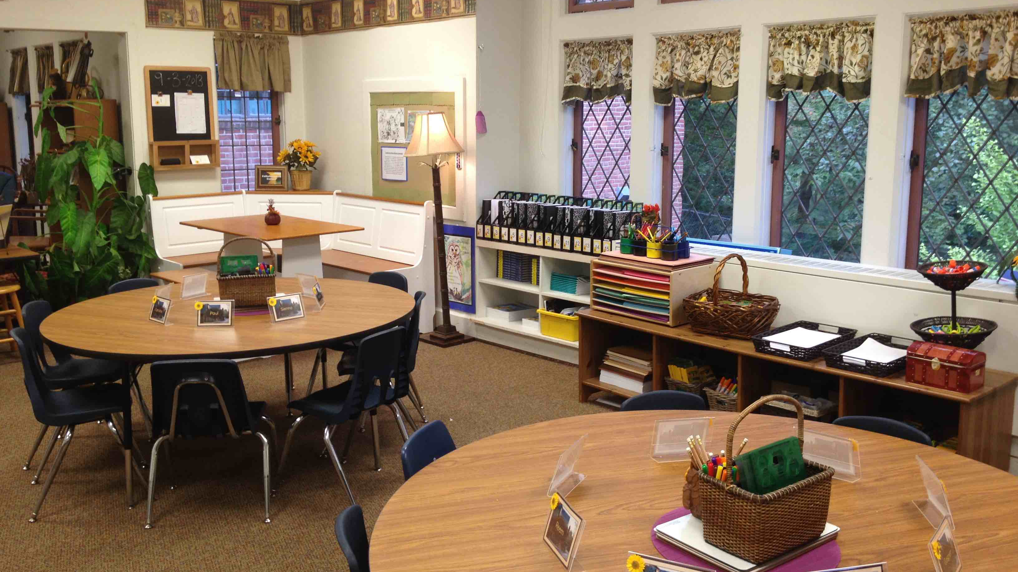


Slide 55

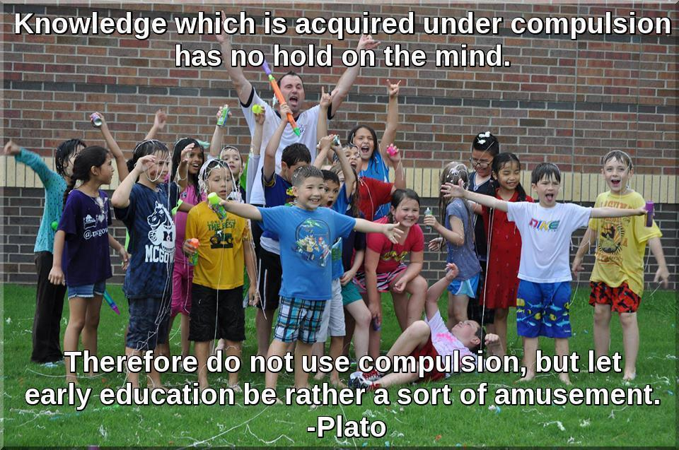
Chaser@LiTerrific.com www.thebestclass.org @chasejyoung1

