Slide 1
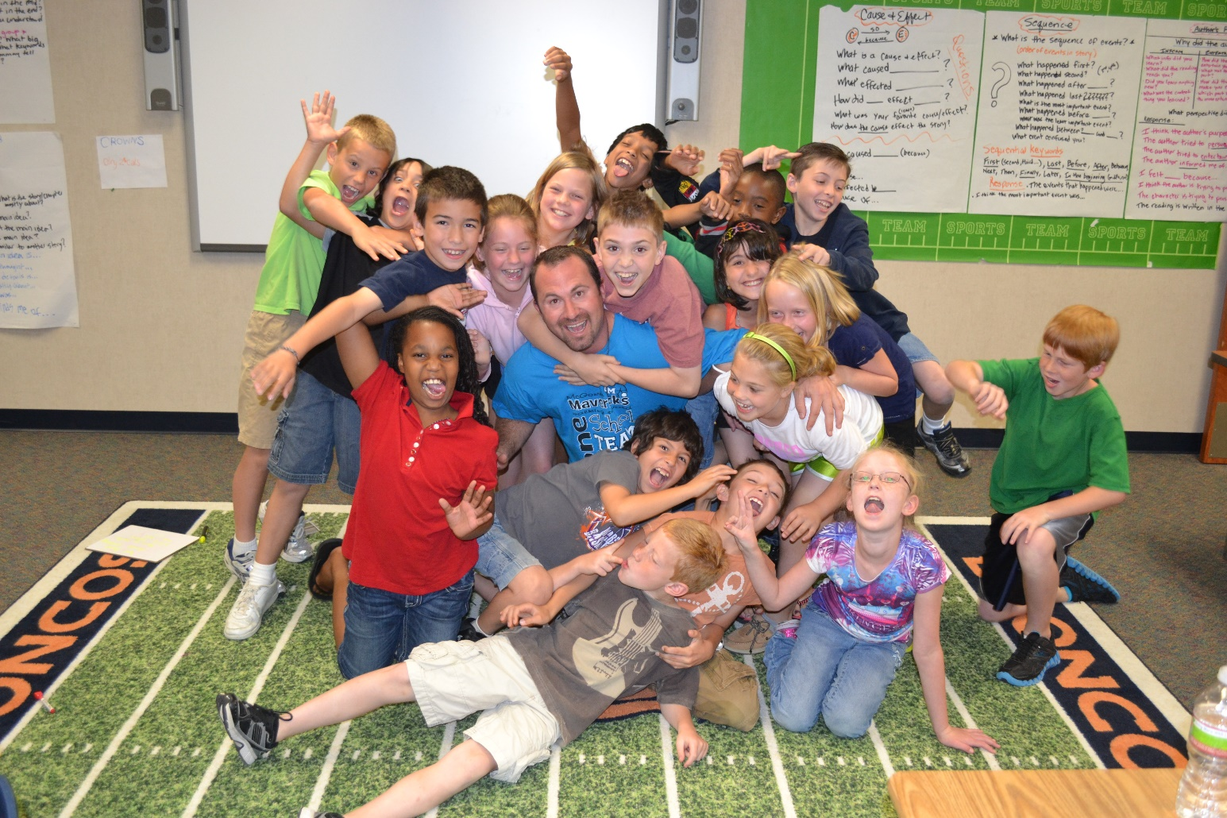
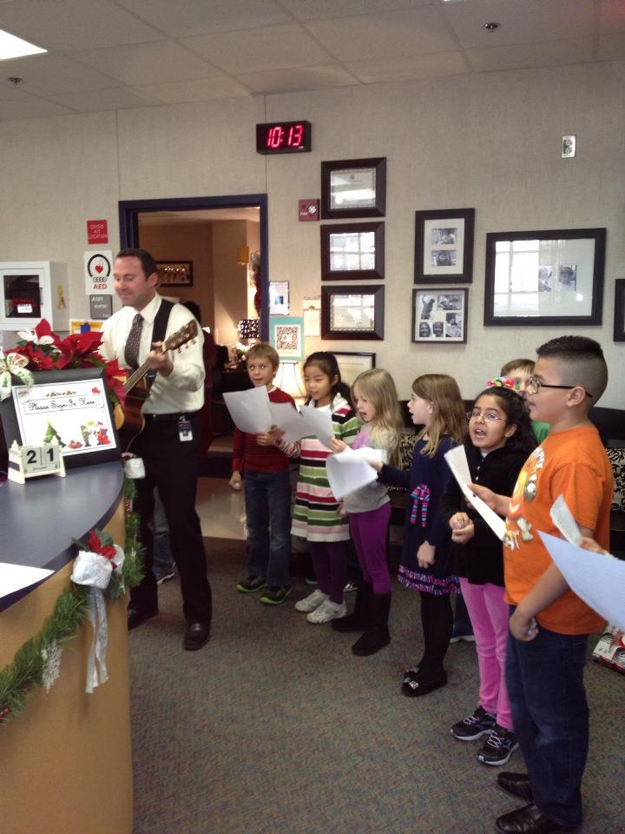
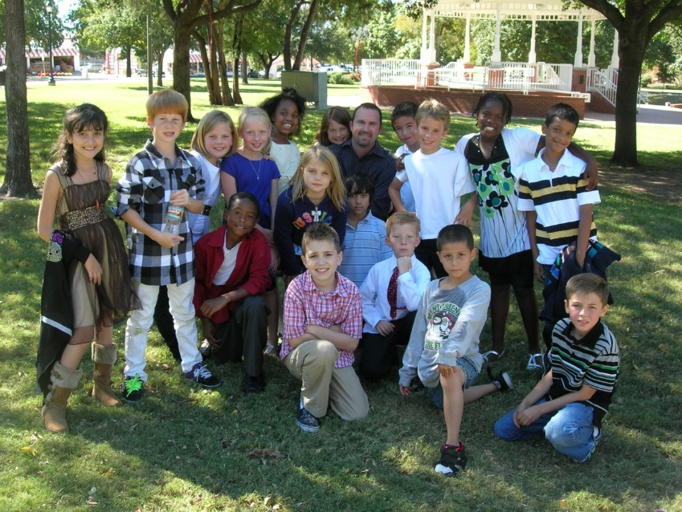

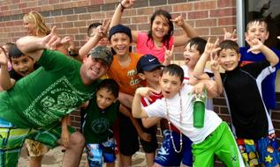

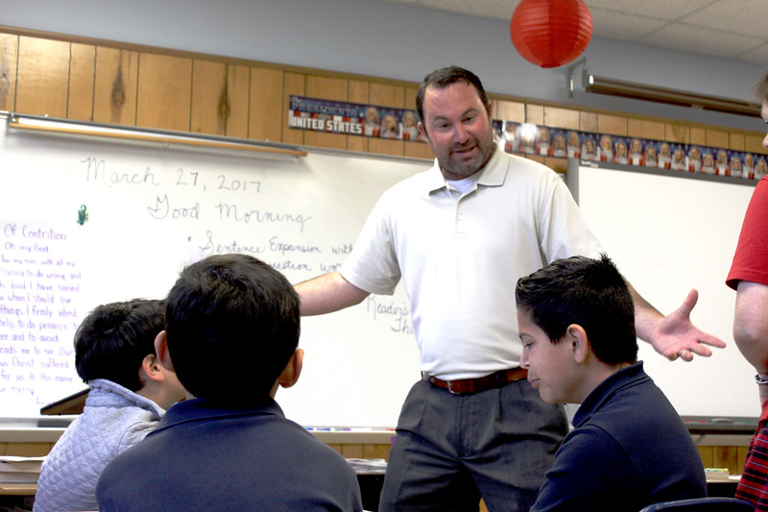
Writin’

Slide 2

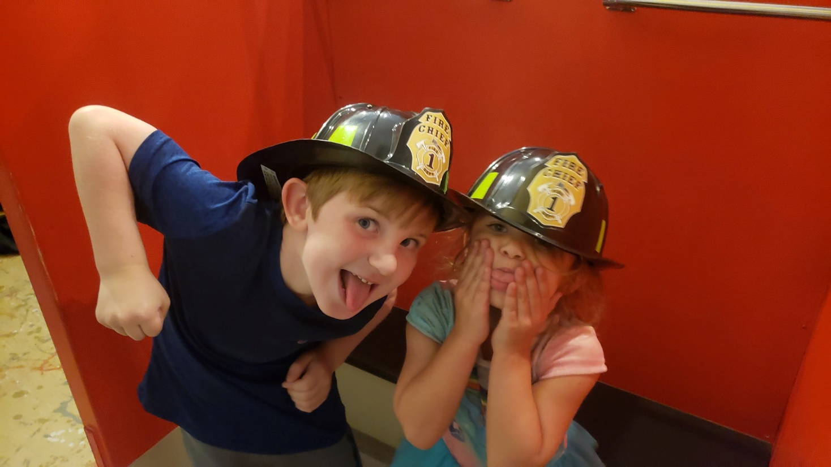
Peer-Editing
Conferring with an Avatar
https://www.youtube.com/watch?v=Y9gHpIH9RTA

Slide 3

The Writing Process

Slide 4
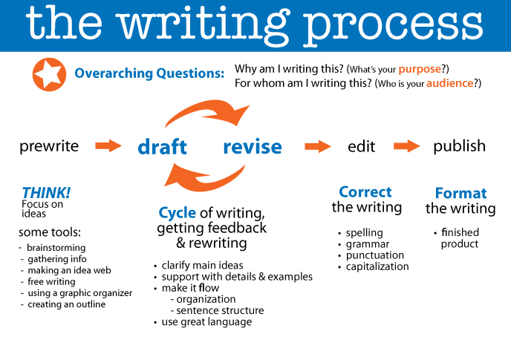

Teacher
Peer

Slide 5

NARRATIVE WRITING

Slide 6
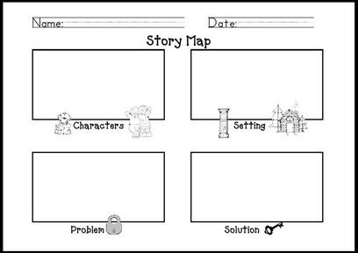

Slide 7
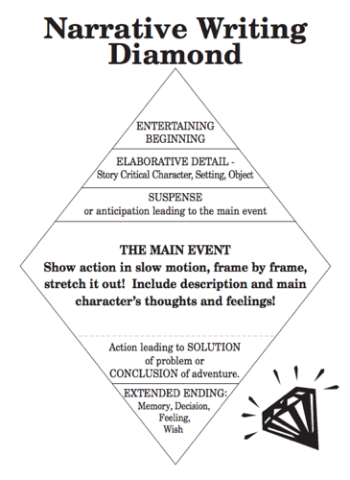
“Entertaining Beginnings”
Start with action or dialogue.
Ask a question or set of questions.
Describe the setting so readers can imagine it.
Give background information that will interest readers.
Introduce yourself to readers in a surprising way.

Slide 8
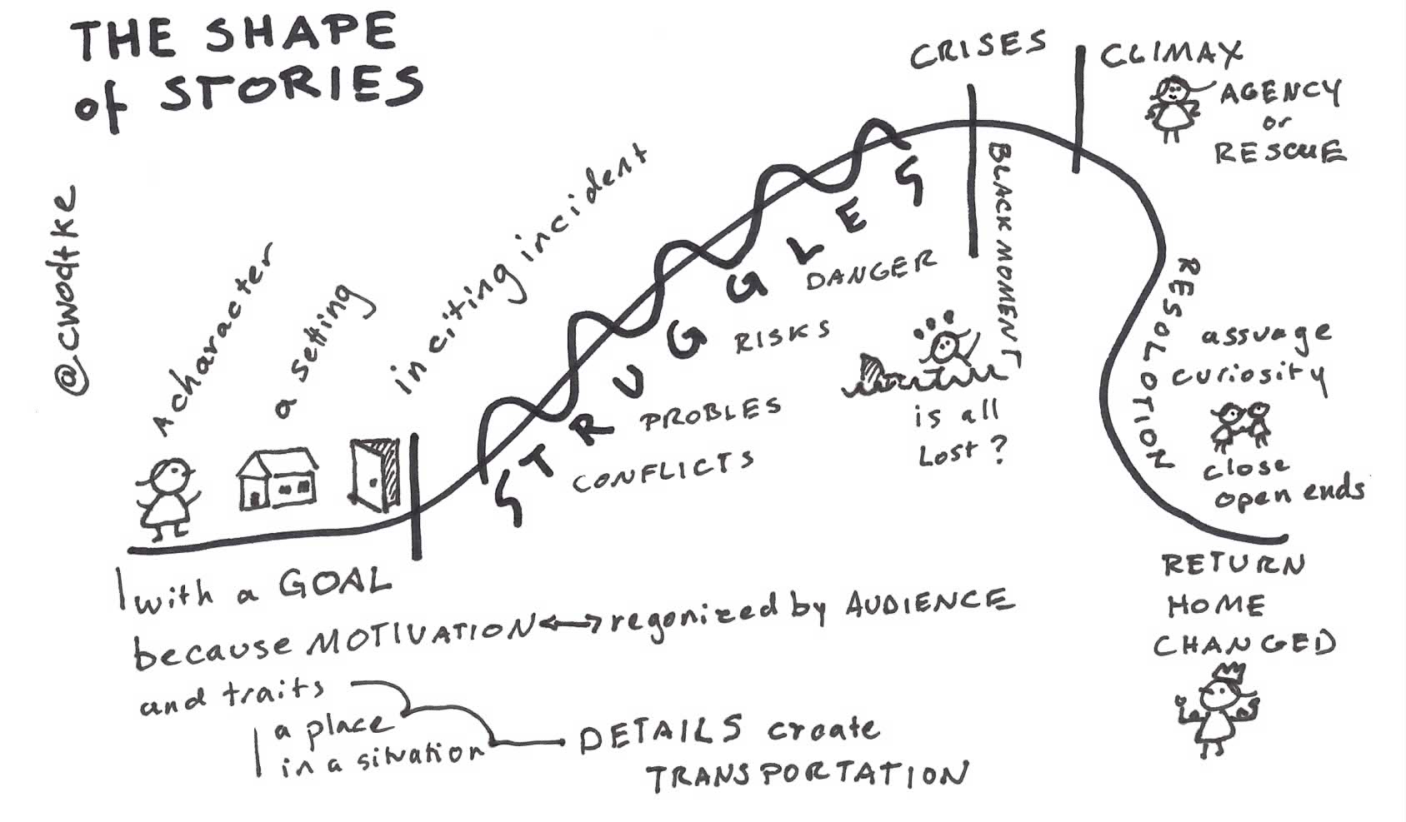

Slide 9
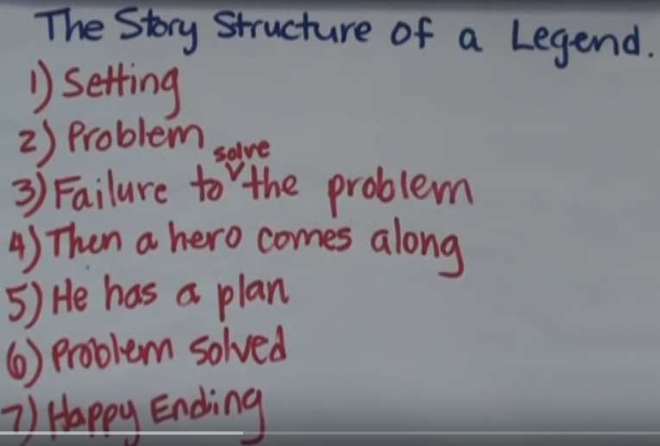

Specifics Help Immensely

Slide 10
Guidance is Huge.
Phase I
Choose the place.
Write down the basics of the place’s geography, landscape, and physical features. If you’re describing an interior space, the same ideas still apply except that you’re describing floor plans and architecture rather than landscape. Now, write about the sense that you have of the place: cultured/backward, beautiful/ugly, etc…
Finally, describe the people who occupy this place
Phase II
Let’s draft a plan for the setting introduction.
Model. Model. Model.
Go back and write/draw your plan. Share.
Phase III
Let’s turn our plan into a draft paragraph.
Model. Model. Model.
Go back and write your own setting introduction. Share.
Phase IV
Post the process somewhere in the room. Writing center?
This is now an option for writers’ workshop.
Plan, draft, confer, edit, revise, confer, publish.*

Slide 11

Diary of a Second Grader
Mentor Texts are Huge.
Diary of a Second Grader
https://www.youtube.com/watch?v=Qm2LW0rl7XI
Another Diary
https://www.youtube.com/watch?v=Zq0CHqjGgbM
What are they?

Slide 12
EXPOSITORY WRITING
It’s all about text structure

Slide 13
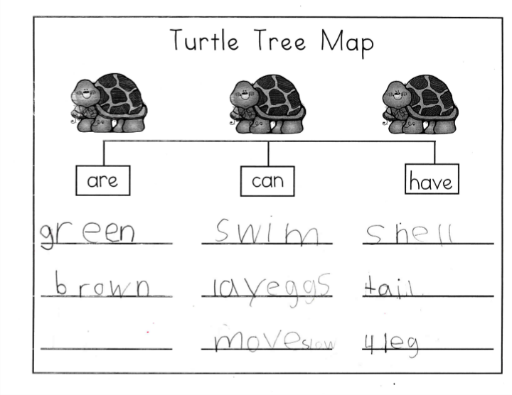

Slide 14
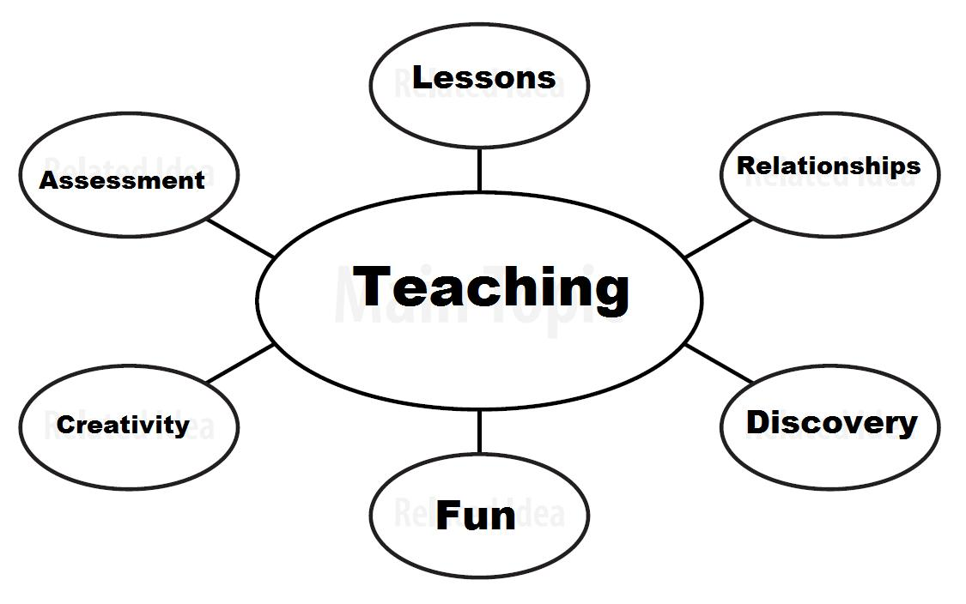

Slide 15
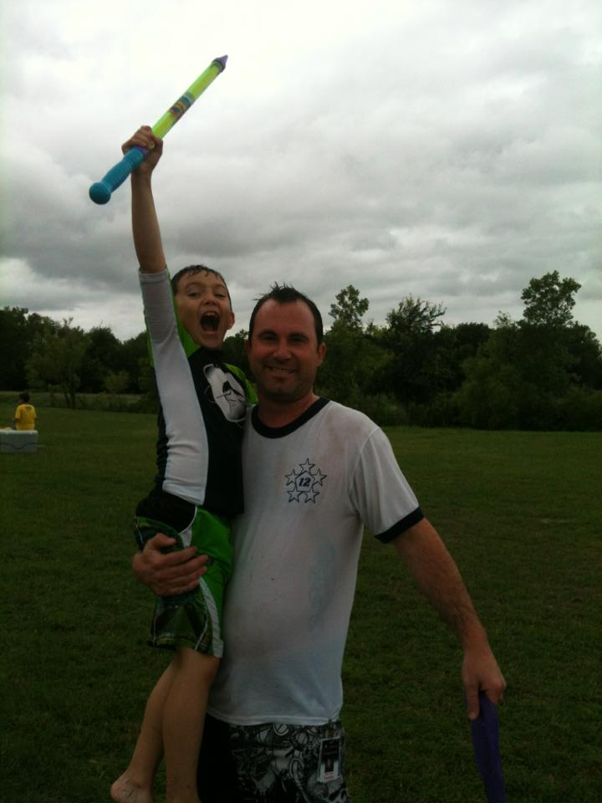
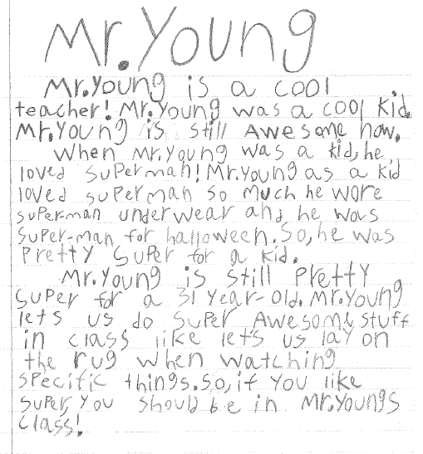
Example by Riley
Video

Slide 16
Let’s Do THIS!
Phase I
Write down three things you know a lot about.
Pick one that you’d like to write about. Share.
Go back and draw a concept web for your topic. Share.
Phase II
Let’s write an introductory sentence (practice a new one?).
Let’s complete the introduction (topic and details).
Go back and write your introduction. Share. Repeat for other sections.
Phase III
Post the process somewhere in the room. Writing center?
This is now an option for writers’ workshop.
Plan, draft, confer, peer-edit, revise, confer, publish.*

Slide 17
“by teaching we learn”
Instructional Video

Slide 18

Make it work for you
For your consideration:
Choose your genre and objective
Know the structure
Learn it, plan it, model it.
Guided practice is imperative
Provide independent practice
The writing process should guide writers’ workshop
Confer, confer, confer
Allow time for sharing
Consider occasions for creative publishing

Slide 19

Writing and the Brain

Slide 20
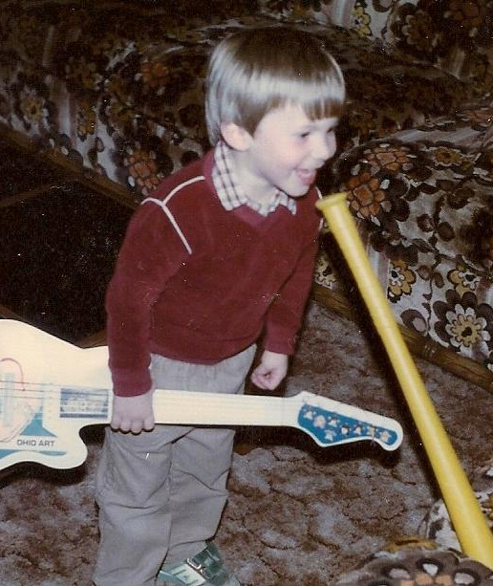
Learning Styles
Mastery
Interpersonal
Duke
Buddy
Understanding
Self-Expressive
Electra
Celeste

Slide 21
MASTERY -
Start with clear expectations
Tell students what they need to know and how to do it step by step
Establish opportunities for concrete experiences
Provide speedy feedback
Separate practice from performance
INTERPERSONAL -
Tie content to a personal experience
Reinforce learning through support and positive feedback
Use the world outside the classroom as a resource
Select activities that build on personal experiences and cooperative structures
Take time to help establish personal goals, encourage reflection, and praise performance

Slide 22
UNDERSTANDING -
Provide questions that puzzle and data that teases
Require students to hypothesize and develop plans of action before they explore answers
Open the learning process to questions that stimulate deeper thought
Build in opportunities for students to share their explanations and to provide evidence and proof for their ideas
Evaluate students’ critical thinking and problem solving skills
SELF-EXPRESSIVE -
Inspire students to think divergently and imaginatively
Model creative work so students can examine and establish criteria for assessment
Allow students choice of activities and multiple methods for showing what they know
Give feedback, coach, and provide an audience for sharing work
Evaluate and assess performance according to established criteria

Slide 23
Writing about Math with the Brain in Mind
Mastery
Interpersonal
Identify Steps
Game and Reflect
Understanding
Self-Expressive
Essay
Creative Choice

Slide 24
Identify the Steps
Go online.
Find the steps to multiplication and division.
Identify how they are alike/different, and complete a Venn diagram.
Write compare/contrast nonfiction article.

Slide 25
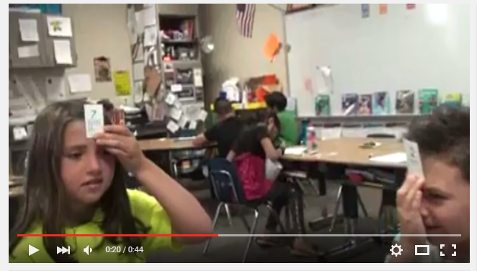
Missing Factor Game
Video
Once complete, students write a reflection – give language stems like:
This game helped me practice _____ because ______. One thing new
I learned was _______. I still can’t figure out _____. I need more
practice with _______. I am really good at _______.

Slide 26

Math Expository Essays
Video

Slide 27
Write a…
…story that uses division/multiplication in the plot. Share.
…poem that that includes multiplication/division. Share.
…song about division/multiplication. Share.

Slide 28
Writing about Science with the Brain in Mind
Mastery
Interpersonal
Experimental
Write-Ups
Teach the Scientific
Method in Groups
Understanding
Self-Expressive
Essay
Create and Perform
A Readers Theater

Slide 29
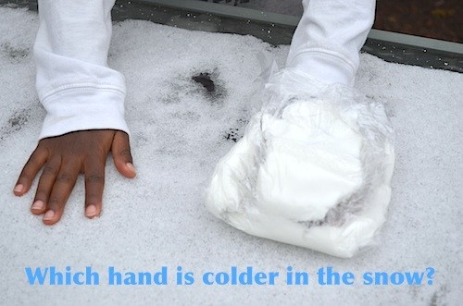
The Write Up
The Blubber Experiment

Slide 30

Teaching the Scientific Method
Instructional Video

Slide 31

Write an Expository Essay
Another Explain Everything

Slide 32
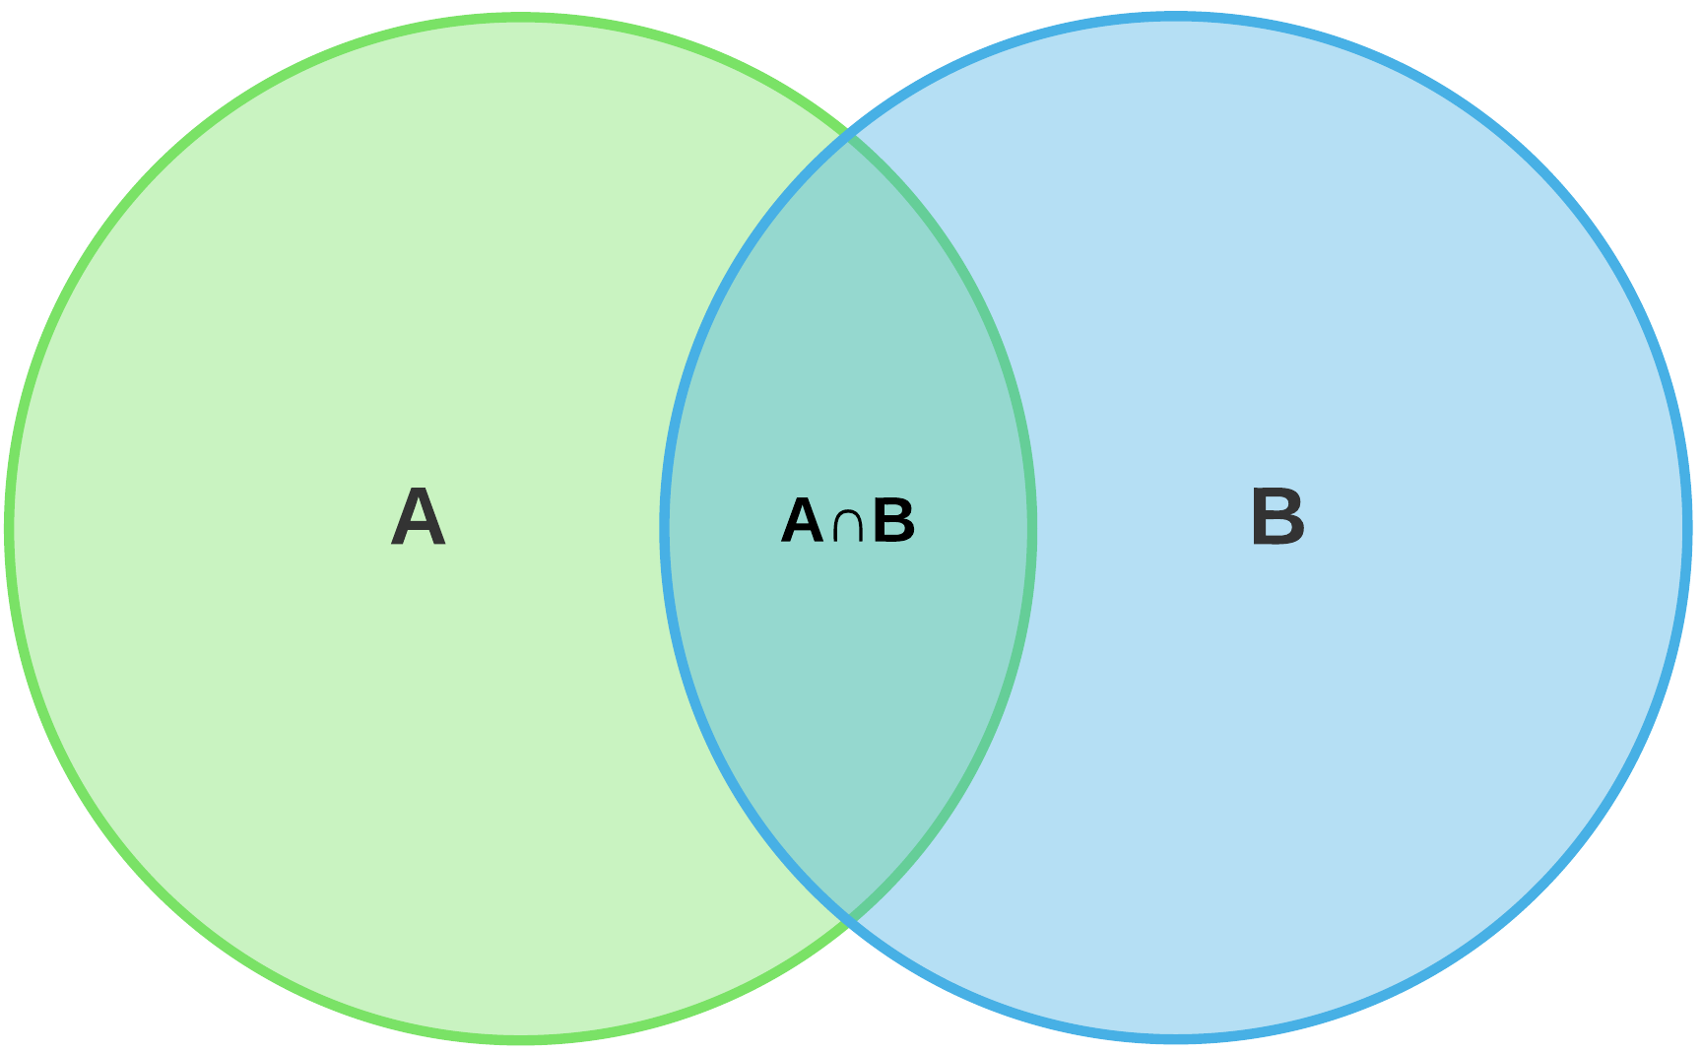
Learn, Write, Perform
I need 3 volunteers.

Slide 33
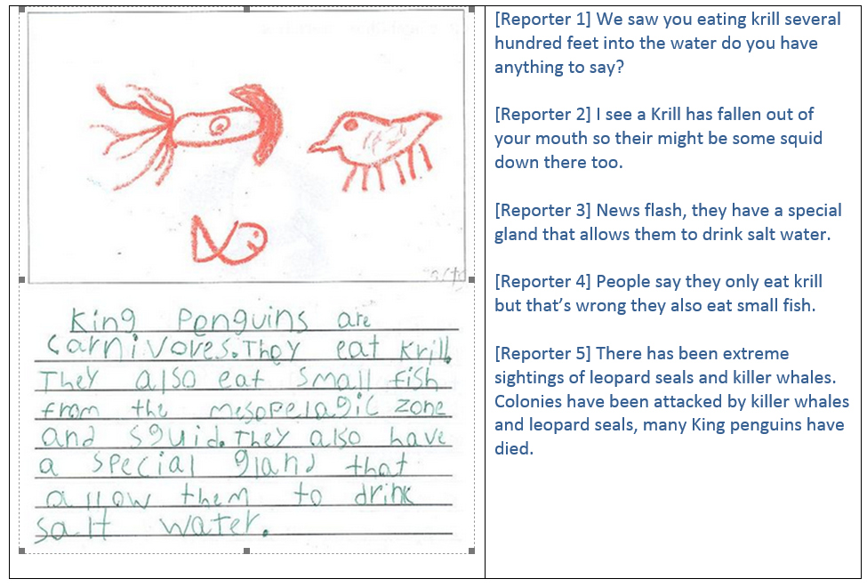
Webcast
Or, you can have it all!
Research
Organize
Writing Process
Work in Groups
Write Scripts
Rehearse
Record

Slide 34
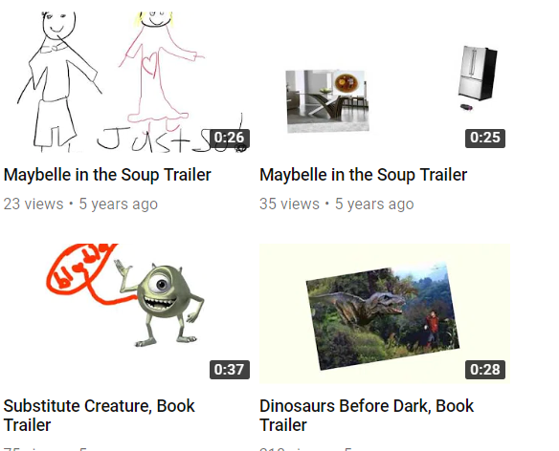
Book Trailers
Kids read books together, wrote, and produced book trailers using explain everything.

Slide 35
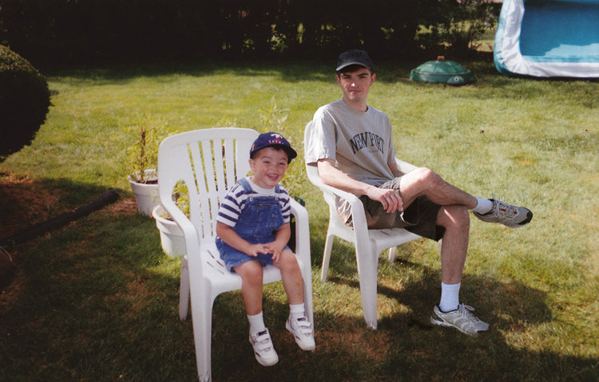


from K-5

Slide 36


In grade level groups, use the learning styles and your choice of standard.

Slide 37


Slide 38
Writing in Motivating and Authentic Contexts
Last segment.

Slide 39


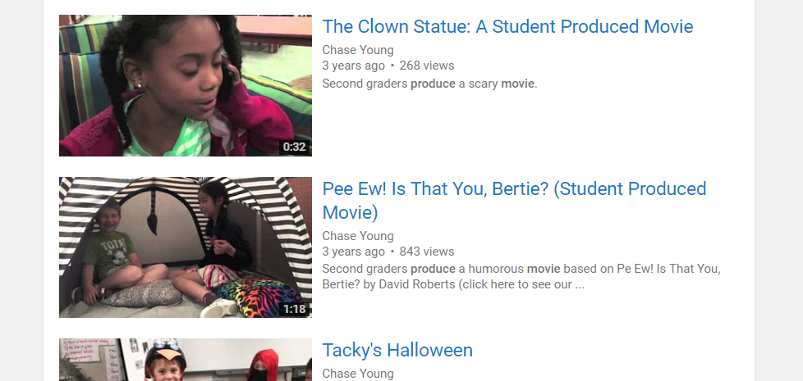

Slide 40
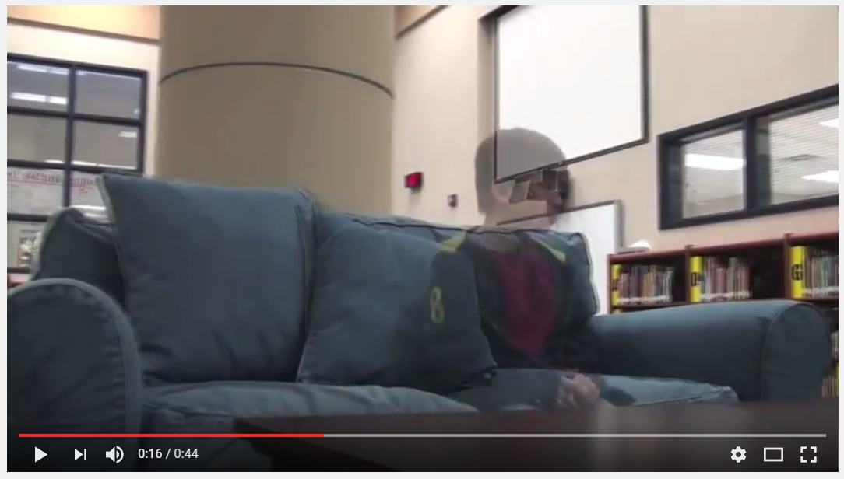
The Bad News by Alvin Schwartz

Slide 41

Student Produced Movies
Phase 1: Grouping
Phase 2: Idea Development
Phase 3: Script Treatment
Phase 4: Storyboard
Phase 5: Scripting
Phase 6: Preproduction Conference
Phase 7: Filming
Phase 8: Post-Production

Slide 42
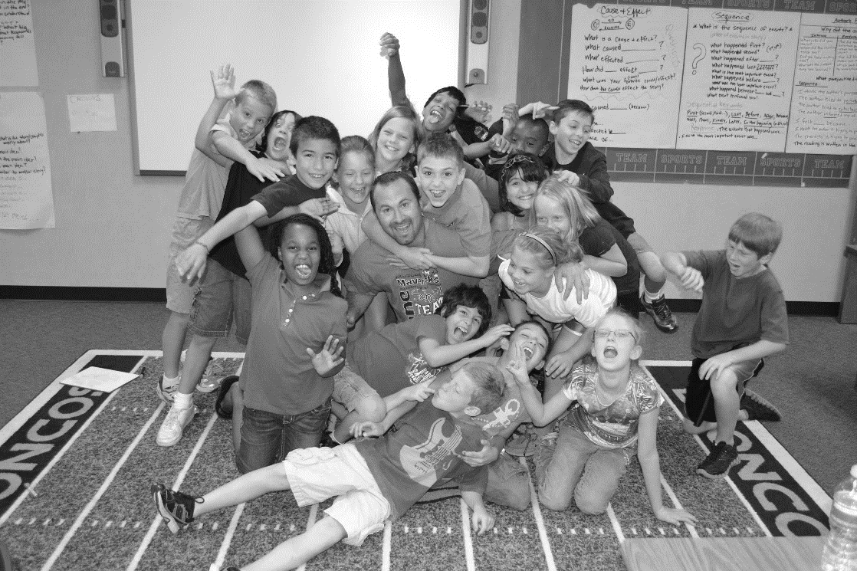
Phase 1: Grouping
(Risko & Walker-Dalhouse, 2011; Pachtman & Wilson, 2006)
Students groups are selected based preferred genre

Slide 43
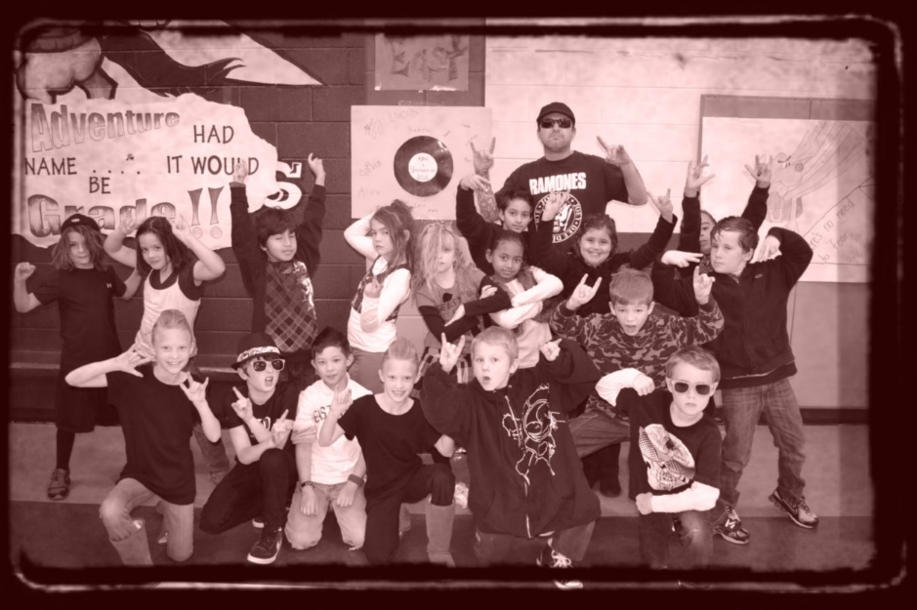
Phase 2: Idea Development
(Culham, 2011; Dorfman & Cappelli, 2007; Smith, 1994)
Students choose method for creating scripts: mentor, parody, or from scratch

Slide 44

Phase 3: Script Treatment
(National Institute of Child Health and Human Development, 2000)
Students write a summary and assign roles

Slide 45
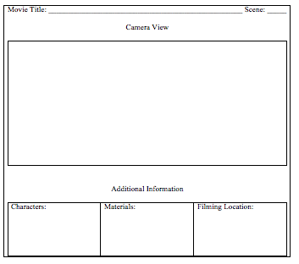
Phase 4: Storyboard
(Naughton, 2008)

Slide 46

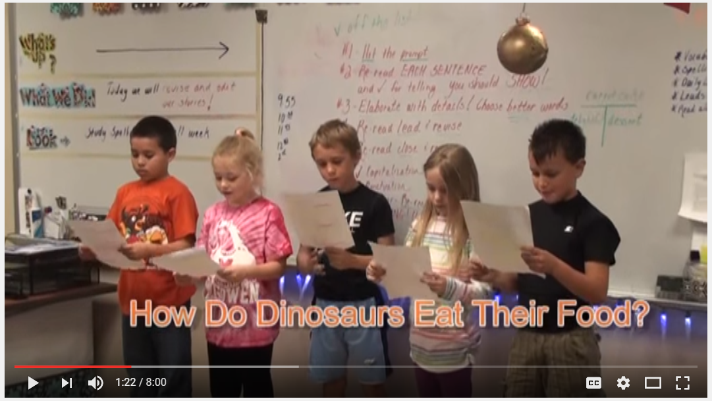
Phase 5: Scripting
(Culham, 2011; Dorfman & Cappelli, 2007; Smith, 1994; Young & Rasinski, 2011)

Slide 47
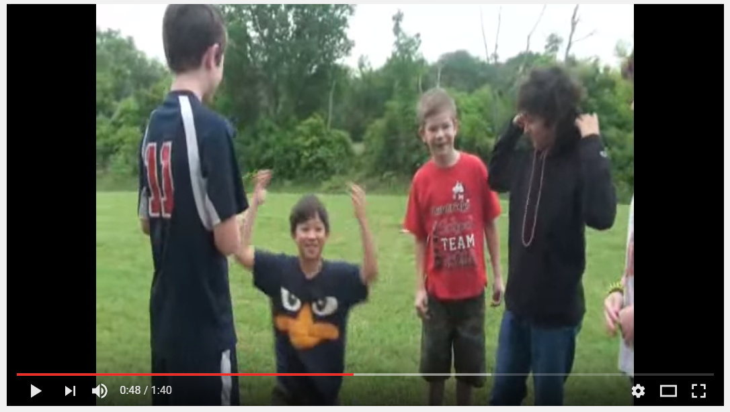
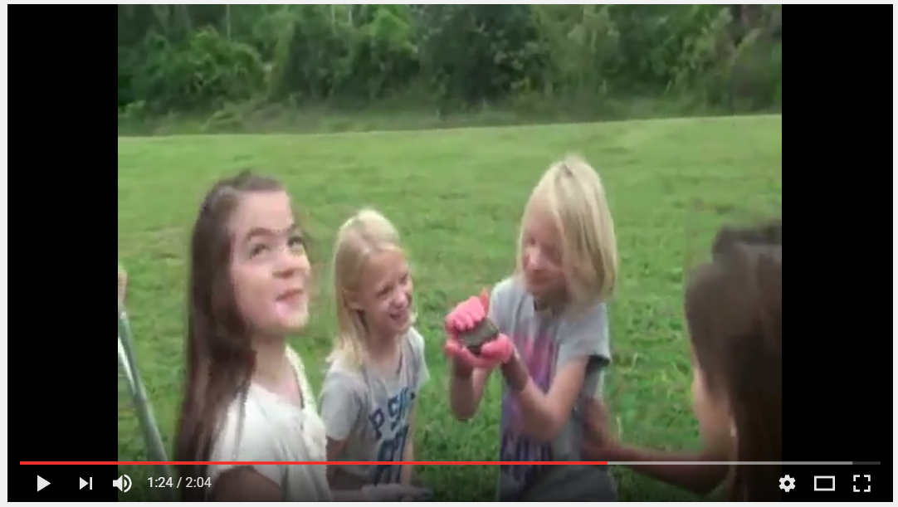
Enhancing Authors’ Voice Through Scripting (Young & Rasinski, 2011)
Mentor Text
Parody

Slide 48
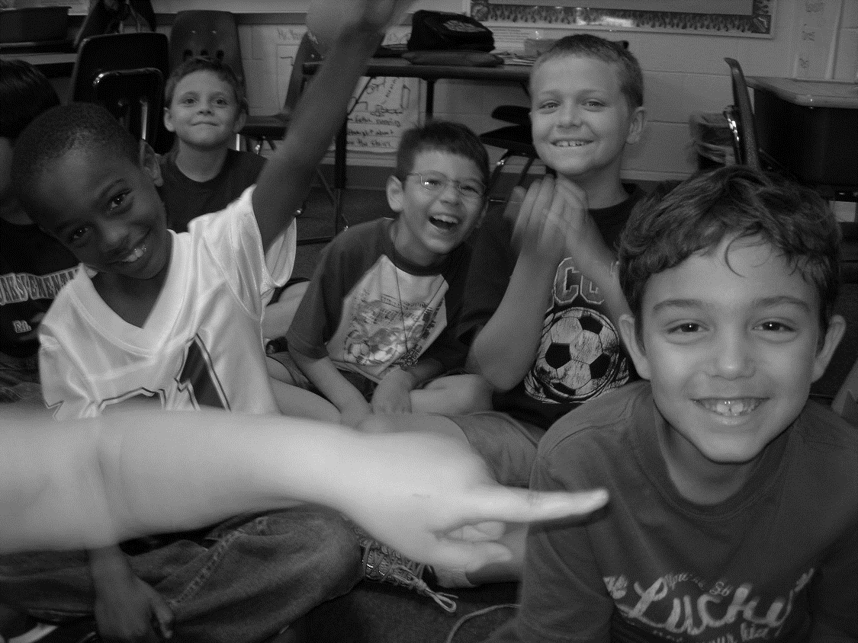
Phase 6: Preproduction Conference
(Young & Rasinski, 2013)
The production team meets with the teacher and discuss light edits, materials, and responsibilities.

Slide 49
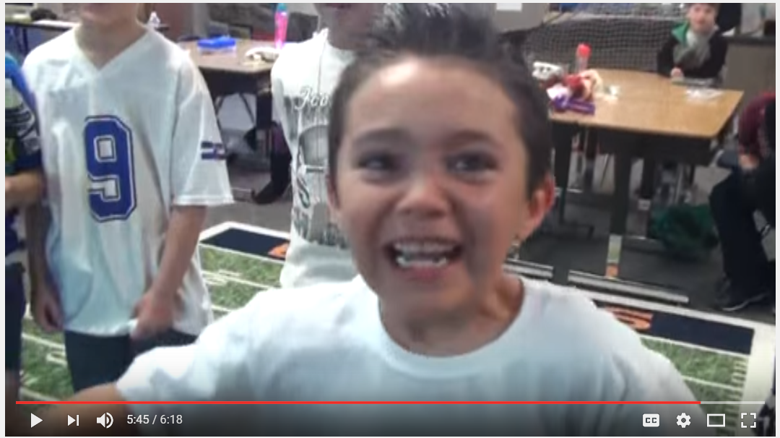
Rehearsal
(Griffith & Rasinski, 2004; Martinez, Roser, Strecker, 1998; Young
& Rasinski, 2009; Vasinda & McLeod, 2011; Worthy, 2005; Worthy & Prater, 2002)

Slide 50
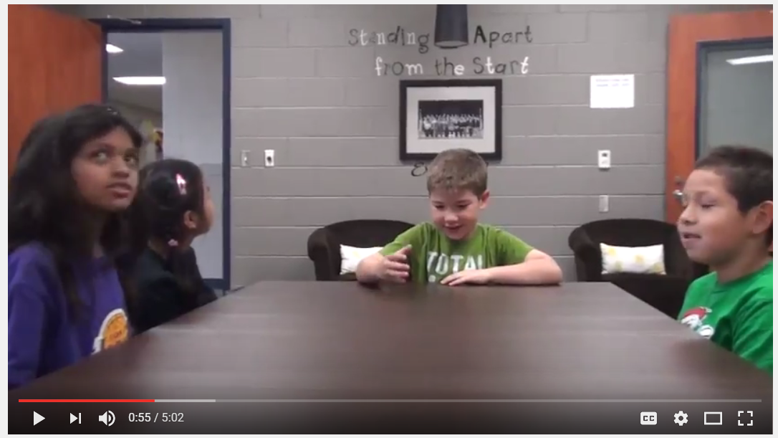
Phase 7: Filming

Slide 51
Phase 8: Post-Production
(National Governors Association for Best Practices & Council of Chief State School Officers, 2010)
Students learn how to upload the movies into the software, drop clips into the editing line, delete unused takes, reorder and cut clips, configure special effects, utilize transitions, add music, and create title and credit sequences.
Final

Slide 52
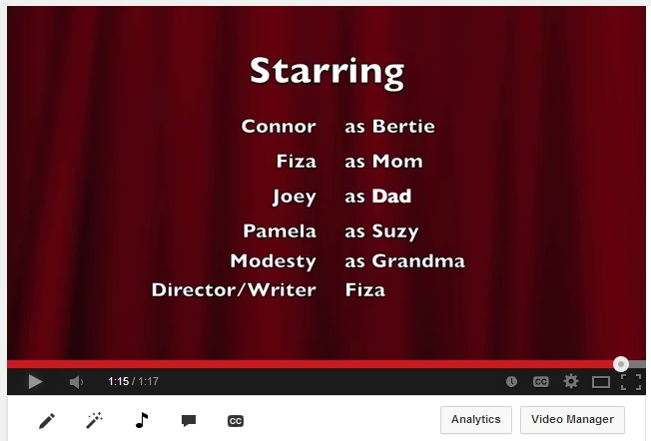
Literacy Skills and Processes
Consider reading preferences (Pachtman & Wilson, 2006)
Explore genres (Risko & Walker-Dalhouse, 2011).
Visually represent sequences of text (Naughton, 2008),
Compose summaries (NICHD, 2000)
Transform texts into dialogue ideal for movie production (Culham, 2011; Dorfman & Cappelli, 2007; Young & Rasinski, 2011)
Students utilize software to produce a movie (National Governors Association for Best Practices & Council of Chief State School Officers, 2010)

Slide 53


Slide 54


