Slide 1
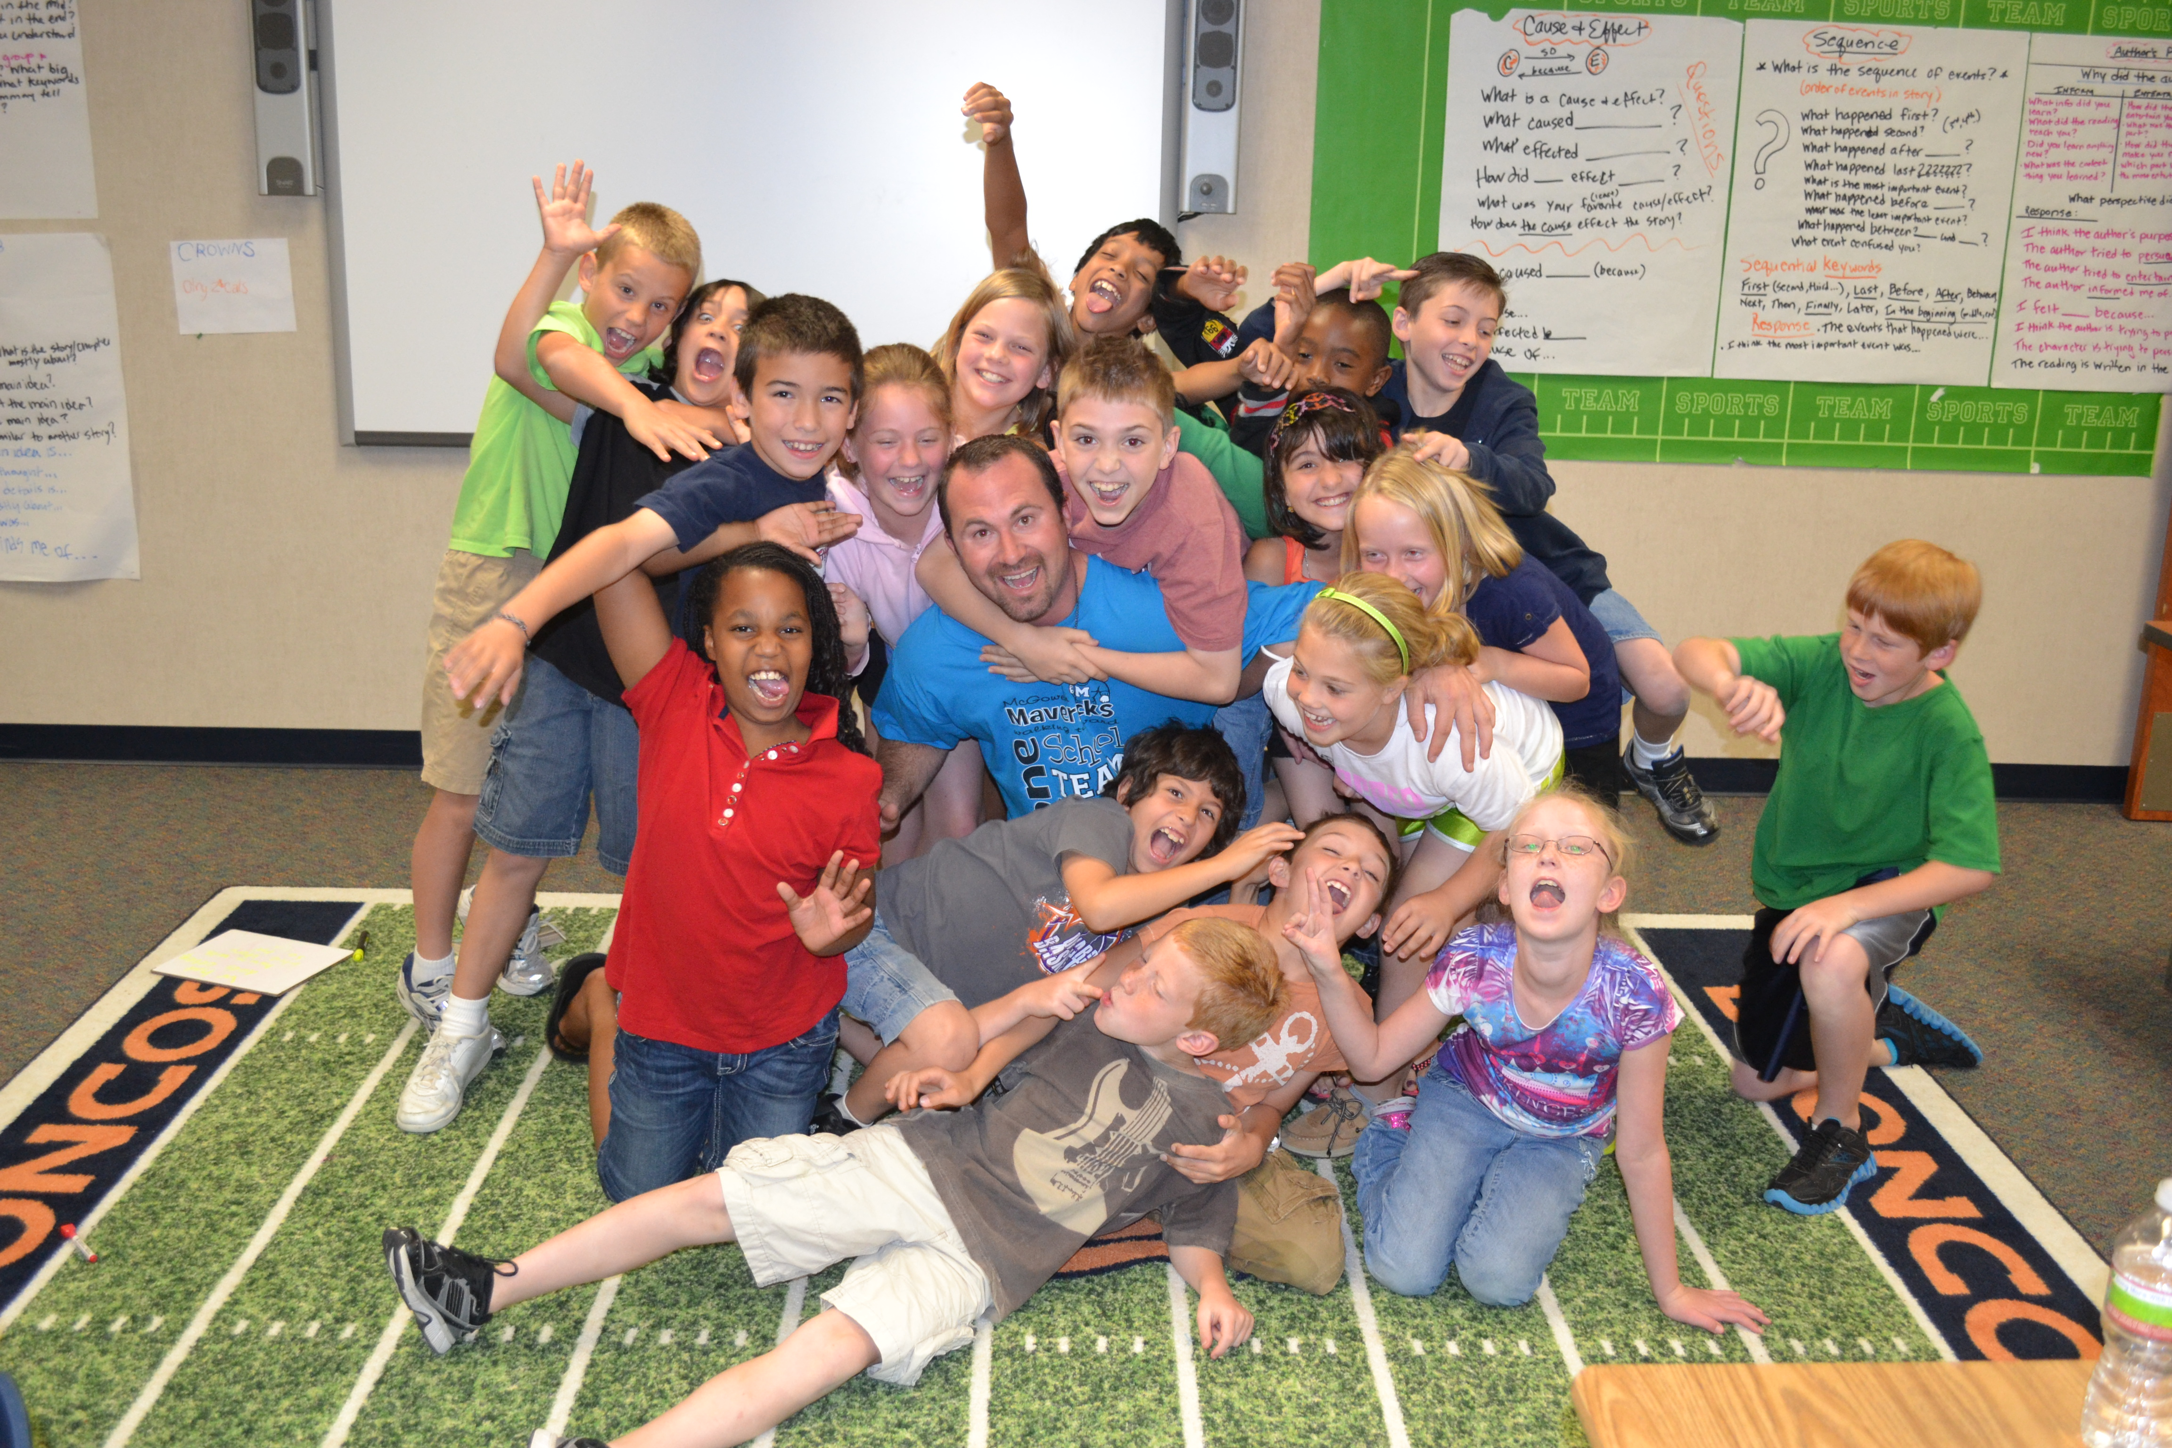

Unbalanced Literacy
GUIDED READING
Chase Young, Ph.D. – Sam Houston State University

Slide 2
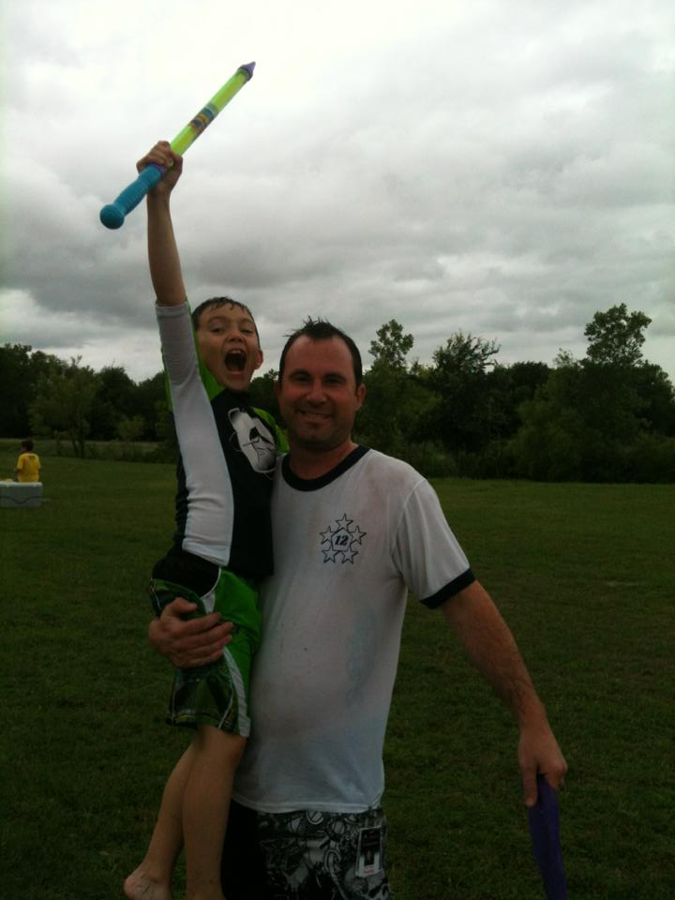
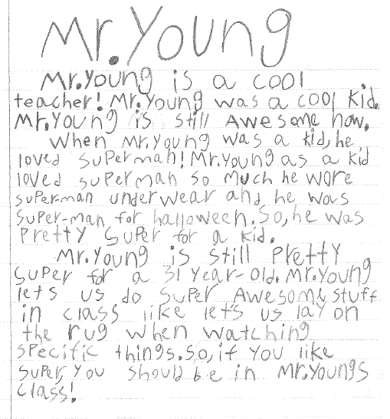
Introduction by Riley
Video

Slide 3

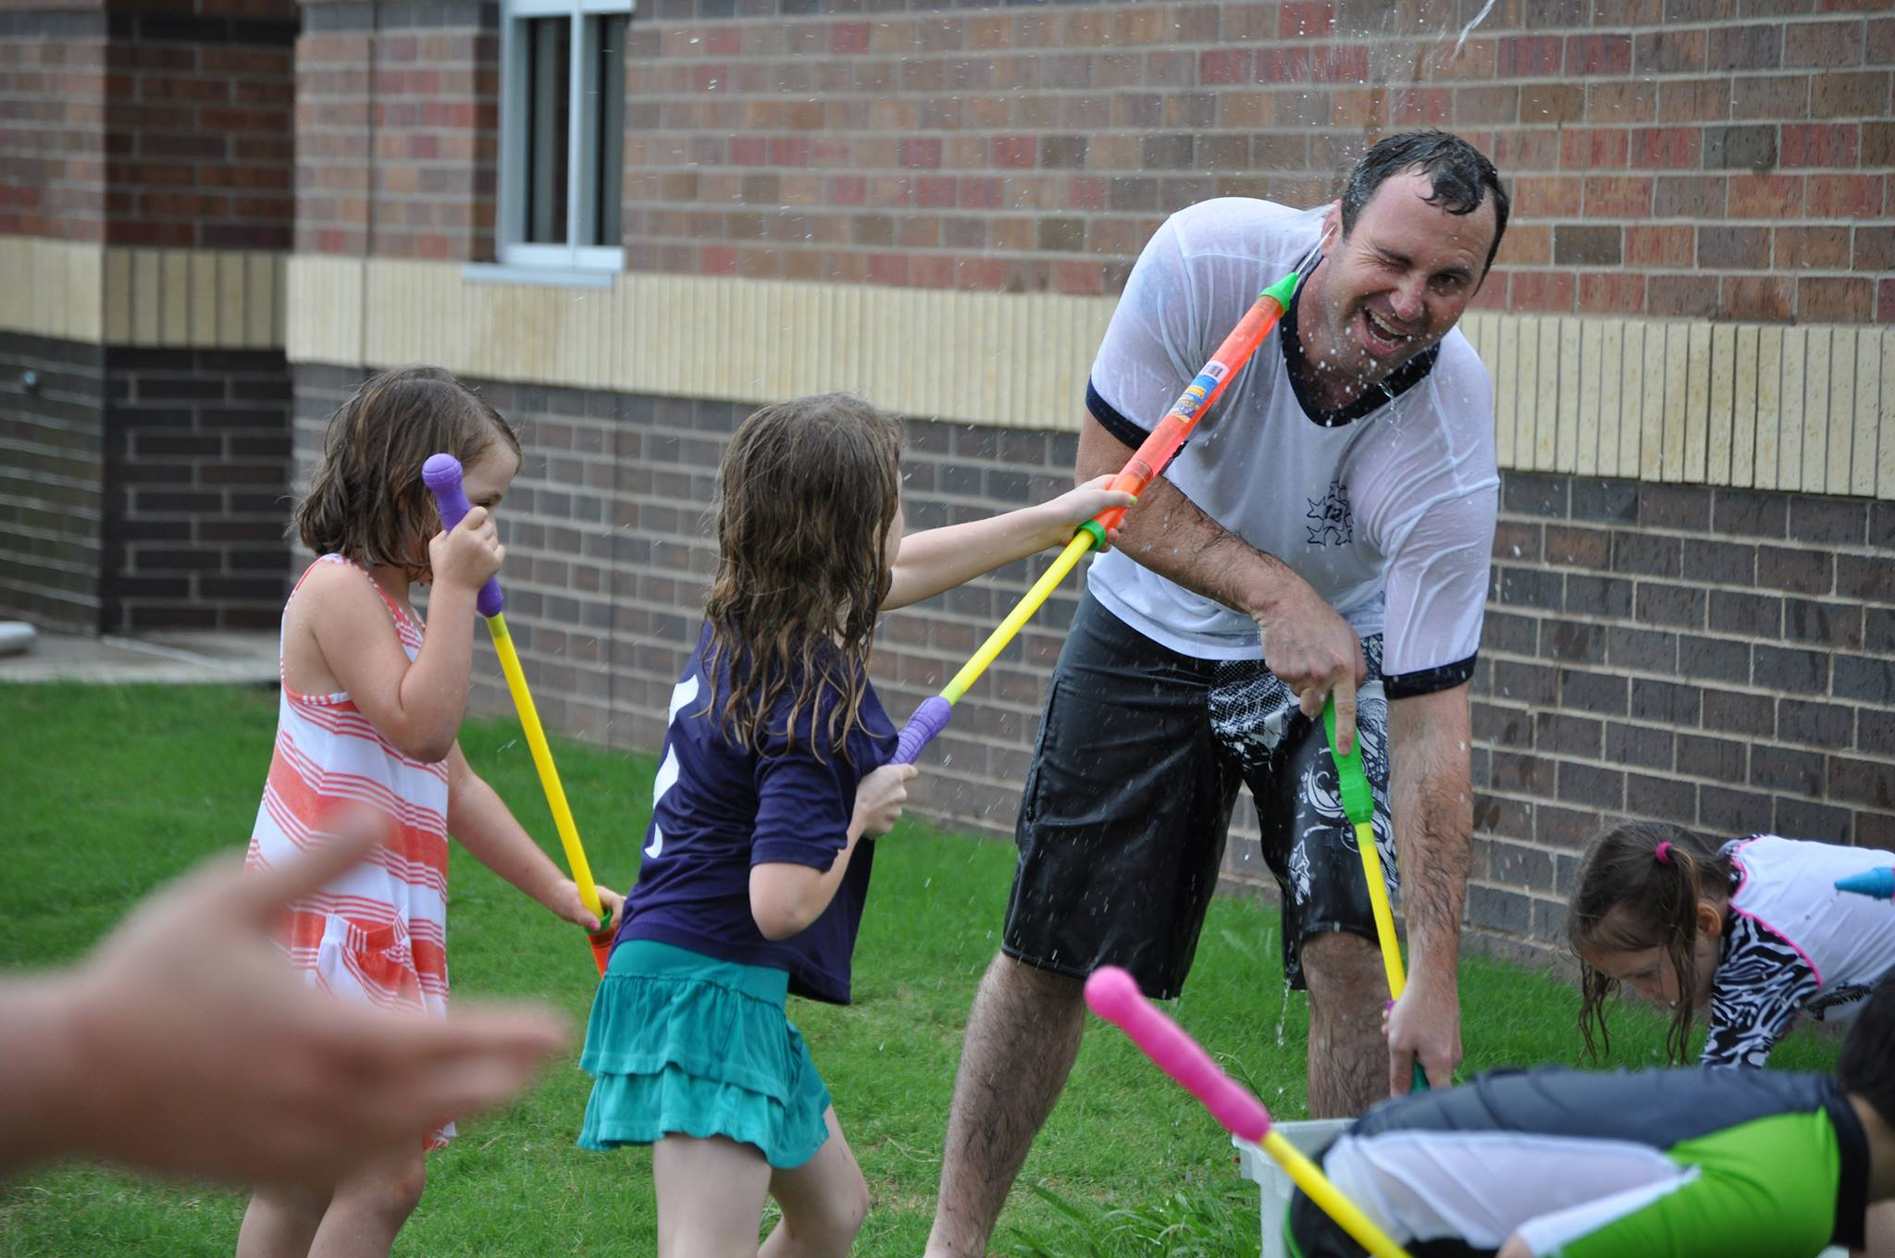
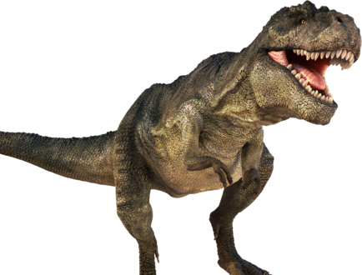


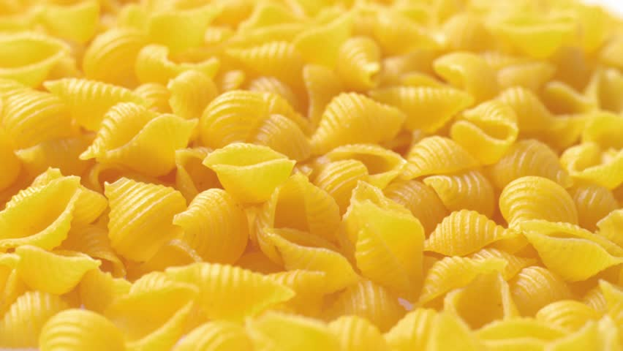
Congratulations

Slide 4


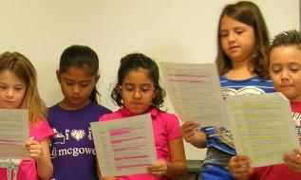
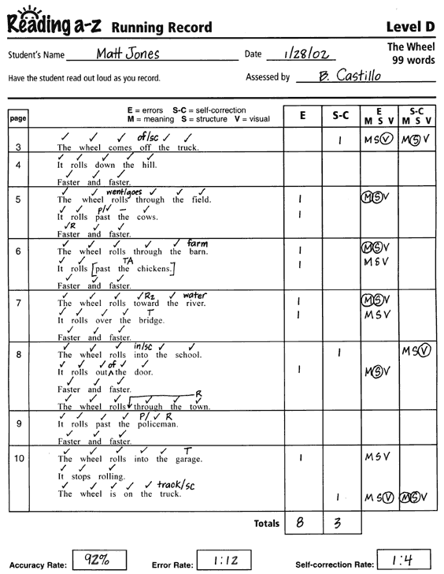
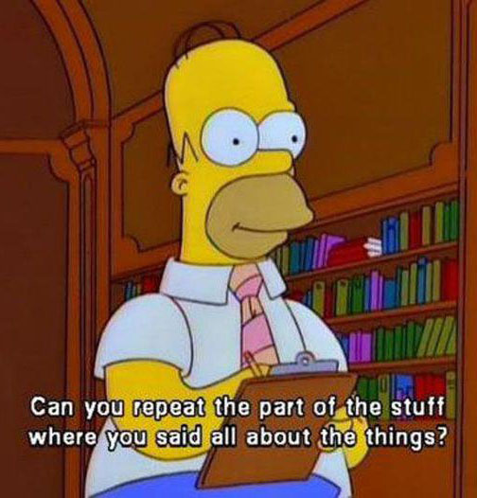
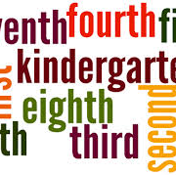
Assessments
DIBELS
Accuracy
Fluency
Comprehension
Levels

Slide 5
Take our Test

Slide 6
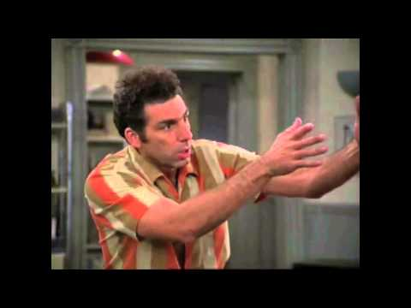

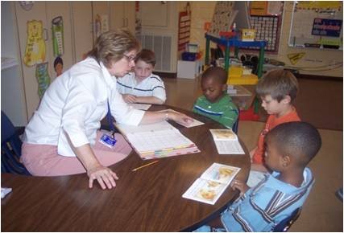
Levels…

Slide 7
NAME | LEVEL
Chase | A
Tim | D
Robin | D
Carol | E
Ryan | G
Randy | G
Donna | H
Leonard | K
Corinne | K
Faye | L
Danny | M
Pete | M
Rosa | M
Lynn | N
Lars | O
Robert | O
James | O
Kirk | O
Austin | Q
How might we group these students?

Slide 8
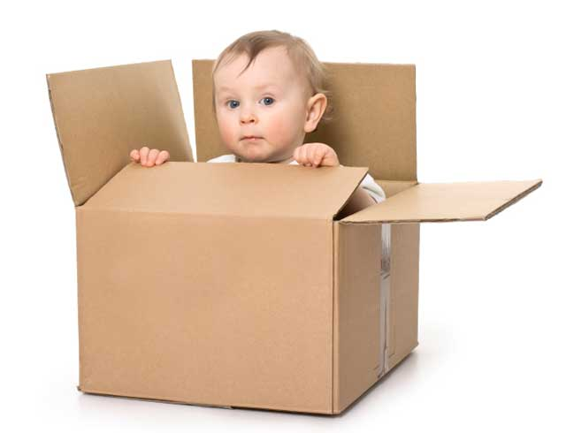
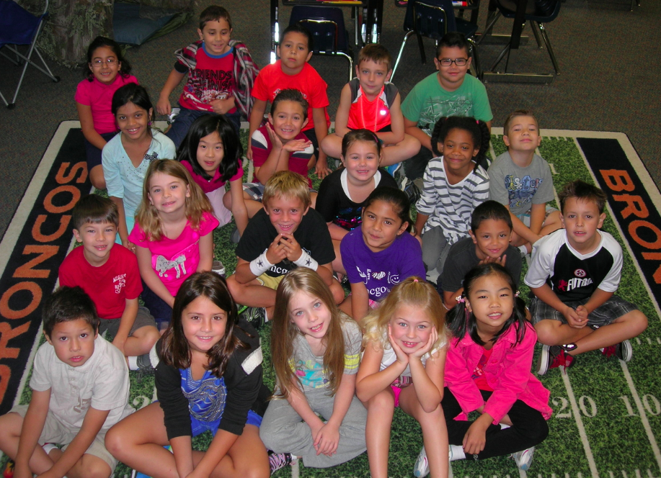
Moving Kids
The purpose of
guided reading.

Slide 9
Talk with some people about what questions or insights you have…
I’ll know you are done when you give someone a high five and tell them they look fabulous.

Slide 10
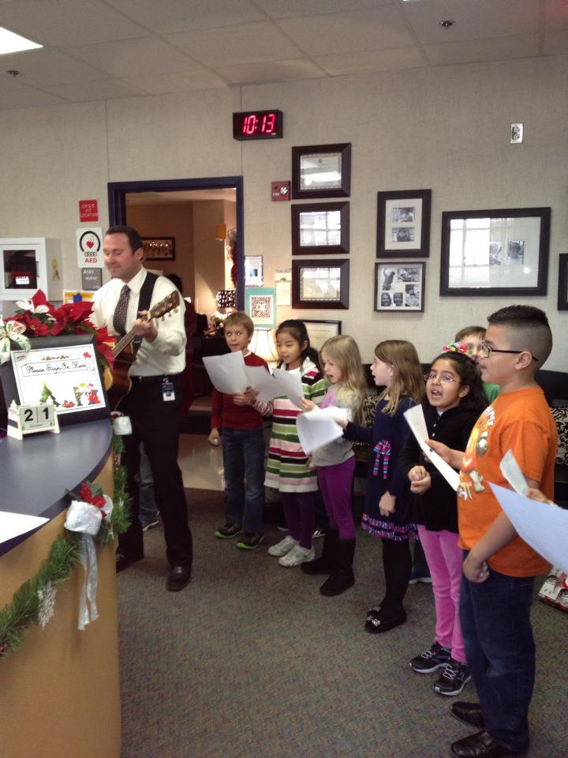
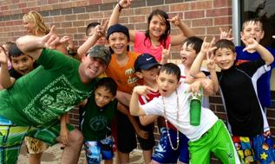
Questions?

Slide 11
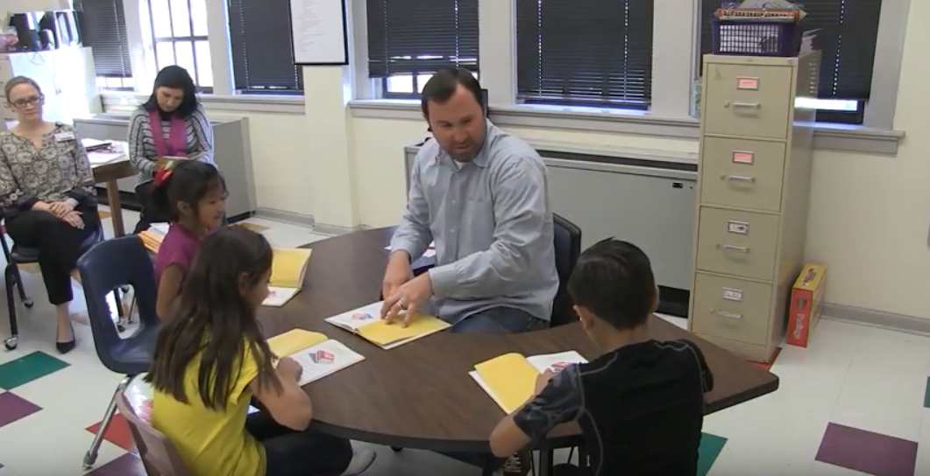
OBSERVATION

Slide 12
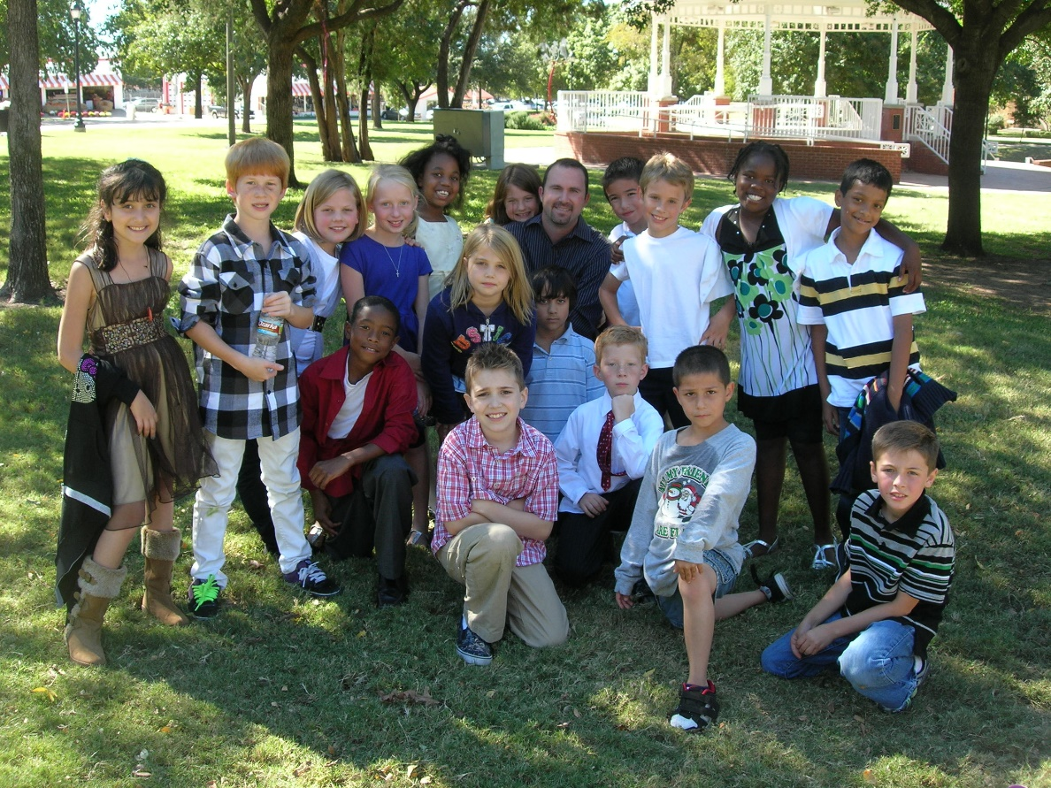
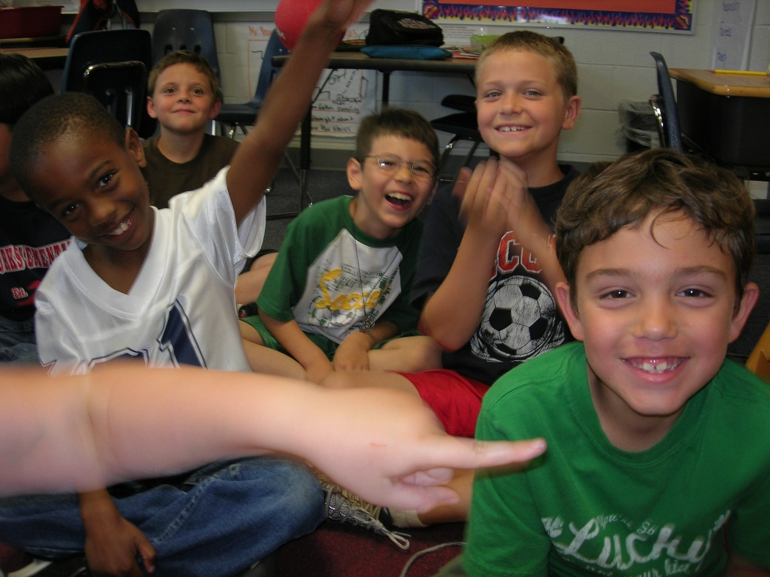
Reflections?

Slide 13
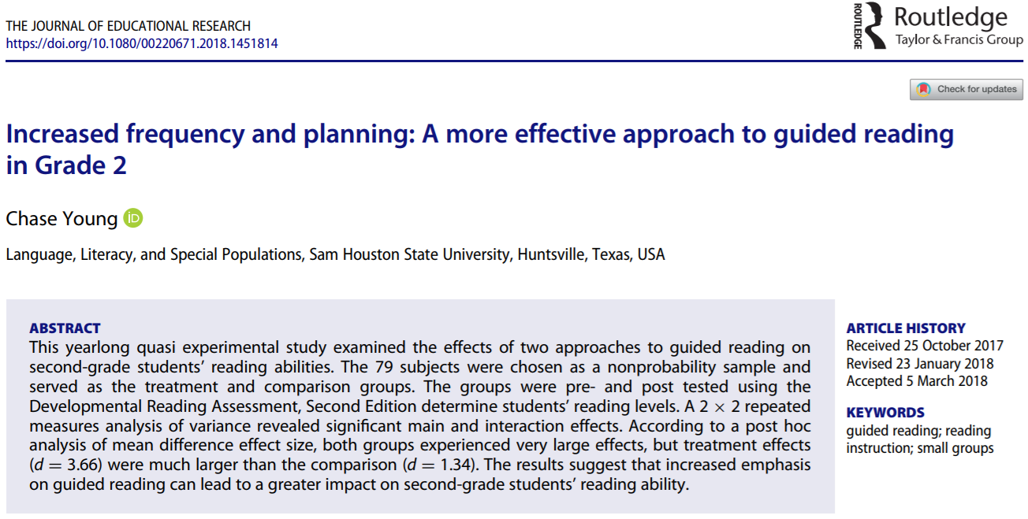

Slide 14
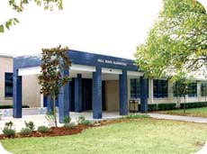
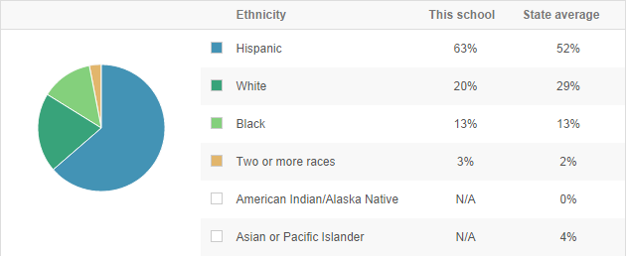
Title 1

Slide 15

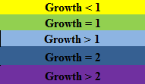
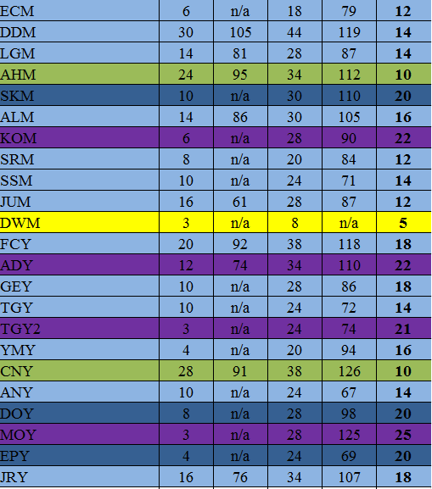
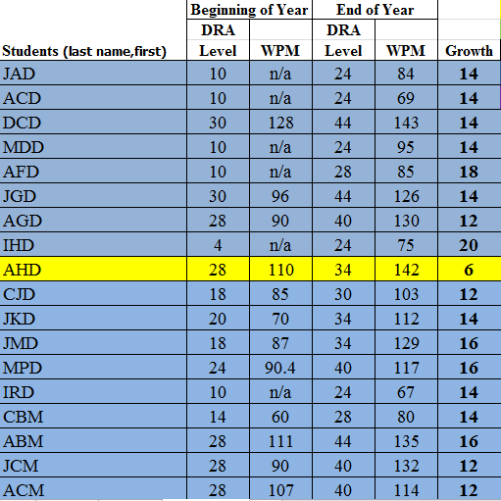

Slide 16
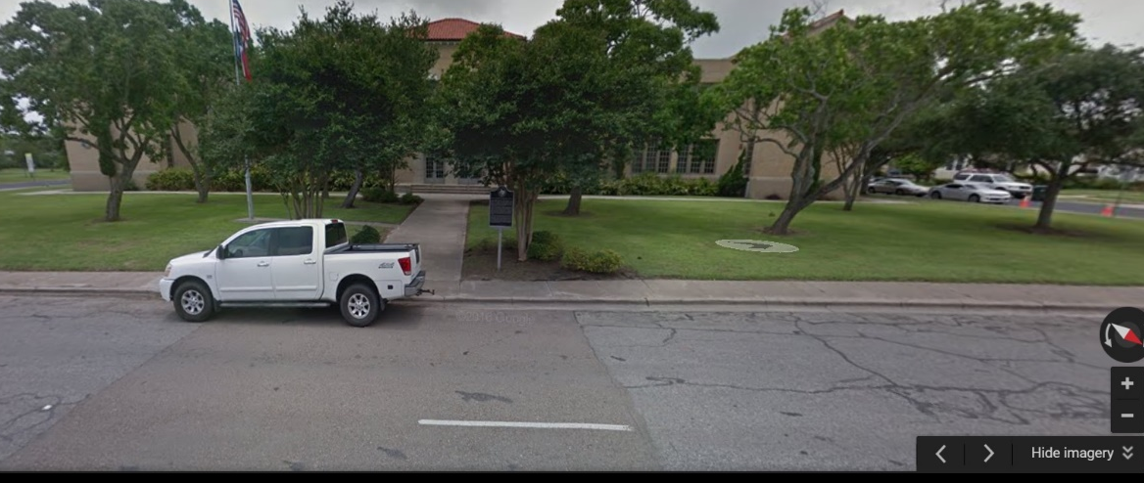

Slide 17


Slide 18
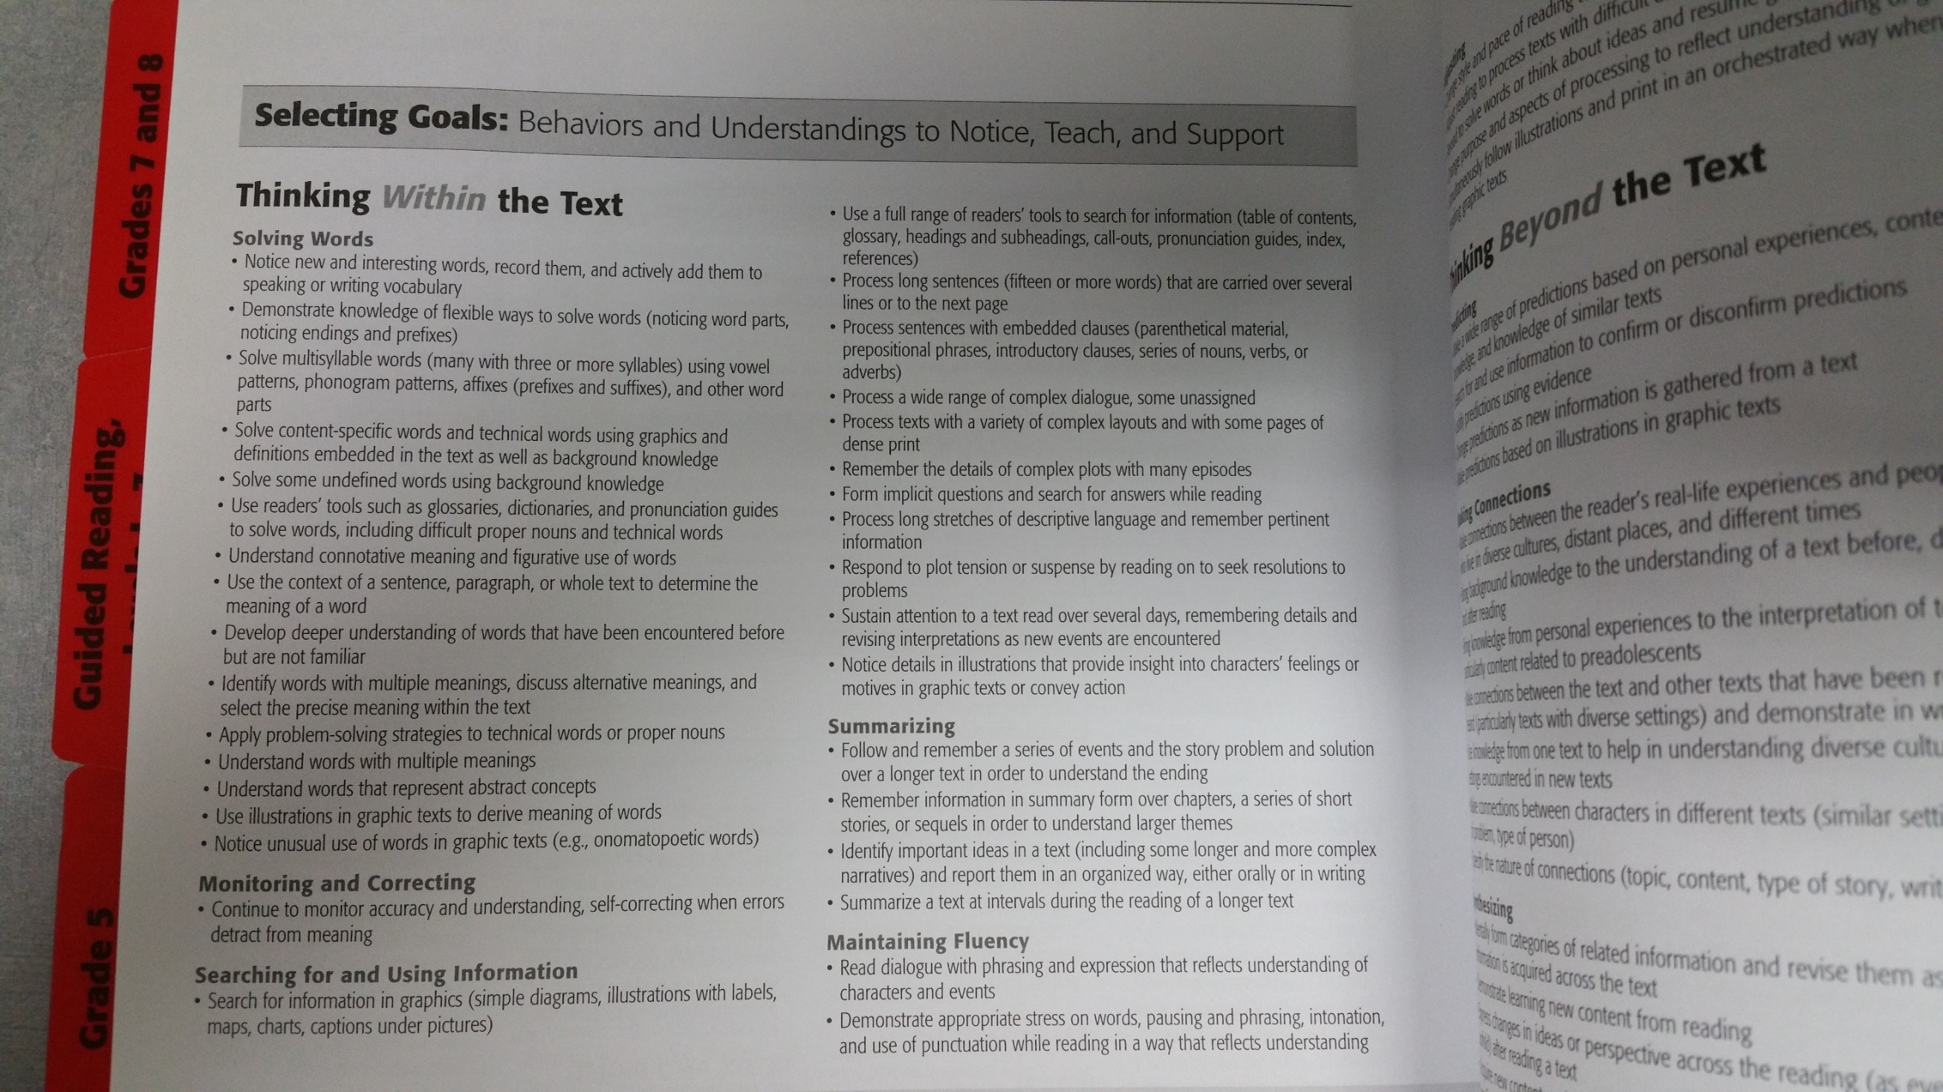

Slide 19
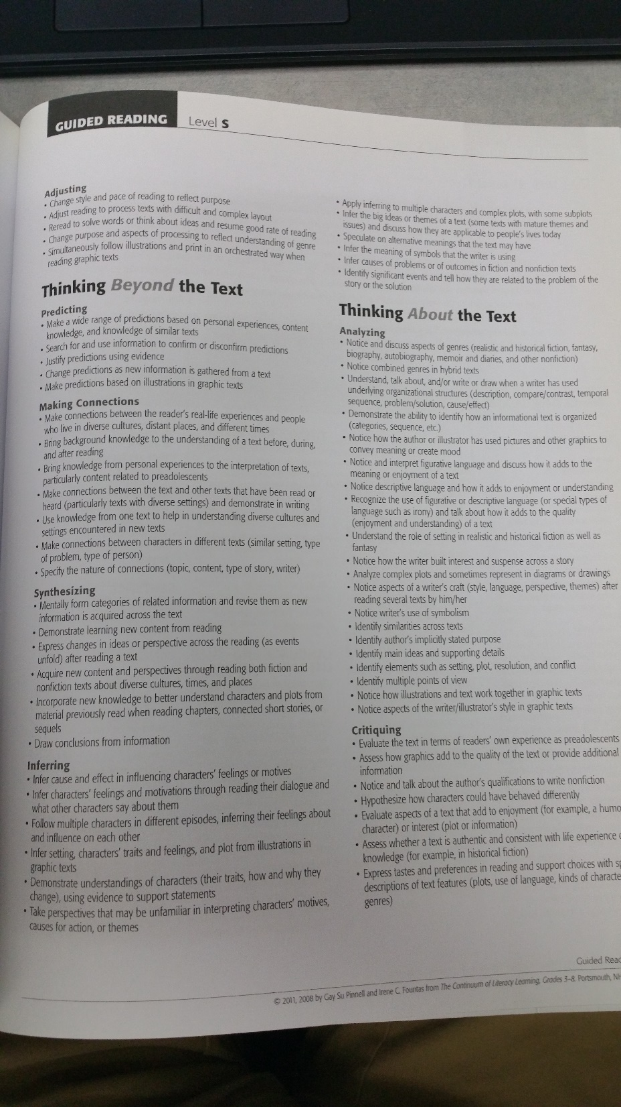

Slide 20
Creating the Lesson
www.thebestclass.org

Slide 21
Talk with some people about what questions or insights you have…
I’ll know you are done when you give someone a handshake and say, “You are an amazing teacher.”

Slide 22
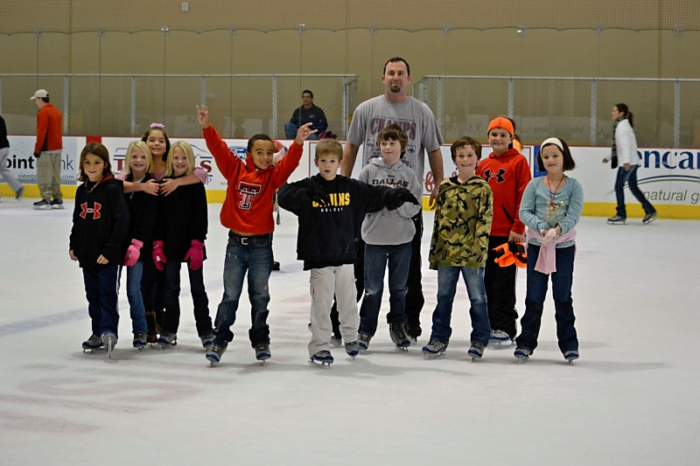
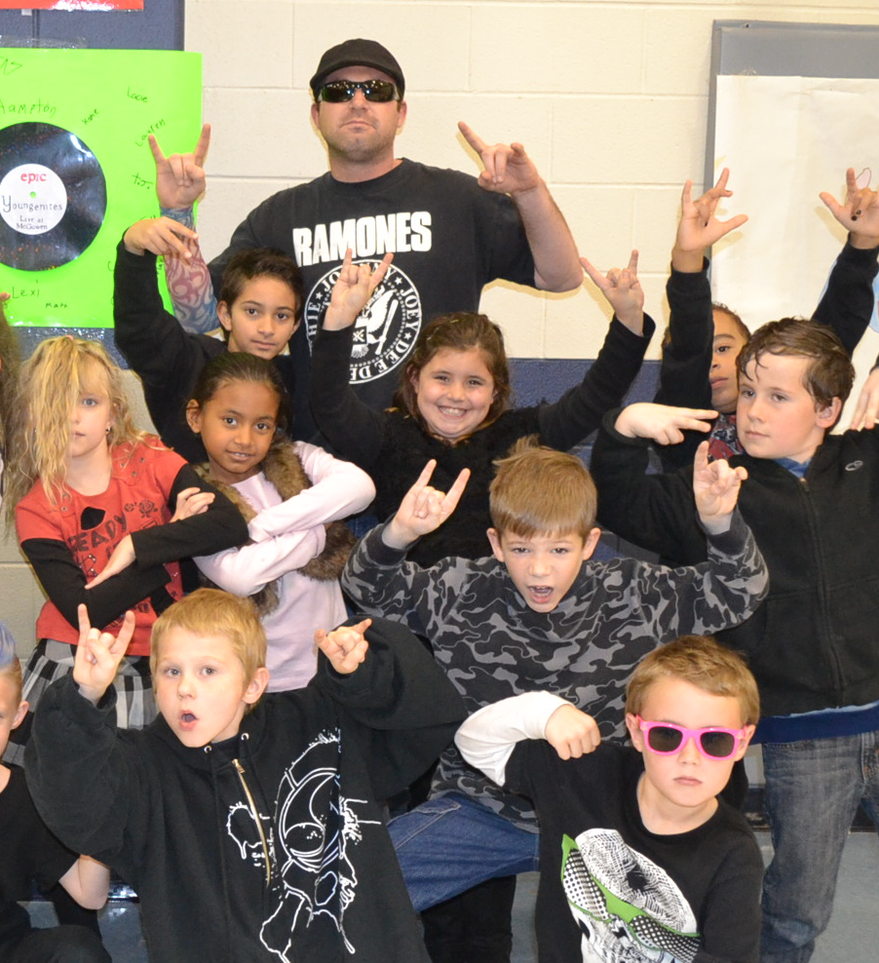
Questions?

Slide 23
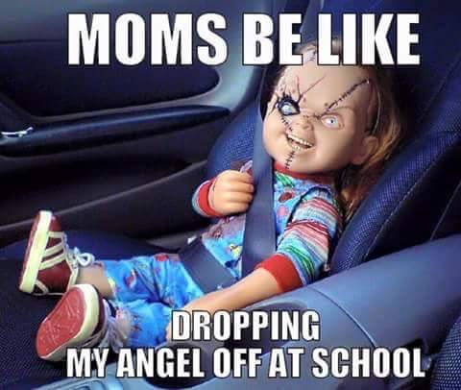

Slide 24
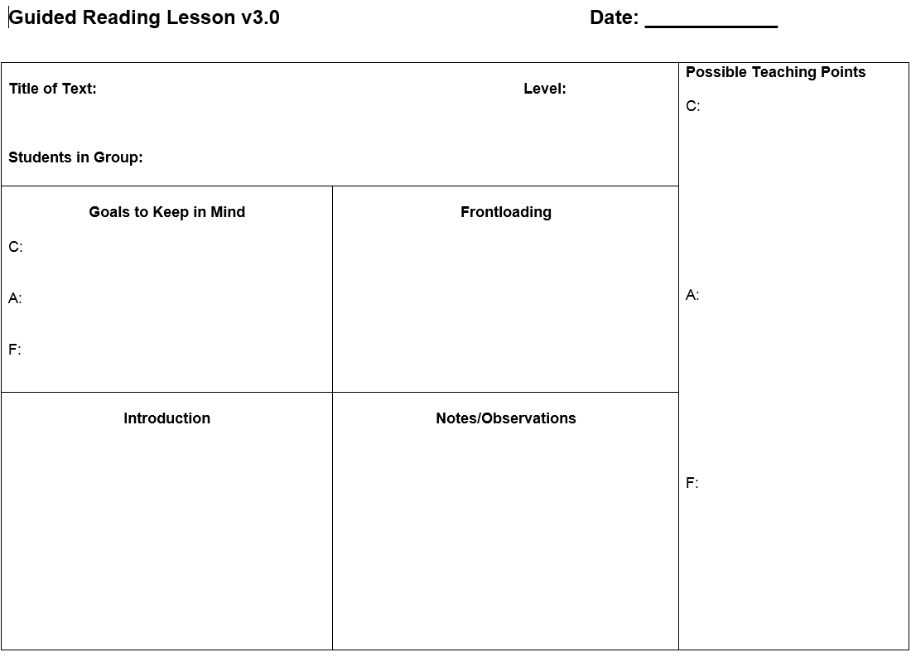

Slide 25
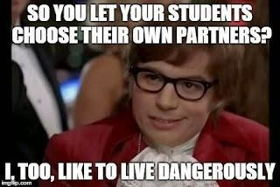

Slide 26
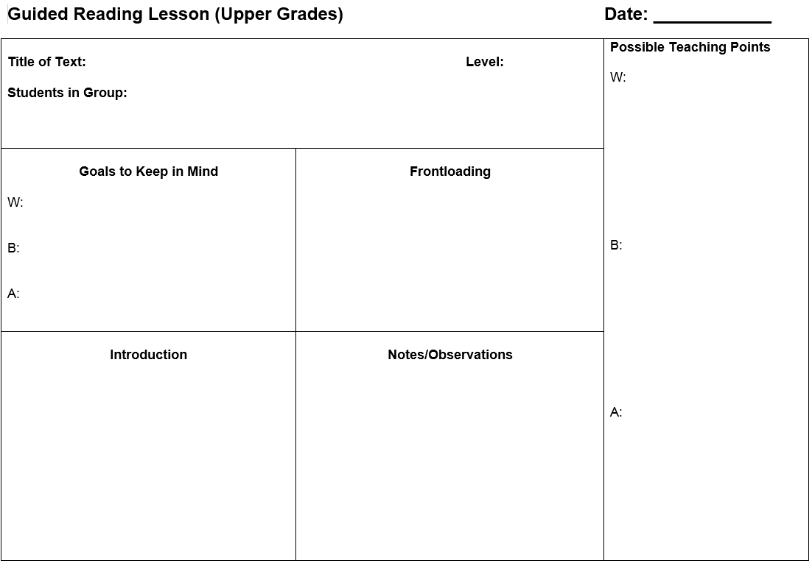

Slide 27


Slide 28
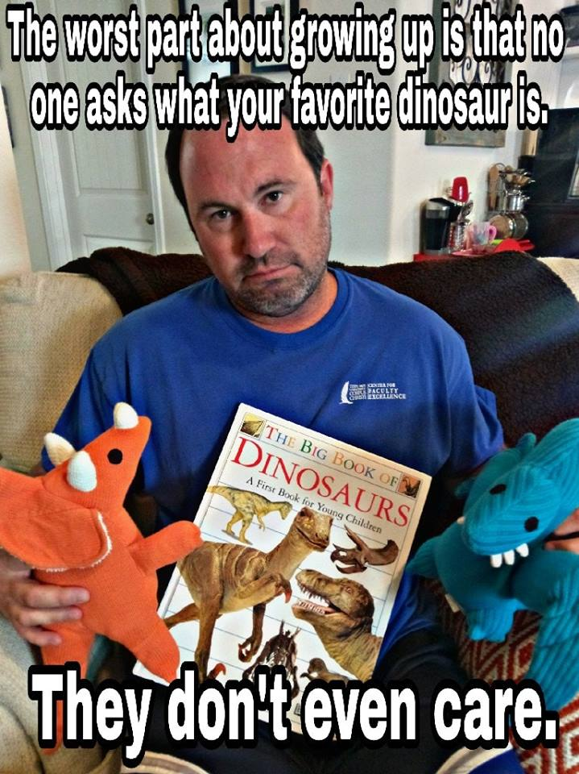

Slide 29
Situating Guided Reading in the BLP Classroom
Objective: Teachers will remain sane.

Slide 30


Your Choice

Slide 31
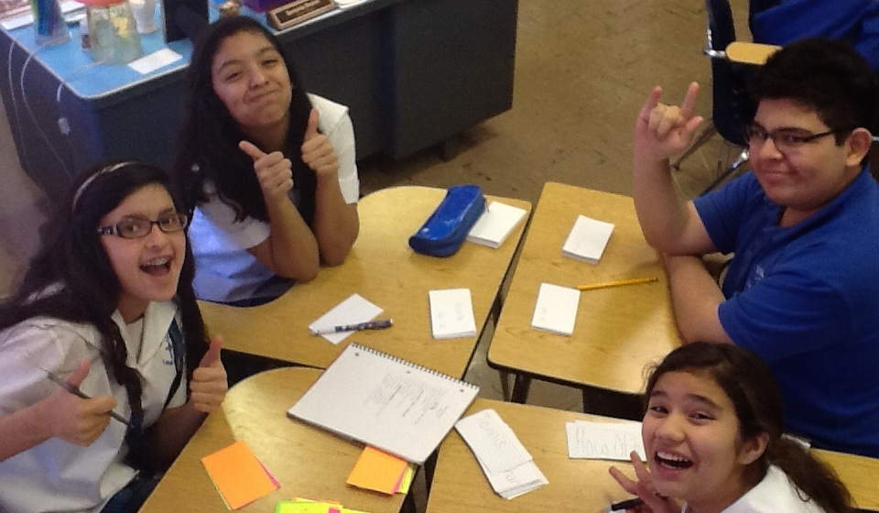
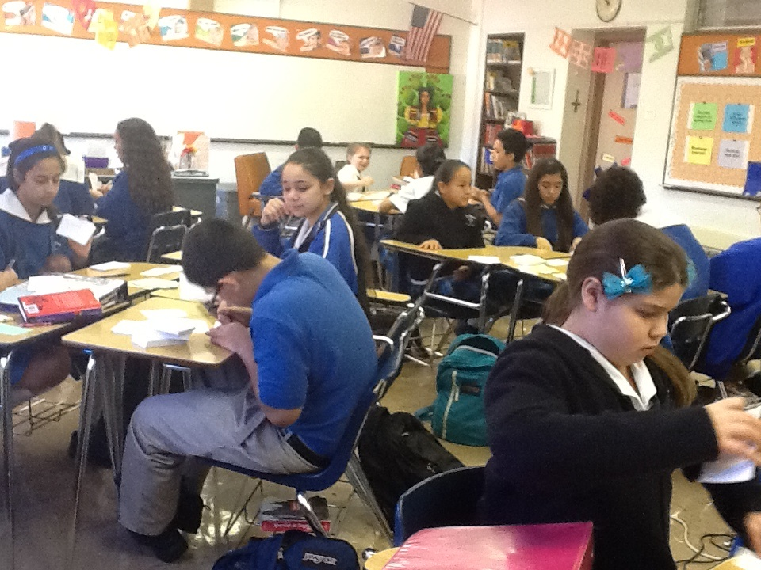
Workstations

Slide 32
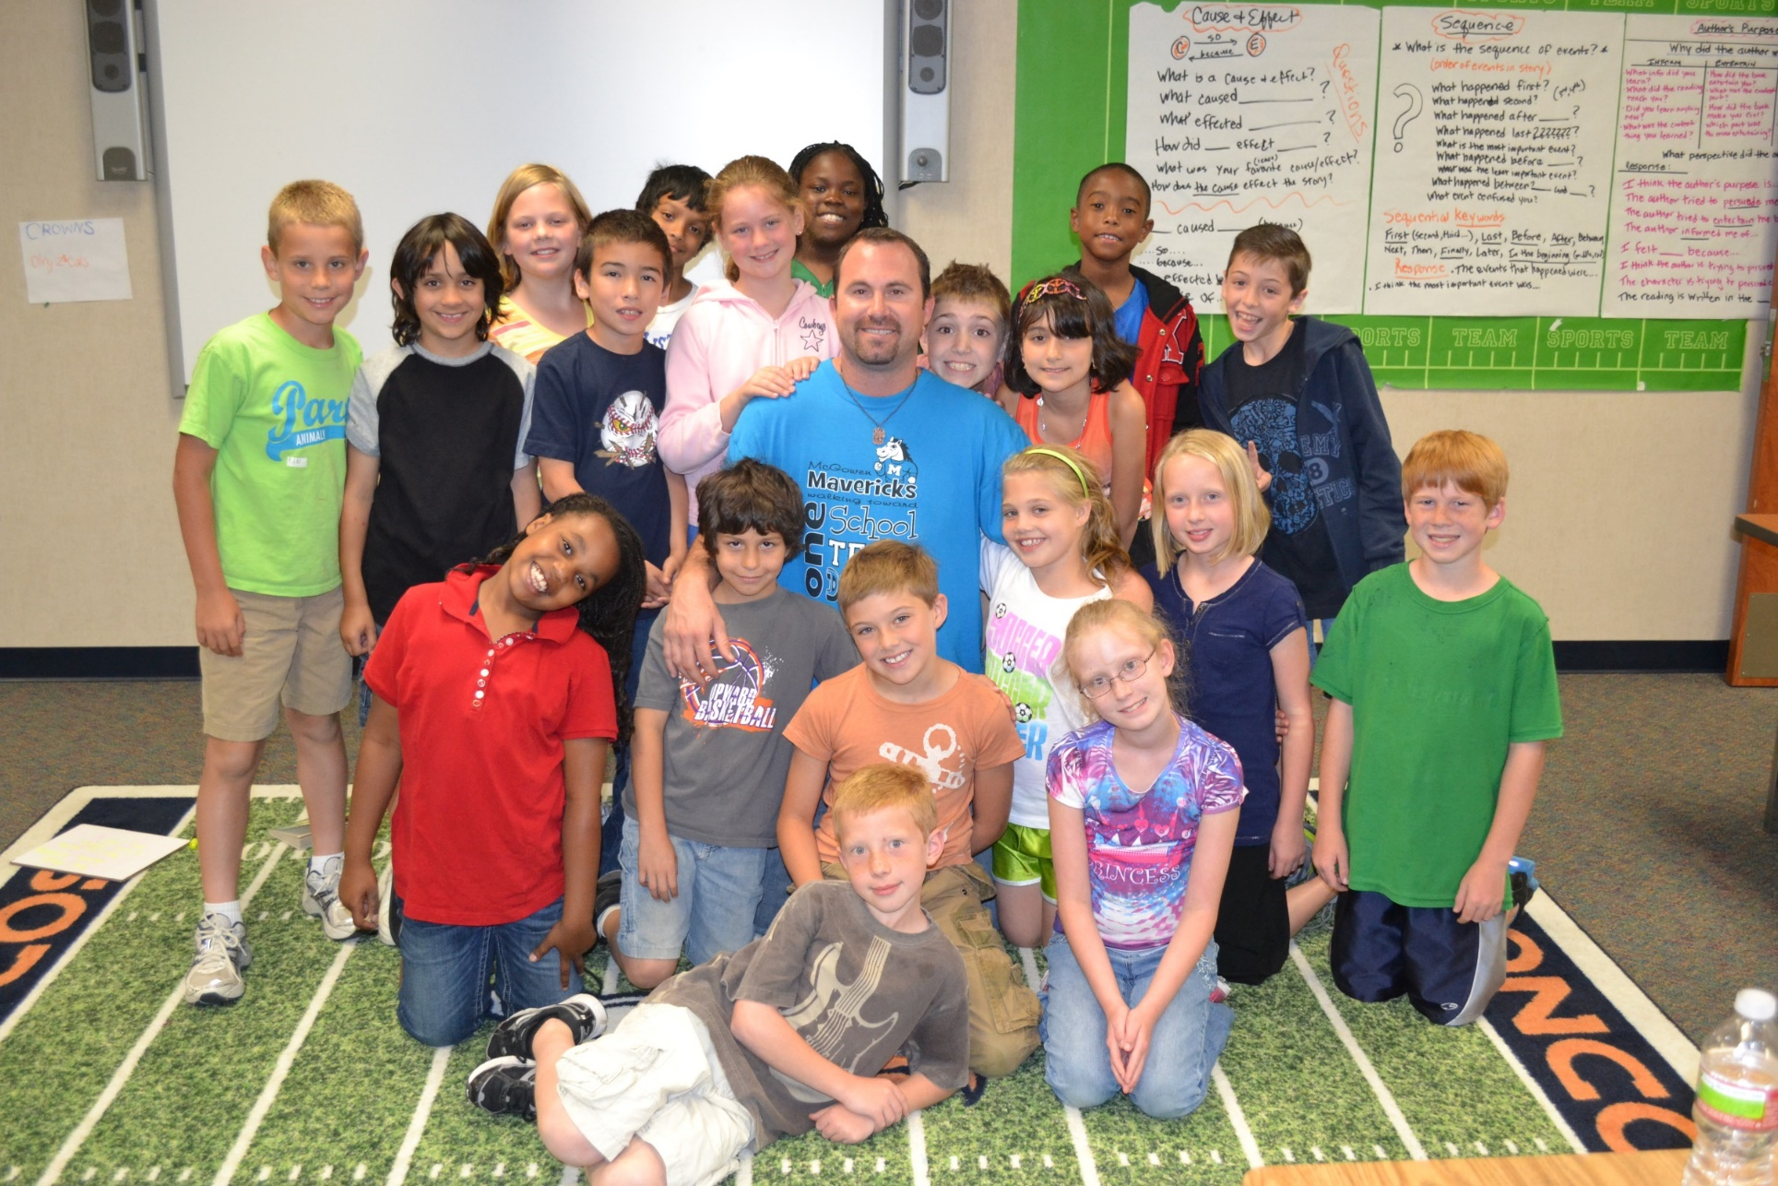
MY GOAL
Reading and/or Writing
No Grading
Never Ending
Easy For Me
Practice for Them

Slide 33
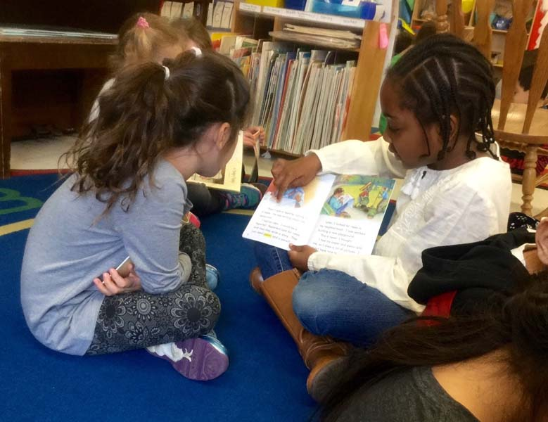
Buddy Reading Station
Yup, they read together. It’s more fun.

Slide 34

Computer Station
Tumble Books, Starfall, ABC Mouse, iStation, District stuff, AR, etc.

Slide 35

Advanced Computer Station
Reading/Writing Games, Research Projects, Webquests, etc.

Slide 36

Listening Stations
Books on “tape”

Slide 37

Making/Writing Words
Magnetic letters, playdough, stamps, word ladders, crossword puzzles, etc.

Slide 38
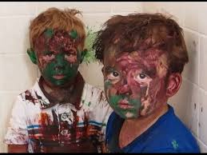
Art Station
‘Cause it’s a good time!
(of course you’ll have to get creative to add rigor)

Slide 39
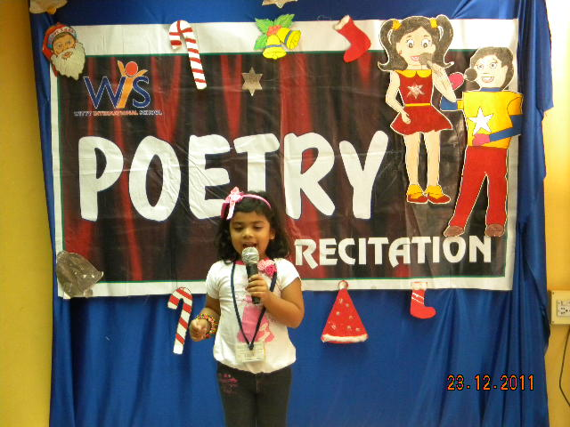
Poetry Station
Rehearse and recite poetry

Slide 40
Readers Theater
Groups rehearse and perform scripts (more on this later)

Slide 41
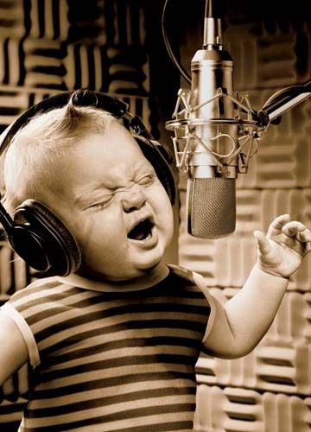
Song Writing
Yeah, about anything. One time I had a social studies theme. Here’s an example…
We also had a rolling potty break song…we loved it. Everyone else hated it.

Slide 42
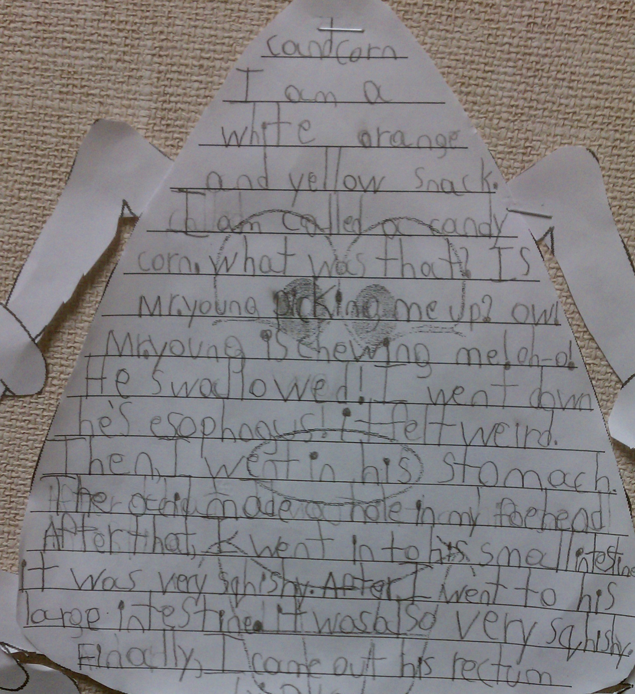
Writing Station
Write. Write. Write.
Story cubes, prompts,
mailbox, wonderbox, etc.

Slide 43
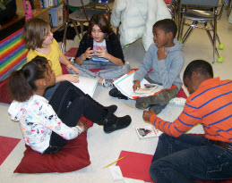
Literature Circles
Candid Camera

Slide 44
Comprehension Stations
Examples from my 2nd Grade Class

Slide 45
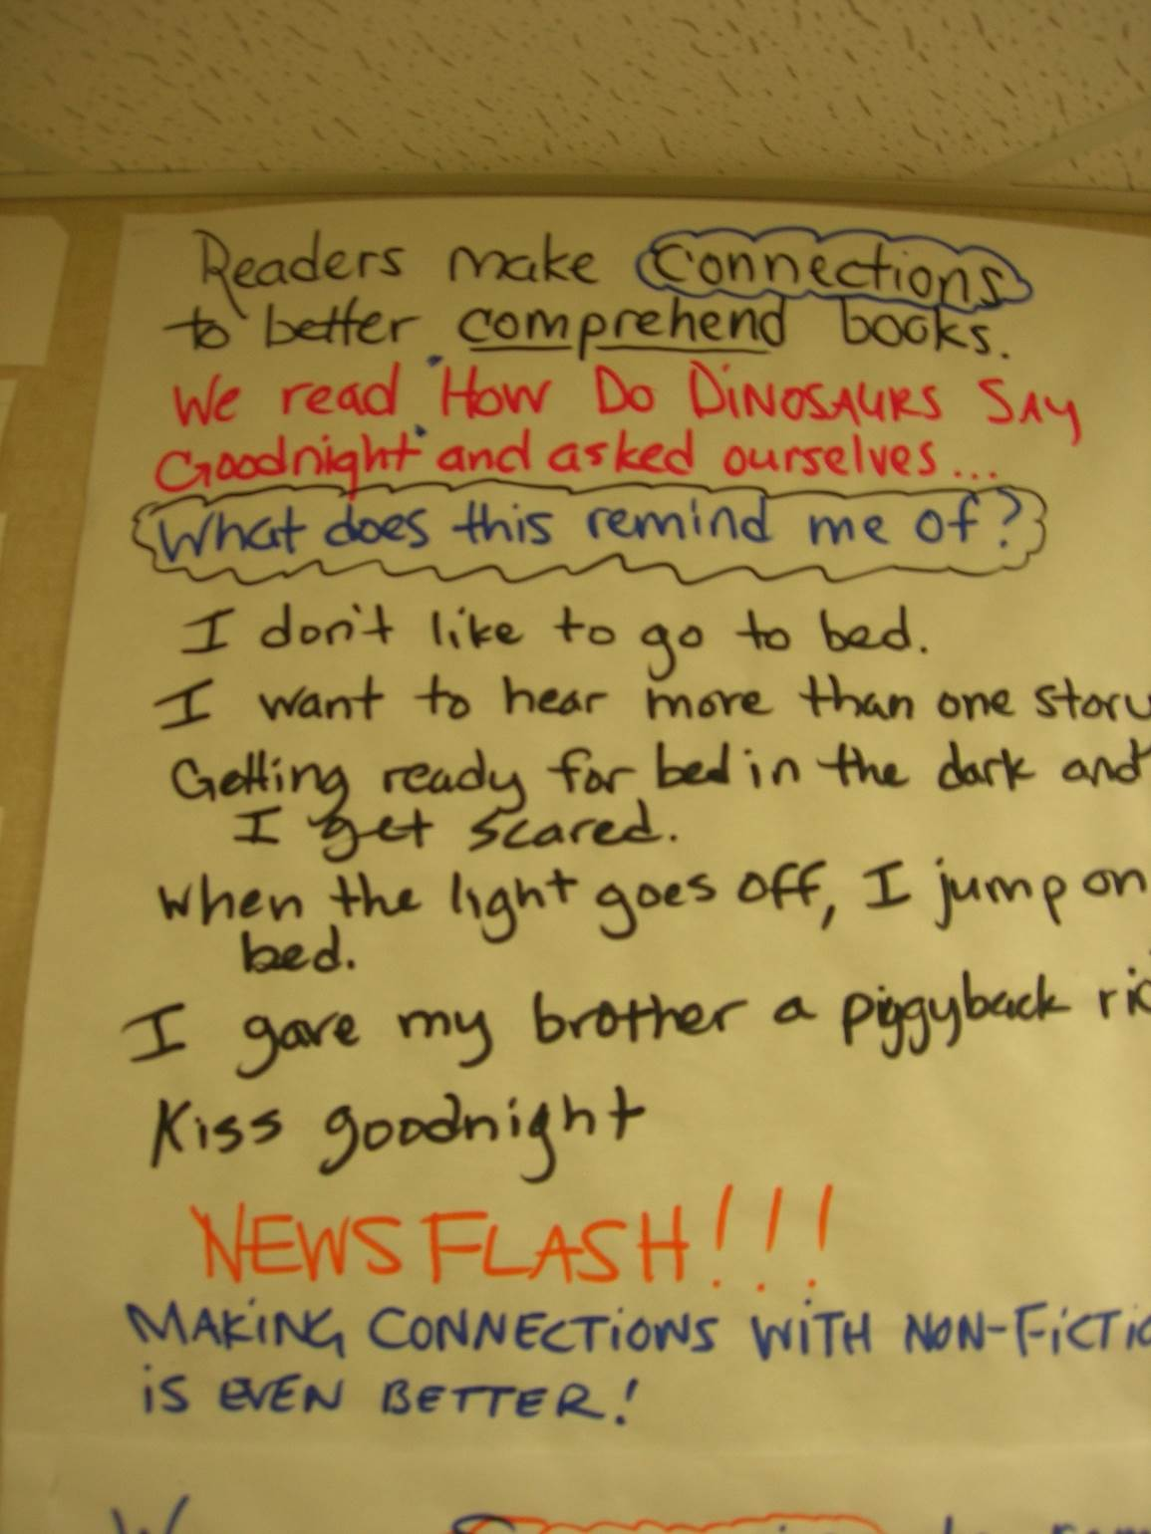

Slide 46
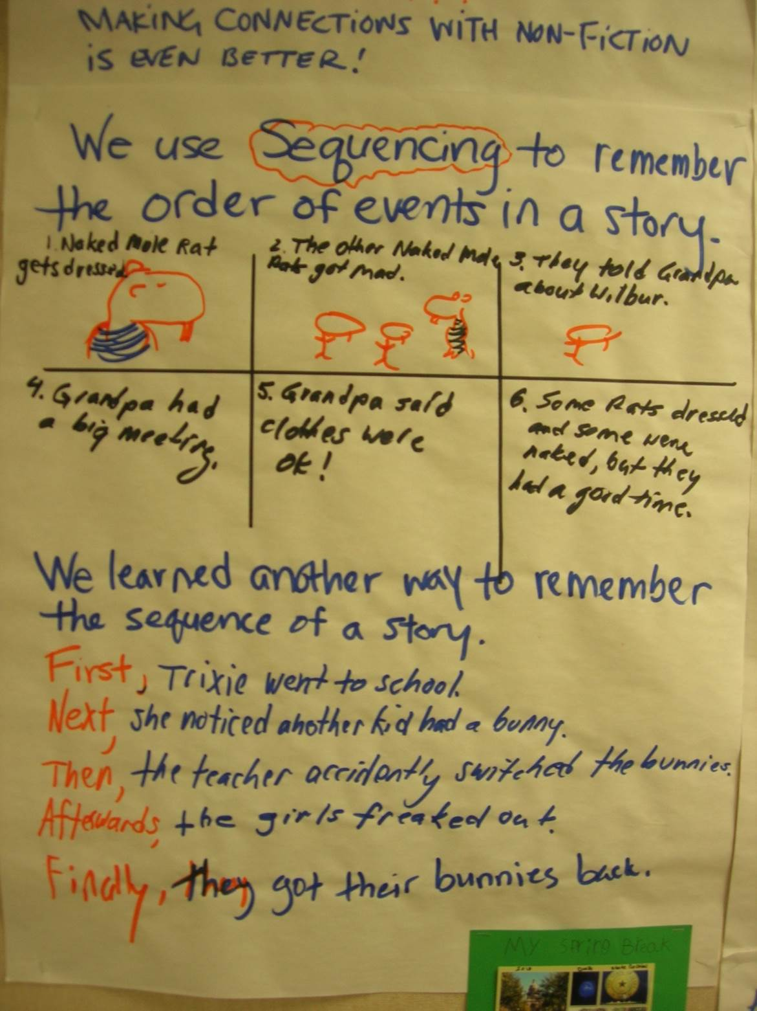

Slide 47
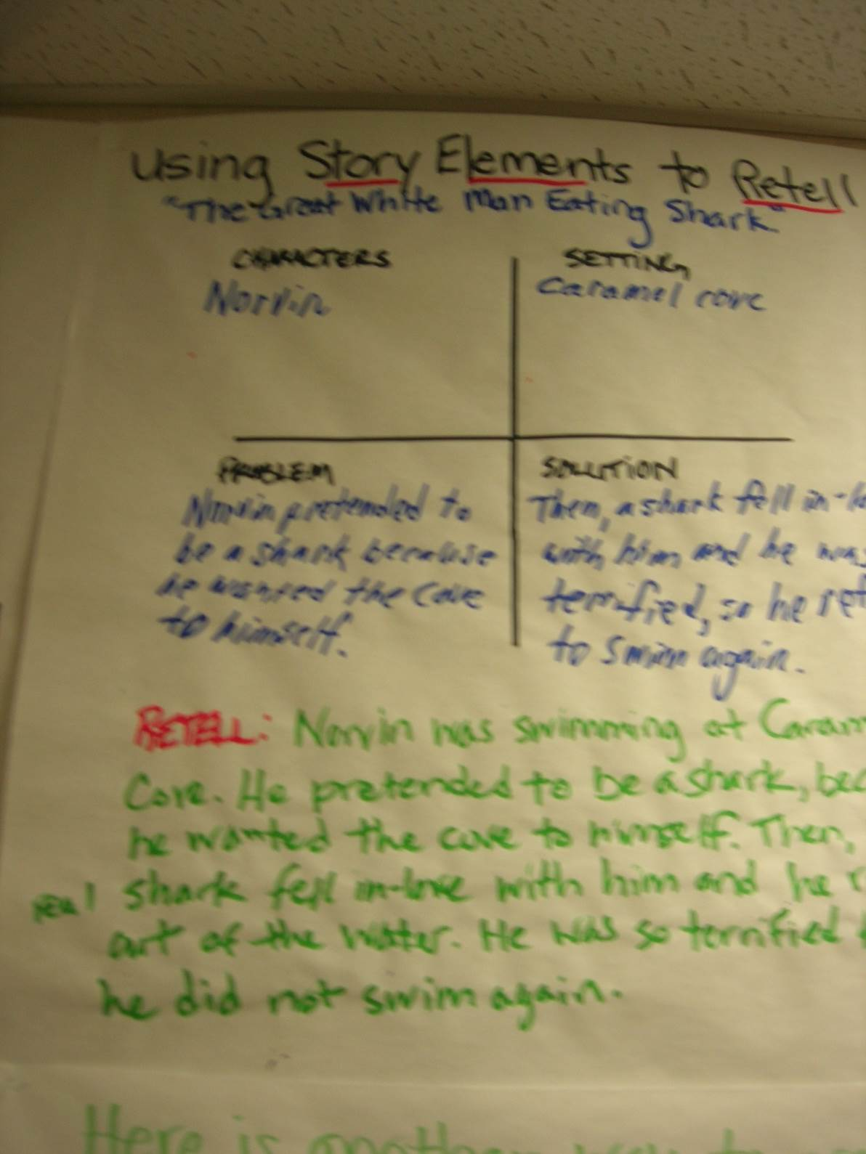

Slide 48
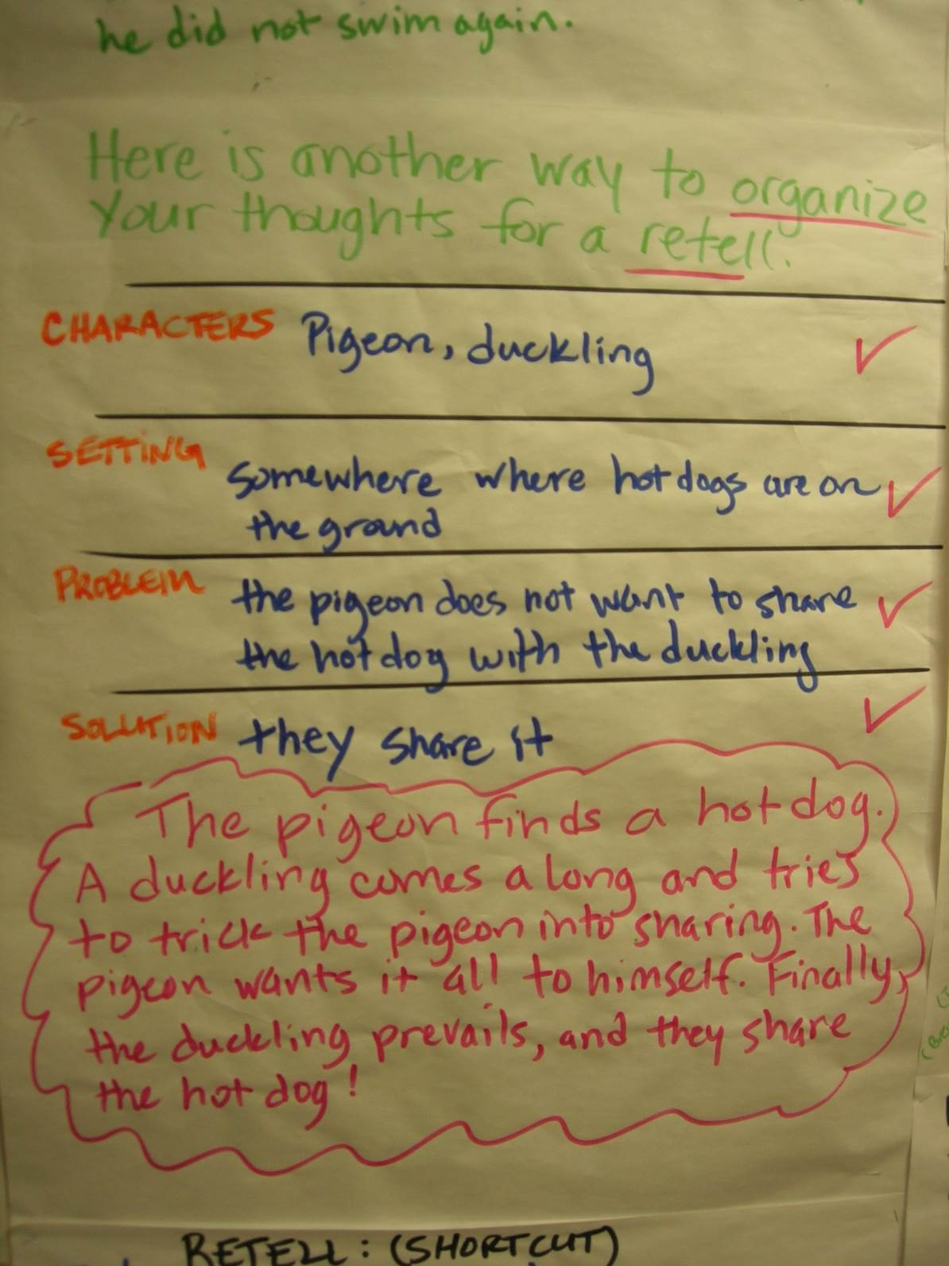
Bonus Video!

Slide 49
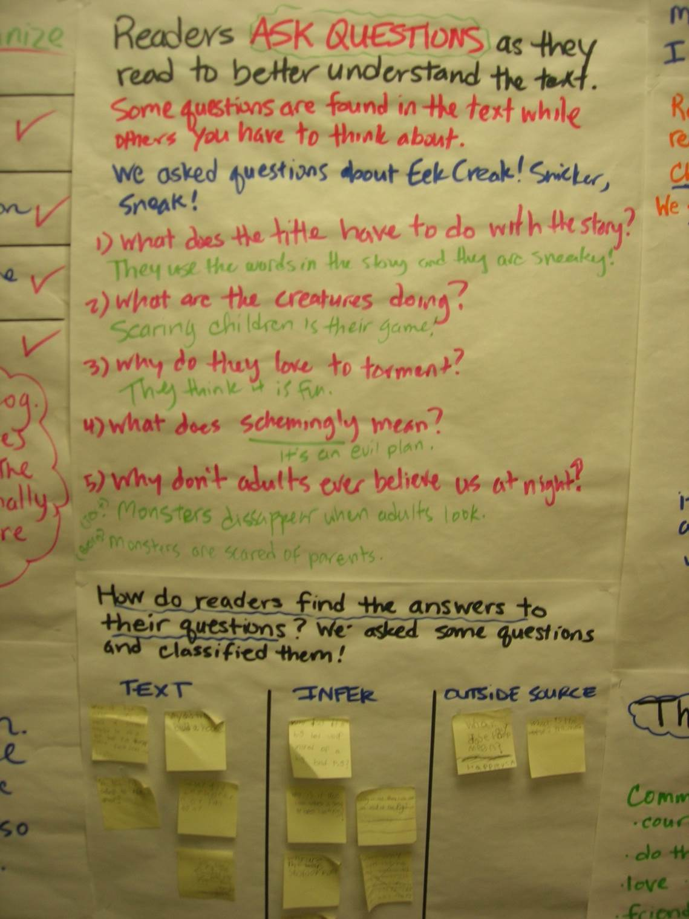

Slide 50
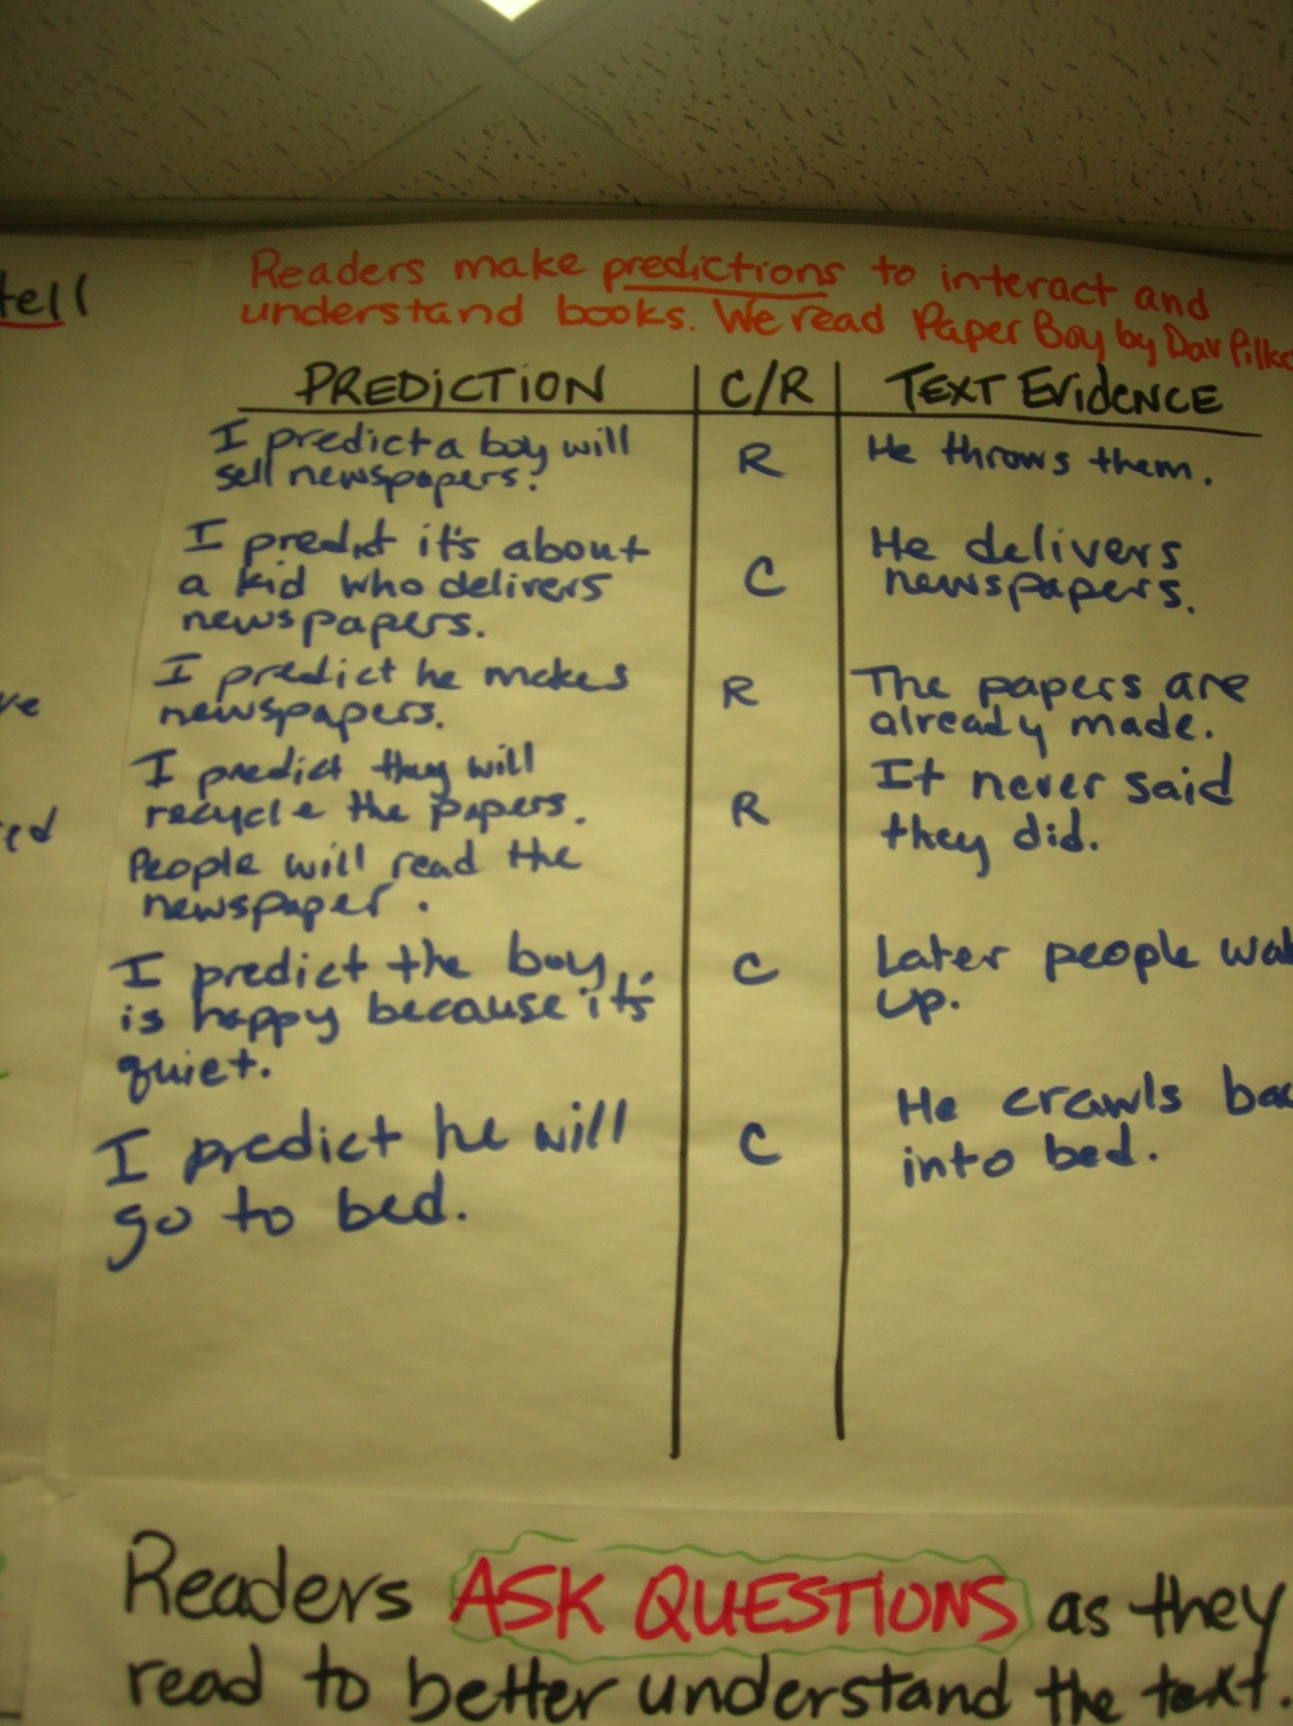

Slide 51


Slide 52


Slide 53


Slide 54


Slide 55


Slide 56


Slide 57


Slide 58


Slide 59

Book Trailers
Kids read books together, wrote, and produced book trailers using explain everything.

Slide 60
Did you think of any others?

Slide 61
Writers’ Workshop

Slide 62

Teacher
Peer

Slide 63
NARRATIVE
From general to specific

Slide 64


Slide 65


Slide 66
Third/fourth
Story arc
Exposition (characters, setting); Introduction of problem, Obstacle 1, Obstacle 2, Climax (Turning Point- Most exciting); Resolution; End
Expo: Action, Dialogue, Thought, Question
Example: This is a story about how I saw a bear in the woods. ACT: I walked along the shady forest path on what seemed like a normal afternoon. DIA: “I love my walks in the forest!” I exclaimed. THO: Todays seems like any other day, I thought as I walked through the forest. QUES: Why don’t I ever seen anyone else in these woods?

Slide 67

Specifics Help Immensely

Slide 69
Expository
It’s all about text structure

Slide 70


Slide 71


Slide 72
First/Second Grade
Phase I
Write down three things you know a lot about.
Pick one that you’d like to write about. Share.
Go back and draw a concept web for your topic. Share.
Phase II
Let’s write an introductory sentence (practice a new one?).
Let’s complete the introduction (topic and details).
Go back and write your introduction. Share. Repeat for other sections.
Phase III
Post the process somewhere in the room. Writing center?
This is now an option for writers’ workshop.
Plan, draft, confer, peer-edit, revise, confer, publish.*

Slide 73
Make it work for you
For your consideration:
Choose your genre and objective
Know the structure
Learn it, plan it, model it.
Guided practice is imperative
Provide independent practice
The writing process should guide writers’ workshop
Confer, confer, confer
Allow time for sharing
Consider occasions for creative publishing

Slide 74


Slide 75


The TEK from K-5
Embarrassing Video

Slide 76
What Most People Call Interactive Reading
Objective: The teacher will be the most interactive, innovative, and effective lesson creator person in the history of homosapiens.

Slide 77


Slide 78
Let’s Create a Lesson!
Choose a text
2. Pick a strategy/objective
3. Plan an Anchor Chart

Slide 79
SHOW WHAT YOU KNOW
With a duo or trio.
Pick an objective, think of a text, create a graphic organizer.
You have 3 minutes before we share.
Tick Tock. (I’ll be actively monitoring)

Slide 80
LAST SEGMENT!

Slide 81

5-10 Min/Day
Forget Levels
Video
Monday: Select scripts and read for meaning
Tuesday: Choose parts and focus on automaticity
Wednesday: Focus on Prosody
Thursday: Practice Performance
Friday: Performance

Slide 82

The Performance
Video (Example)

Slide 83




Slide 84

There Was An Old Woman – 4 Parts
Narrator 1: There was an old woman
Who lived in a shoe;
Narrator 2: With so many children,
What else could she do?
Narrator 3: Their home had no windows,
No doors, and no locks—
Narrator 4: The kids were all happy
But smelled like old socks.

Slide 85

I Gotta Go!
Readers Theater Performance

Slide 86

www.thebestclass.org www.timrasinski.com (resources)
Google “Readers Theater Scripts”
Teacher Created
Student Created
  Mentor
  Parody
  Scratch

Slide 87

Young, C., Stokes, F, & Rasinski, T. (In press). Readers Theater plus comprehension and word study. To appear in the Reading Teacher

Slide 88


Jack was Nimble – 3 Parts
Narrator 1: Jack was nimble,
Narrator 2: Jack was quick.
Narrator 3: Jack jumped over the candlestick.
Narrator 1: Jack kept jumping much too close.
Narrator 2: Now his pants
Narrator 3: smell like burnt toast.

Slide 89



Decoding Word Knowledge Comprehension

Slide 90

Decoding

Slide 91

Word Knowledge

Slide 92

Comprehension

Slide 93

POETRY ACADEMY Wilfong (2008)
Students choose a poem
Rehearse the poem daily
Recite to a volunteer
POETRY SLAMS
(Young & Rasinski, 2017)
Day 1: Choose a poem and read for overall meaning
Day 2: Word Identification
Day 3: Prosody
Day 4: Practice for a Partner
Day 5: Dim the lights, dress in black, and enjoy the poetry slam – don’t forget to “snap clap”

Slide 94



Primary Advanced
You can sing about anything!
Snowball Fight

Slide 95



Slide 96


 | Pretest Meanª | Posttest Meanª | Z^{b} | Asymptotic Sig. (2 Tailed) | Effect Size^{c}
Control | 65.17 | 68.28 | .54 | .59 | .10
Treatment | 64.00 | 81.39 | 3.39 | < .01 | .57

Slide 97
be that teacher… who guides students to the edges of possibility;
who uses challenge as motivation;
who learns alongside their students;
who provides meaningful and authentic learning experiences;
who clearly loves to teach;
that teacher who students remember forever.

Slide 98






Thank you
chase@thebestclass.org
Facebook/thebestclass.org

